Slide 1
WELCOME
By: AVINASH KORDE
DIV:-B
ROLL NO:- 21

Slide 2
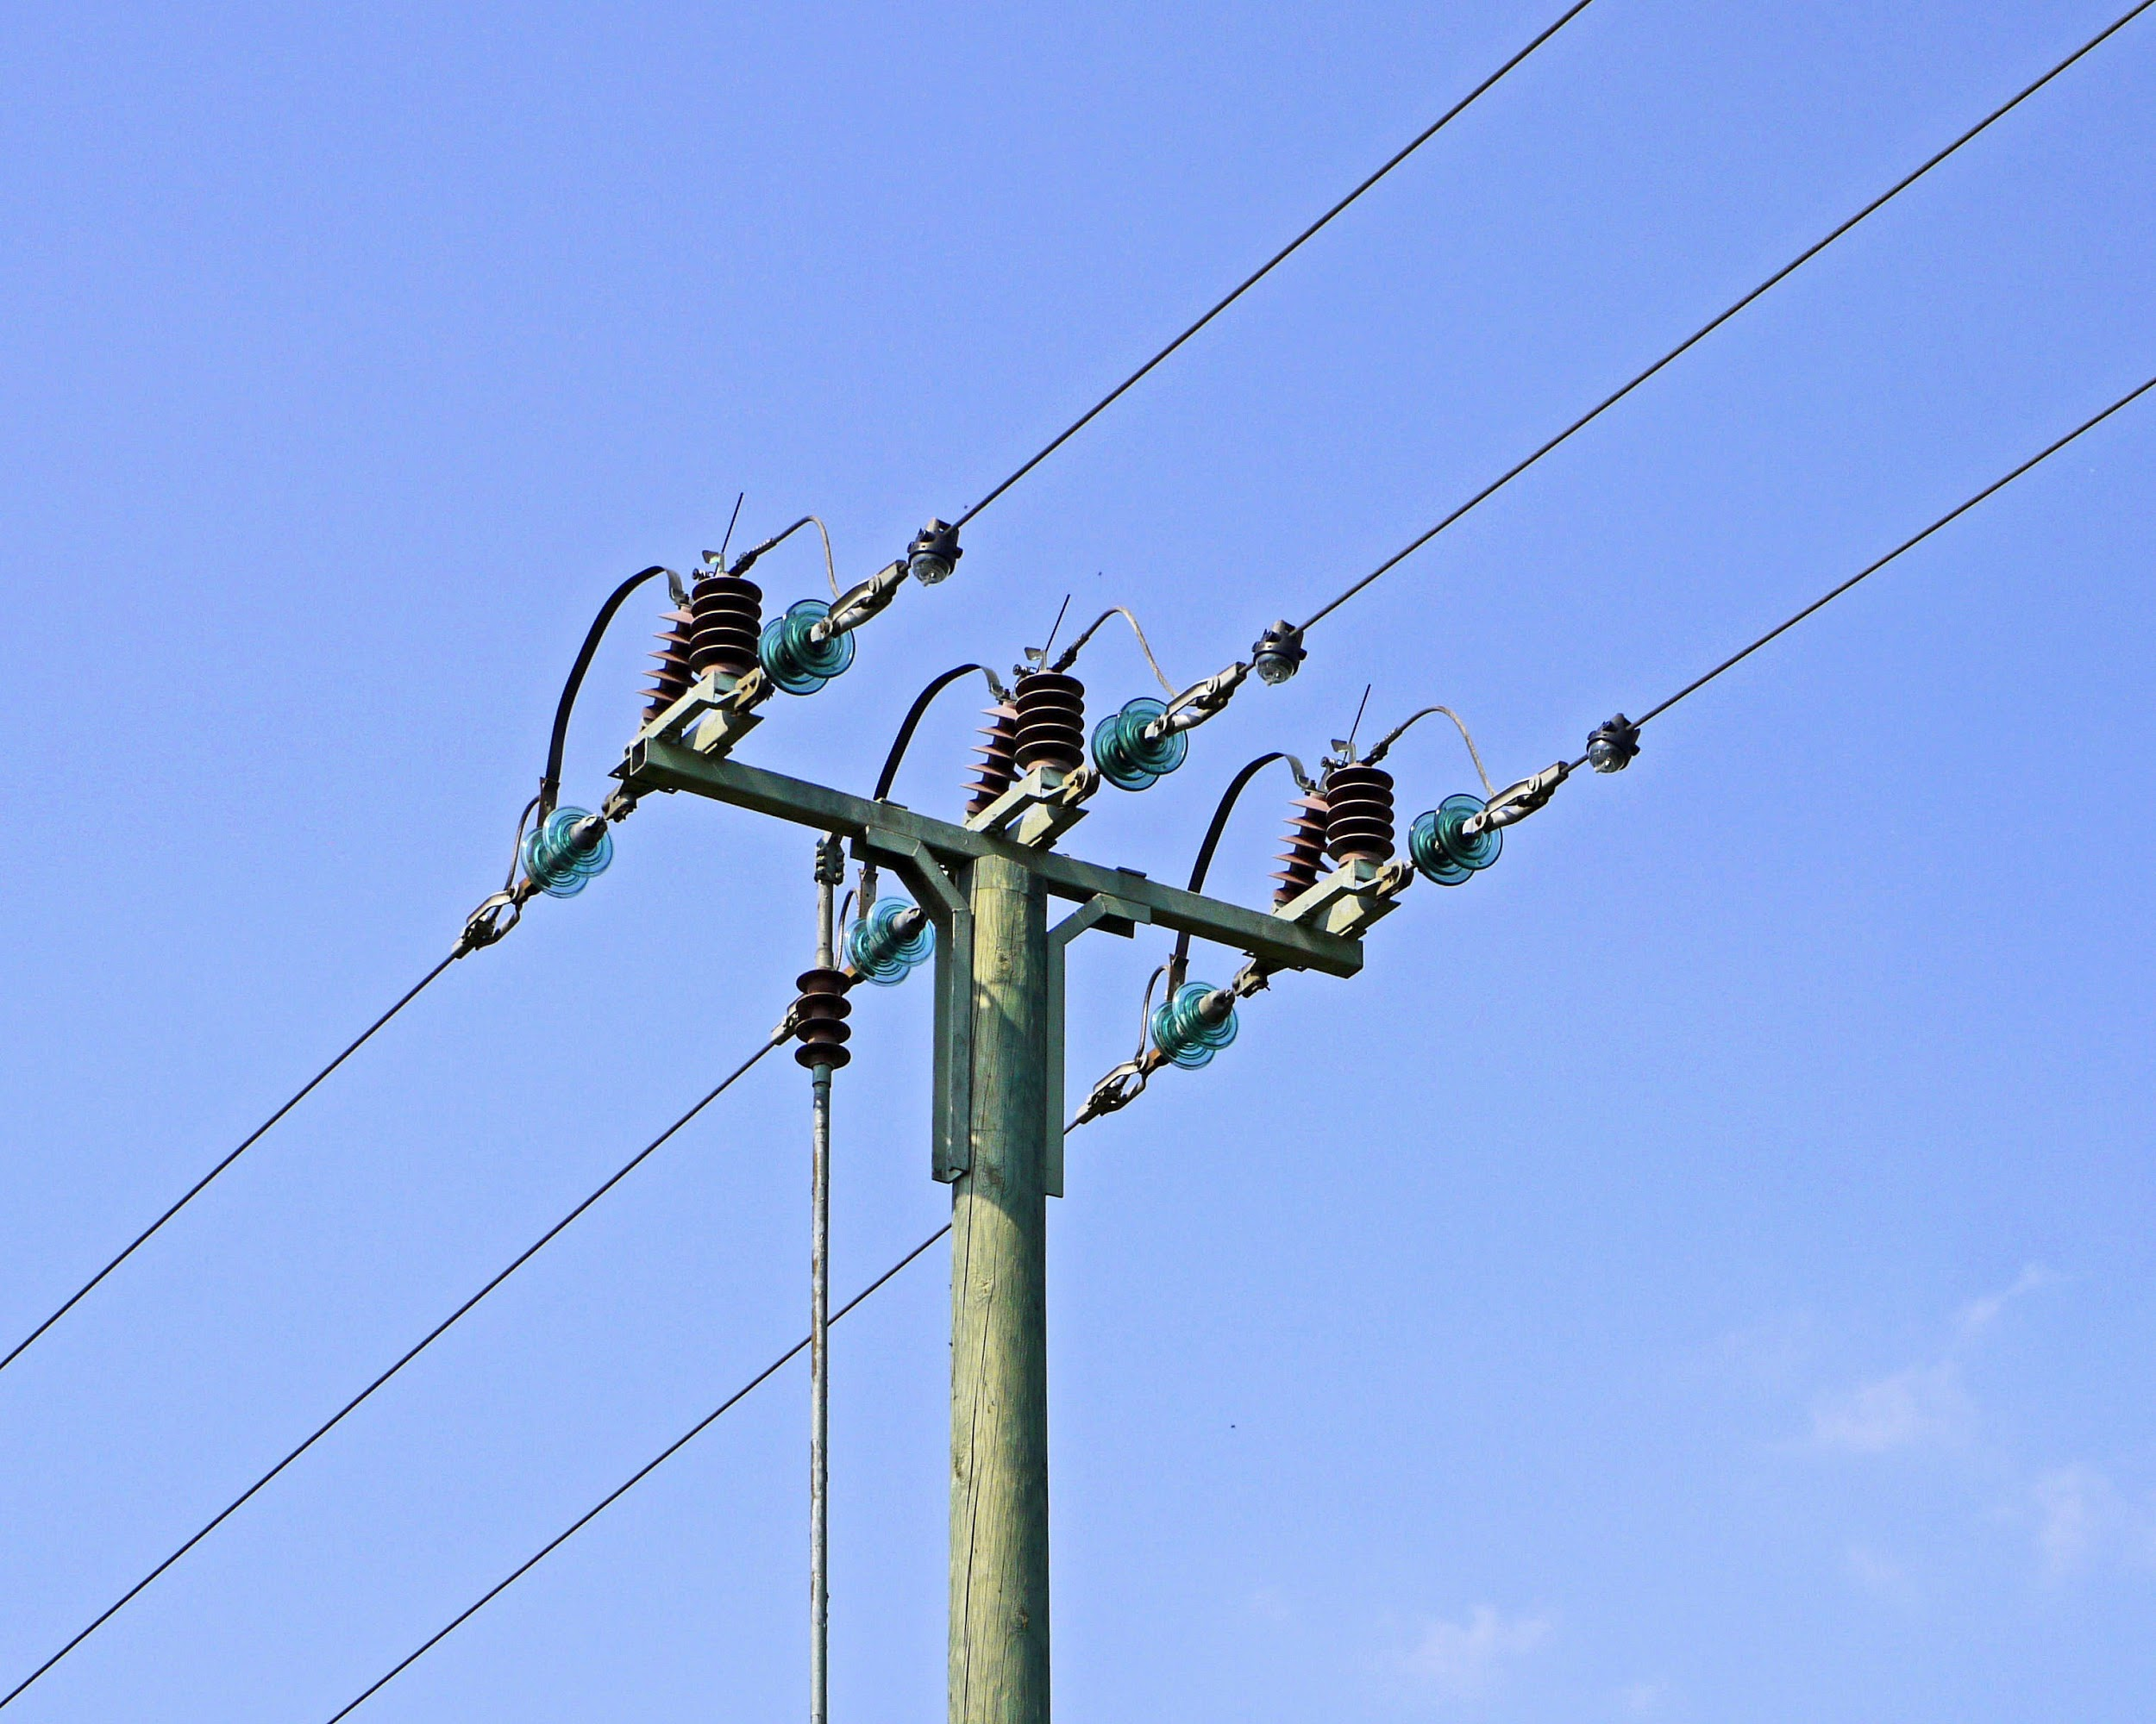
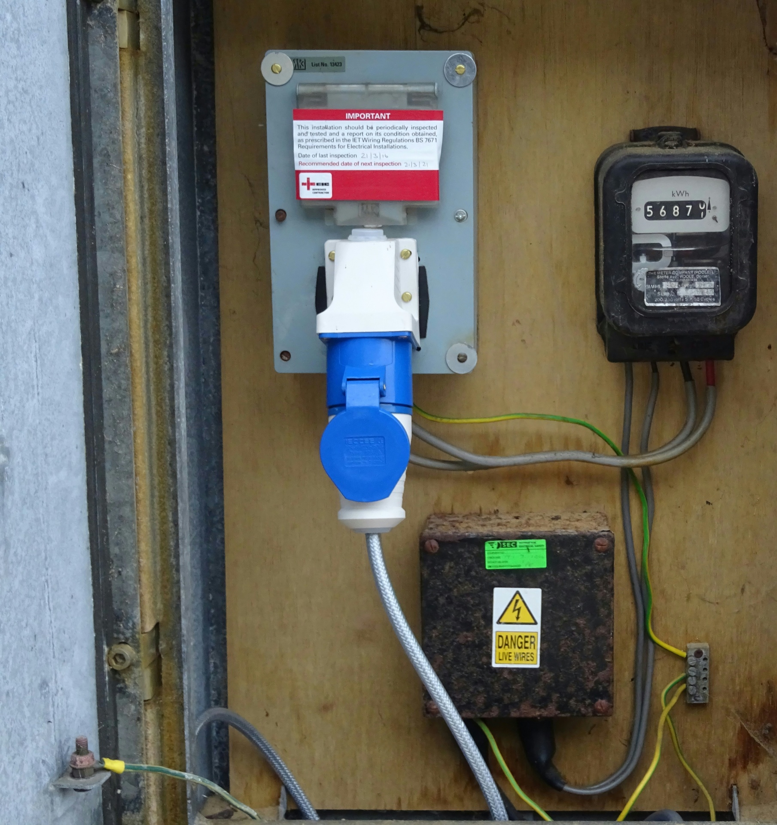
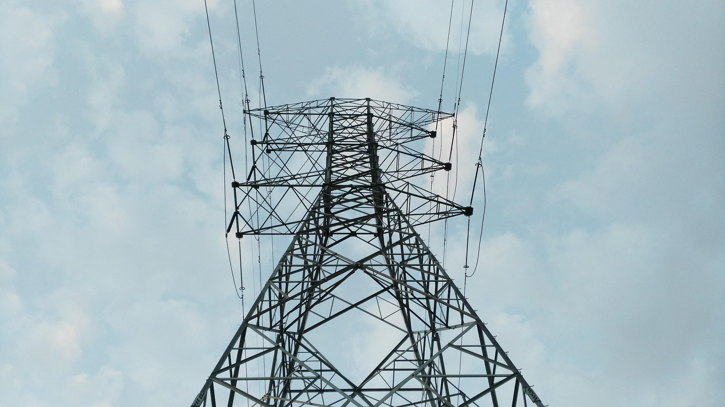
TOPIC: TO APPLY FOR ELECTRICITY CONNECTION ONLINE

Slide 3
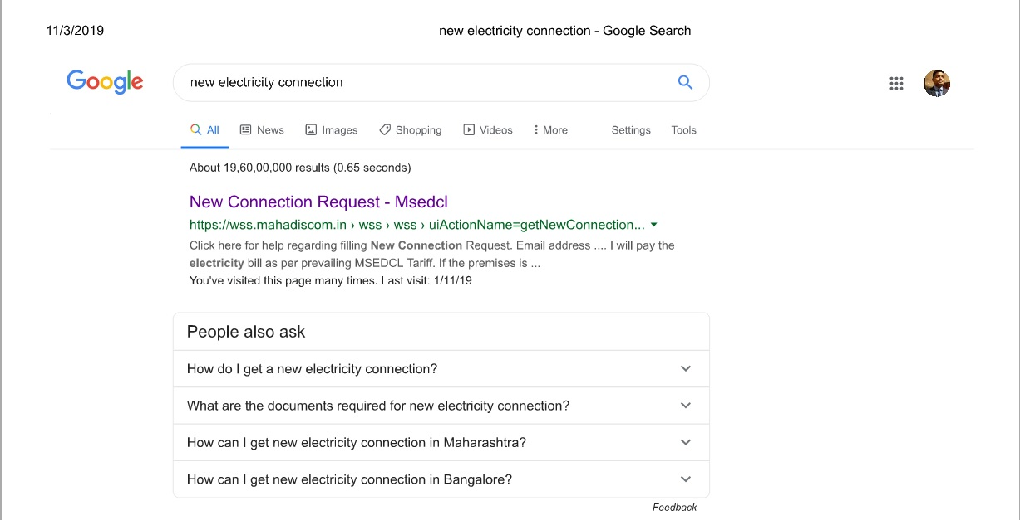
Website for online application : https://wss.mahadiscom.in

Slide 4
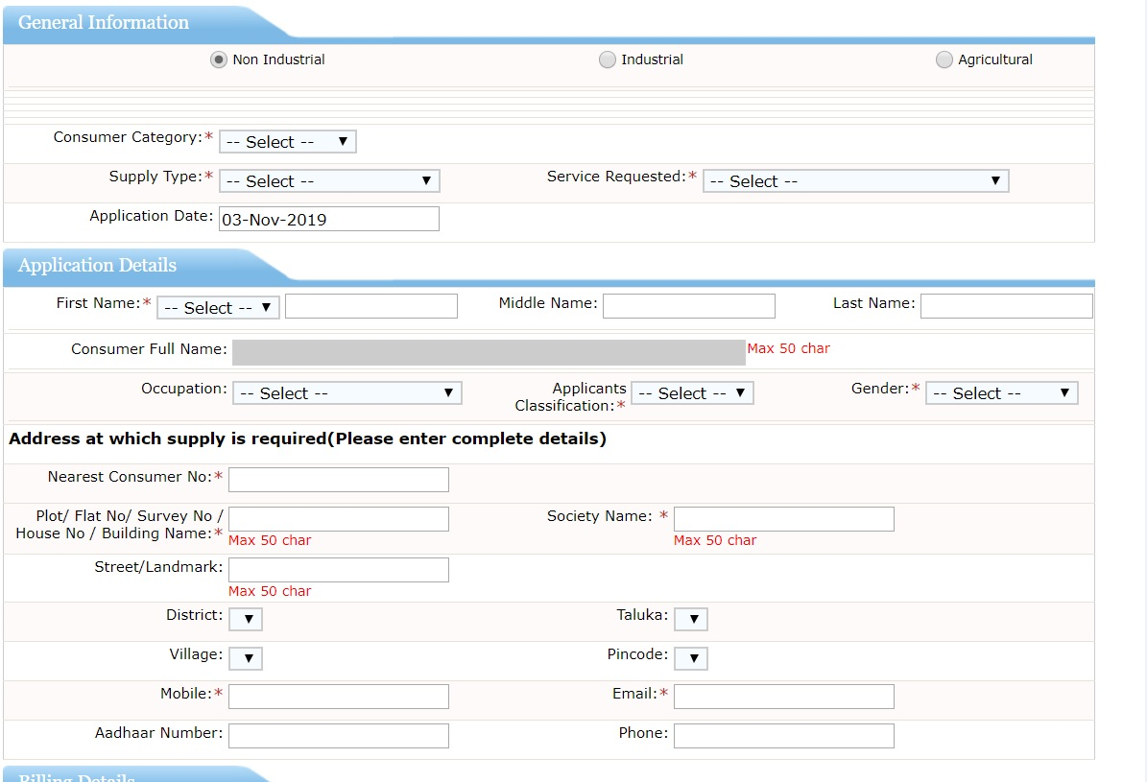

Slide 5
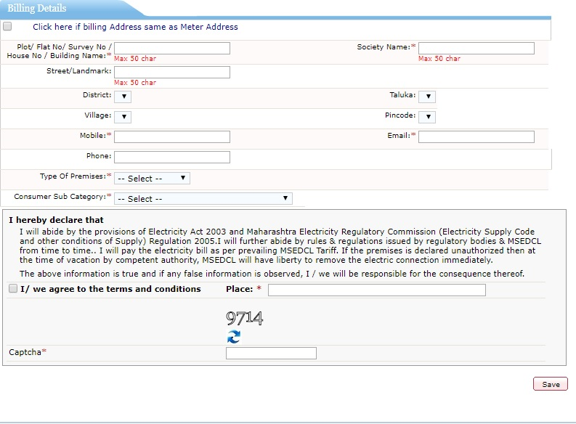
Billing Details:

Slide 6
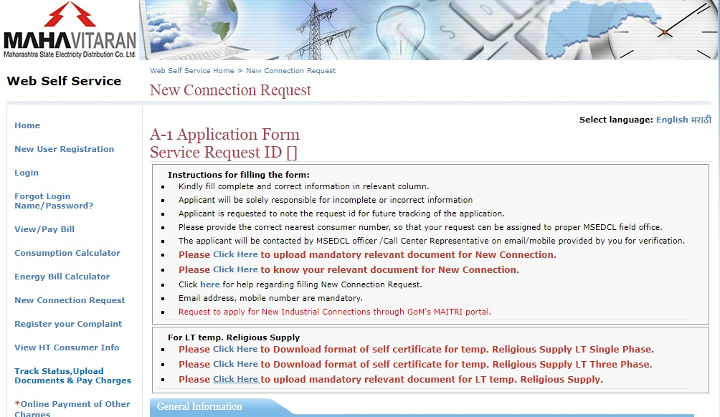
STEP 2 : UPLOAD REQUIRED DOCUMENTS

Slide 7
A-1 Form for Power Supply for Residential / Commercial /Industrial Purpose
Documents Required (Please Tick which is applicable)
a. Proof of Ownership or Occupancy of Premises (Any one of the following)
Occupancy Certificate issued by Statutory body / Competent Authority
Ownership Document/form 8 / Form 7-12 / tax / lease issued by Local Authority
In case of tenant Leave & License /Lease agreement with Property Owner’s NOC
In case of Quarter, Allotment letter of its authority.
In case of Slum Area, if none of the above
documents is available then affidavit on Rs. 200/- stamp paper.
b. Identity Proof (Any one of the following)
1) Voter’s identification Card
2) Collector/Govt. Authorized Photo ID
3) Aadhar Card
4) PAN Card
5) Driving License
6) Passport.
c. Documents required for relevant category (If applicable)
SC / ST Caste Certificate / BPL Certificate
Remarks: 1) Required Statutory & regulatory permission is to be submitted.
2) For industrial connection purpose following additional documents required:
a) Industrial Registration / DIC Certificate.
b) Separate sheet for Load profile

Slide 8
Power Supply Application Form A-1 (Agricultural)
Documents Required (Please Tick)
a. Address Proof (Essential documents) 7/12 Extract (If the well / borwell in same land then it should be
mentioned in 7 / 12 Extract)
b. Other Documents (if applicable)
NOC from concern Department in case of dark water shed area only. If the agricultural land / Well/ Water Pump is shared then NOC shall be submitted from other shareholders. SC/ST Certificate
(Note):-
1) ELECTRICAL CONTRACTOR'S COMPLETION REPORT (AS PER THE PROVISIONS OF ELECTRICITY RULE 2005) Form D-1 shall be submitted separately.
2) In case of Lift Irrigation Scheme submit list of members.
----------------------------------------------------------------------------------------------------------------
Change Load / Demand
Documents Required:
For Load change / Demand change for LT /HT consumers:-
1) Test report from licensed electrical contractor

Slide 9
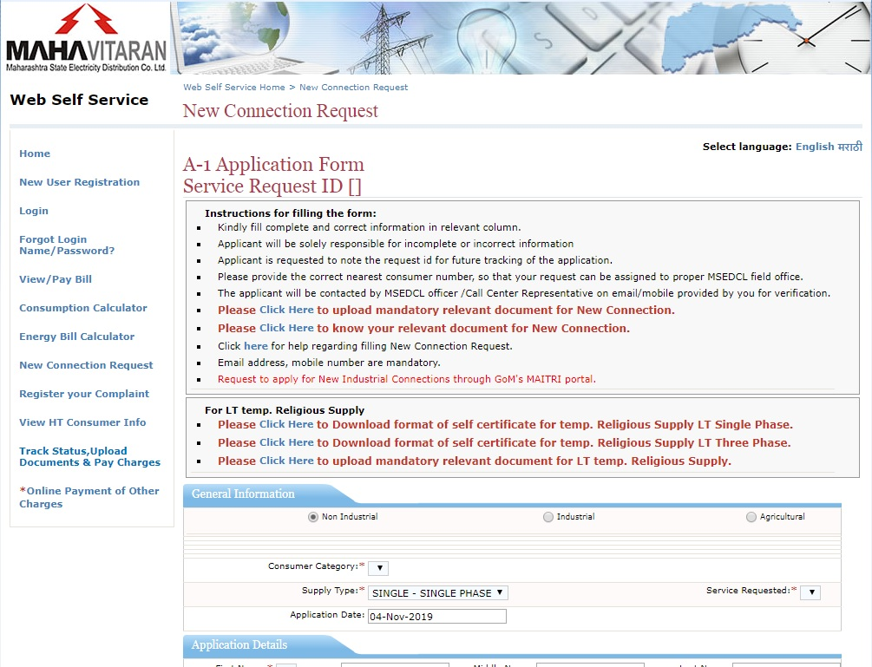
Track Status :

Slide 10
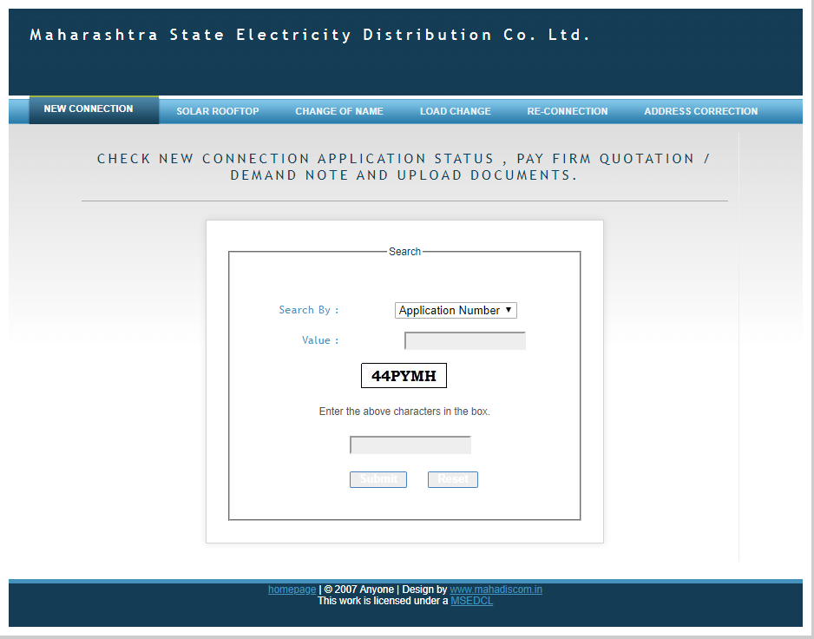
Status Of Application

Slide 11
Within three days of online form submission for electricity connection, the field inspection of the site will be done, which will lead to the process to estimate preparation, load sanction and intimation for fee deposit to be completed in next four days.

