Slide 1
Use of shared drive storage instead of email attachments
By
Mayur B. Khengale
Tahsildar
CPTP 5

Slide 2
Objectives
Introduction of shared drive storages
Inefficient old email system
Advantages of shared drive storage over email attachments
Understand how to use shared drive storages

Slide 3
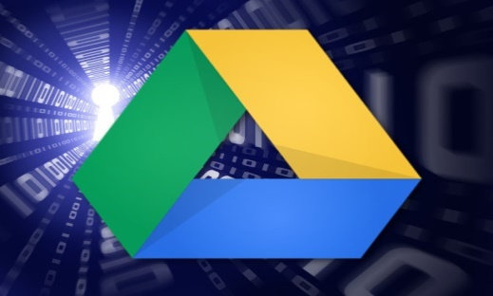
What is a Shared Drive?
Also known as a Network File Share or a Personal Data drive (P: drive).
An area dedicated for files users create and share
Commonly where work product is stored
Files can be grouped together by content – by function, task, work unit, etc
example:Dropbox,Google Drive, OneDrive and more
Notes:
What is spam?
Spam is unsolicited or undesired electronic junk email. Some characteristics of spam are:
Mass mailing to a large number of recipients
Usually a commercial advertisement,
Annoying but usually harmless unless coupled with a fraud based phishing scam

Slide 4
Shared Drives:
Studies have shown that a vast of amount of information resides on shared drives
Proper recordkeeping system
Grouped with related records
Retrievable
In a usable format
Protected from inappropriate dissemination, modification or destruction

Slide 5
Inefficient old email system
Takes time to upload and download files or other attachments.Then delete the message.
Large files cannot be sent by free email service.
Additional software is required to open specific file format.
Sometimes attachments and files sent by email contains virus which may affect your computer.
Files may not be uploaded or downloaded properly from email if internet speed is slow.

Slide 6
Advantages of shared drive storage over email attachments
Multiple users can access the record
Controls can be put into place for who can access, modify or delete files Then delete the message.
Backed up
With proper and consistent management, this type of shared drive could be a recordkeeping system for some record
Increased Reliability and Higher Availability
Central Management and Simplicity

Slide 7
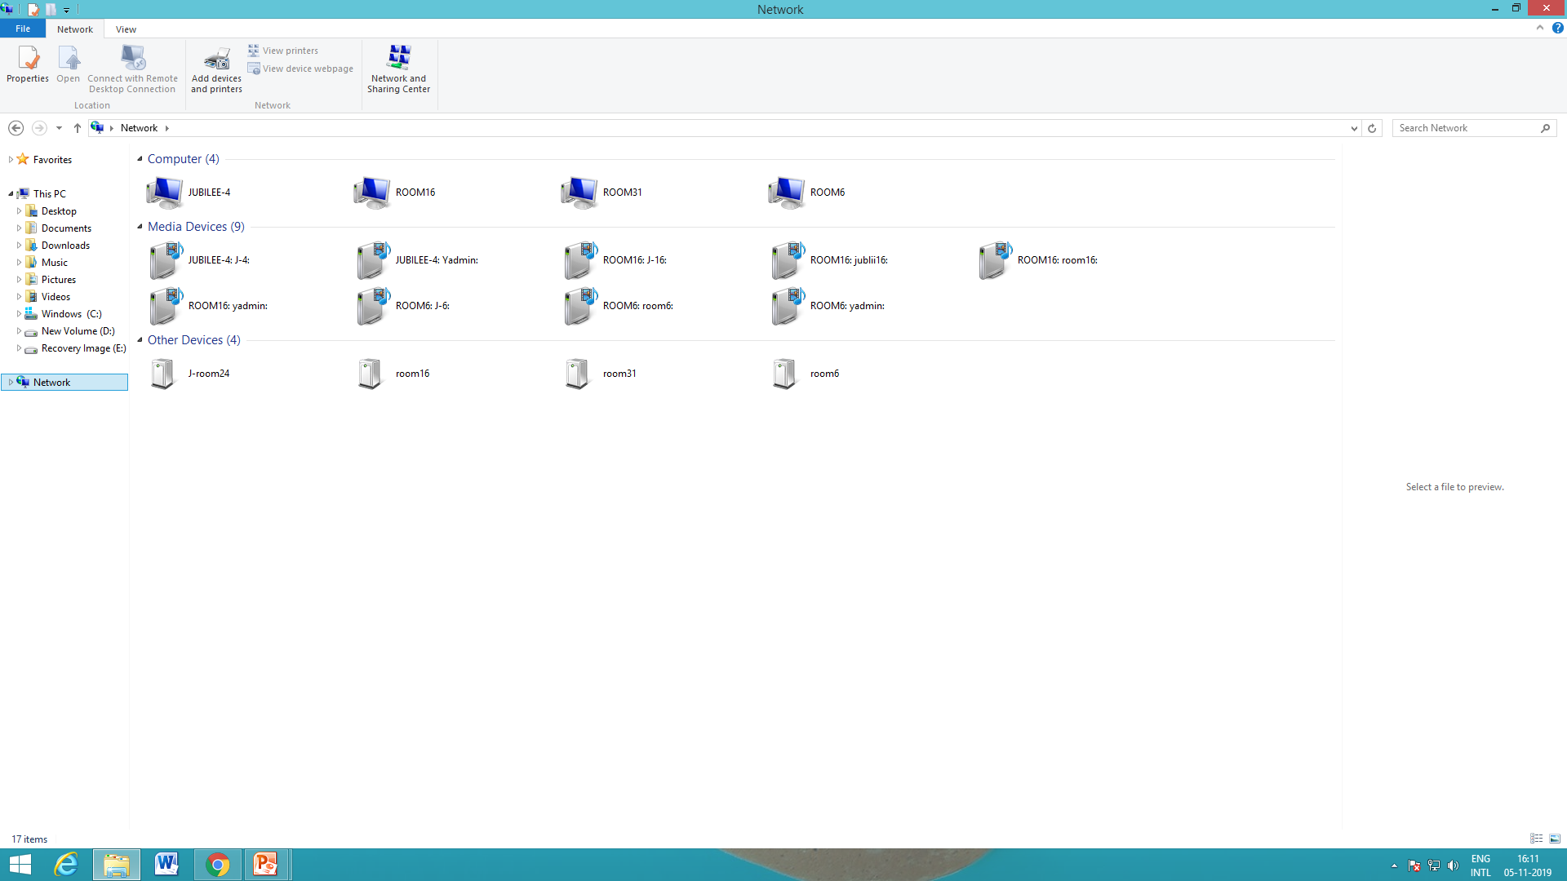

Slide 8
Strategies/Best Practices
Establish some rules
─ Naming conventions for folders and files/documents
─ Who can add new folders
─ Who can delete folders
─ Who can access folders
─ Who can add documents
─ Who can modify documents
─ Who can delete documents

Slide 9
Summary
In todays era of information explosion it is impractical to store same data at different places. It is far more secure, manageable, and convenient to store data at one place and then share it with desired people.

Slide 10
Thank you!

