Slide 1
SECURE MY AADHAR CARD DATA
Shivraj Janardan Khade
Assistant Commissioner Of Sales Tax
C 26

Slide 2
What is AADHAR ?
AADHAR - 12 digit random number issued by UIDAI to residents of India
Requires minimal Demographic and Biometric information for enrolment
AADHAR is a Unique number generated after de-duplication of demographic and biometric data
Only proof for Identity & Not for citizenship and domicile

Slide 3
Features of AADHAR
Uniqueness
Portability
Random Number
Scalable technology architecture
Open source technologies

Slide 4
Legal framework of AADHAR
AADHAR(Targeted Delivery Of Financial and Other Subsidies,Benefits and Services)Act 2016
Supreme Court held constitutionality of AADHAR Card valid

Slide 5
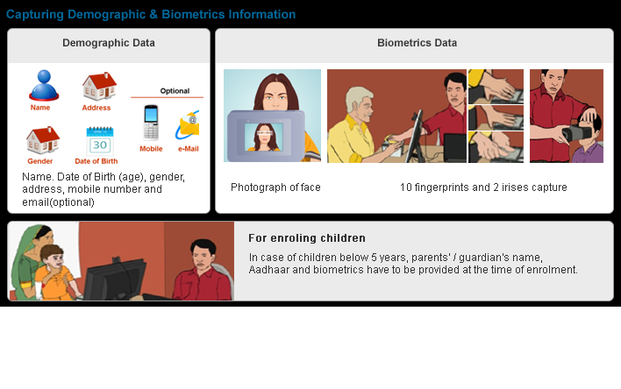
AADHAR Card Data

Slide 6
Threats to AADHAR Card Data
Breach of Privacy
  Identification without consent of UID
  Identification without consent using biometric data
  Illegal tracking
  Illegal profiling of individuals

Slide 7
Measures to secure AADHAR data
Lock/Unlock Biometrics feature provided by UIDAI
https://resident.uidai.gov.in/bio-lock
To protect privacy and confidentiality of Biometric Data
Registered mobile number is essential to avail this service
Use of VID (Virtual ID)

Slide 8


