Slide 1
WELCOME

Slide 2
Encrypt files to protect data
BY
JANARDAN A. KASAR
(PROB. DEPUTY COLLECTOR)
CLASS – D
ROLL NO – D-31

Slide 3
WHAT IS ENCRYPTION AND HOW DOES IT WORK?
While IT security seeks to protect our physical assets—networked computers, databases, servers, etc.—encryption protects the data that lives on and between those assets. It’s one of the most powerful ways to keep your data safe, it’s a major deterrent to hackers. Even if data does end up getting stolen, it will be unreadable and nearly useless if it’s encrypted.

Slide 4
How does it work?
Encryption—based on the ancient art of cryptography—uses to turn plain text into an unreadable, jumbled code. To decrypt that text into plaintext, you need an encryption key, a series of bits that decode the text. The key is something only you or the intended recipient has in their possession. Computers are capable of breaking encrypted code by guessing an encryption key, but for very sophisticated algorithms like an elliptic curve algorithm, this could take a very, very long time.
Notes:
sophisticated = गुंतागुंतीचा व प्रभावी

Slide 5
Example
Say you want to encrypt this sentence:
“Protect your data with encryption.”
If you use a 39-bit encryption key, the encrypted sentence would look like this:
“EnCt210a37f599cb5b5c0db6cd47a6da0dc9b728e2f8c10a37f599cb5b5c0db6cd47asQK8W/ikwIb97tVolfr9/Jbq5NU42GJGFEU/N5j9UEuWPCZUyVAsZQisvMxl9h9IwEmS.”
You can send that encrypted message to someone, separately share the key, then they’re able to decrypt it and read the original sentence.

Slide 6
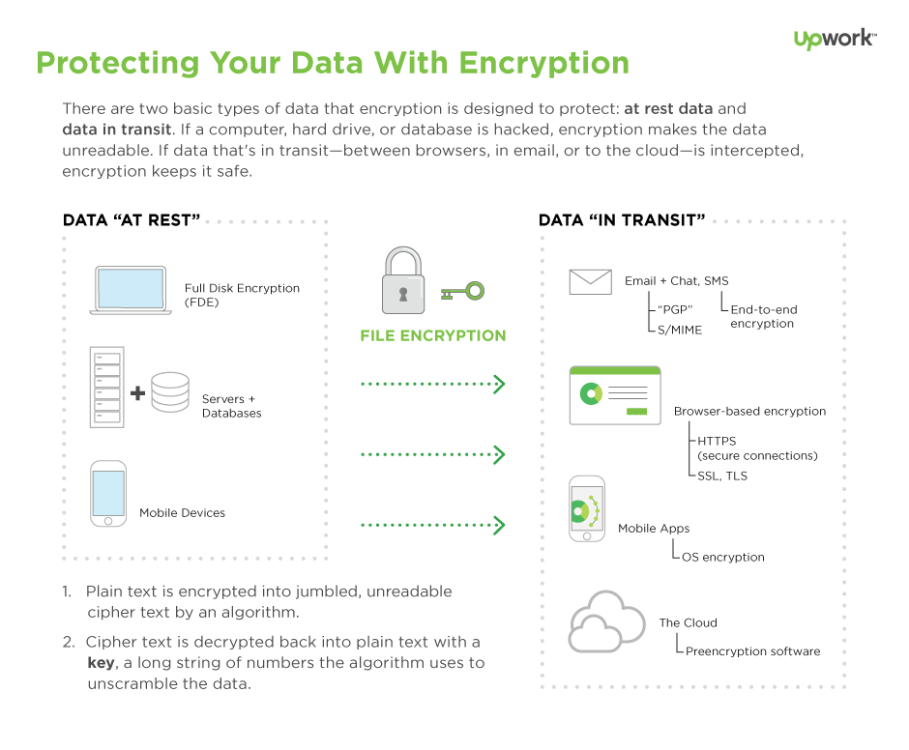
Grphical representation
Notes:
Cipher = गुप्त लिपी
Algorithm = a process or set of rules to be followed in calculations or other problem-solving operations, especially by a computer.

Slide 7
A few types of encryption
Secret-key algorithms: Also known as symmetric algorithms, or private-key, this algorithm uses the same key for encryption and decryption. This is a touch more vulnerable because anyone who gets a hold of that one key can read anything you encrypt. Also, passing that secret key over internet or network connections makes it more vulnerable to theft.
Public-key algorithms: These are also known as asymmetric algorithms. With public-key encryption, there are two different, related encryption keys—one for encryption, and one for decryption. The public key is how the information is sent to you, and the private key decodes it (much like having a secure lock box on your front porch that a delivery person can put a package in, then only you can access that package with your private key). The benefit here is the key isn’t subject to being sent over insecure networks, but it does require more computer processing power so it’s a bit slower.
Notes:
symmetric = सममितीय, प्रमाणबद्ध

Slide 8
Why is encryption important?
Here are three reasons:
Internet privacy concerns are real:
Encryption helps protect privacy by turning personal information into “for your eyes only” messages intended only for the parties that need them — and no one else. You should make sure that your emails are being sent over an encrypted connection, or that you are encrypting each message. Most email clients come with the option for encryption in the settings menu, and if you check your email with a web browser, take a moment to ensure that SSL encryption is available.

Slide 9
Contd.
Hacking is big business
Hackers aren’t just bored kids in a basement anymore. They’re big business, and in some cases, they’re multinational outfits. Large-scale data breaches that you may have heard about in the news demonstrate that people are out to steal personal information to fill their pockets.

Slide 10
Contd.
Regulations demand it
Healthcare providers are required by the Health Insurance Portability and Accountability Act (HIPAA) to implement security features that protect patients’ sensitive health information. Institutions of higher learning must take similar steps under the Family Education Rights and Privacy Act (FERPA), while retailers must contend with the Fair Credit Practices Act (FCPA) and similar laws. Encryption helps businesses stay compliant as well as helps protect the valuable data of their customers.

Slide 11
THANK YOU

