Slide 1

If you copy-paste, first know about
COPYRIGHTS
By- Sharad C. Kamble
Tahasildar (CPTP 5)
Class- D
Roll no.- D15

Slide 2
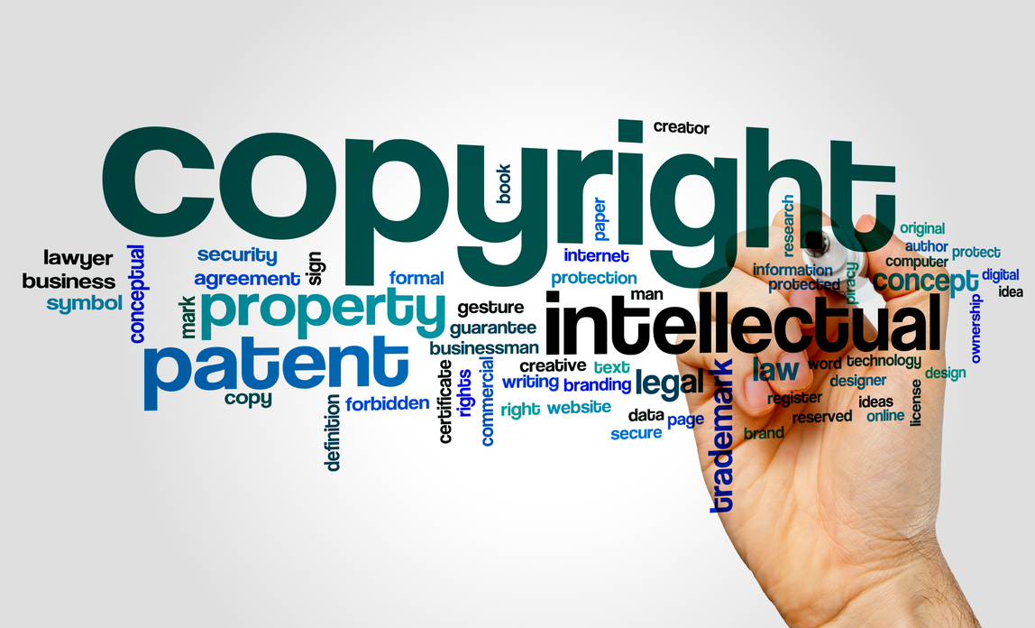

Slide 3
What is Copyright?
The exclusive and assignable legal right, given to the originator for a fixed number of years, to print, publish, perform, film, or record literary, artistic, or musical material.
Copyright is a form of protection given to author/creator of original work.

Slide 4
What can be protected
literary or dramatic work
a musical work
a cinematoghaph film
a sound recording
a photoghaph
a computer generated work
architectural work
Idea,concepts,discoveries

Slide 5
Rights of copyright holder
Right to produce the work.
Right to prepare derivative works.
Right to distribute copies for sale.
Right to perform AV work publicaly.
Right to display musical and artistic work publicaly.
Right to seek legal remedy in case of infringement.

Slide 6

Public Domain
Anything in public domain is useable by anyone in any way that they want.No one owns it.
Everything published before 1923 is in public domain.
Authors can choose to put work in public domain by including a notice that the item is in public domain.

Slide 7
Indian Copyright Act,1957
First right in India in 1914
Now,Indian Copyright Act,1957; w.e.f. 1958
Further amendments in 1983,1984,1992,1993,1999
Adopted many english provisions and also introduced new ideas and concepts.
Created copyright office and Copyright Board.
Introduced civil and criminal remedies against infringement.

Slide 8
Objectives of Copyright Act
to encourage the authors, music composers,singers etc.to create their original piece of works by granting them exclusive rights.
to stop misuse of original work.
to give copyright holders civil and criminal remedies in case of infringement.
to provide methods of acquiring copyrights.

Slide 9
Fair use
Fair use is the right of the public to make reasonable use of copyrighted material in special circumstances without the copyright holder’s permission.
The U.S. Copyright Act recognises that fair use of copyrighted work may be used for purposes such as “criticism,comment,news,reporting,teaching or research”.
The use is for non-profit,educational purposes.
Gives credit for the sources of the work.

Slide 10
Limitation of Copyright
Copyrights are granted to the owner for a limited amount of time.
It is costly to file for copyright protection of any intellectual property.
There is always someone who is out there looking to steal the copyrighted material. Even though the copyright is protected, someone may still reproduce it illegally.

Slide 11
Thank You……!

