Slide 1
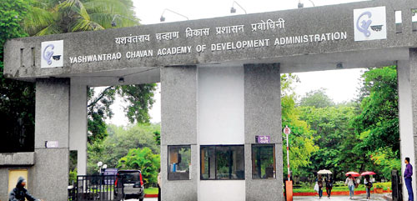
welcome

Slide 2


APPLY FOR PRADHANMANTRI AWAS YOJANA ONLINE…
BY
MANISHA BABASAHEB KAMBALE
PROBATIONARY ASSISTANT COMMISSIONER OF STATE TAX

Slide 3
INDEX
INTRODUCTION
WHO IS BENEFICIARY
REQUIREMENT ONLINE APPLY
REGISTRATION FOR GRAMIN
REGISTRATION FOR PMAY -URBAN

Slide 4
INTRODUCTION
In line with the government’s vision of “Housing for All” by 2022, the Ministry of Housing and Urban Affairs is implementing PMAY-U since June 2015 .The government aims to build 1 crore houses under the scheme.
In the rural housing to providing “Housing for All’’ by the scheme 2022, the of has IAY has been re-structured into Pradhan Mantri Awaas Yojana –Gramin (PMAY-G) w.e.f. 1st April 2016

Slide 5
WHO IS BENEFICIARY
PMAY-G aims at providing a pucca house, with basic amenities, to all houseless householder and those households living in kutcha and dilapidated house, by 2022.
PMAY-Urban ,to provide houses under following verticals of the Scheme:
1. “In-situ” Slum Redevelopment (ISSR)
2. Credit Linked Subsidy Scheme (CLSS)
3. Affordable Housing in Partnership (AHP)
4. Beneficiary-led individual house construction/enhancements (BLC) .

Slide 6
REQUIREMENT ONLINE APPLY
Before applying for PM Awas Yojana online, please make sure that
You are eligible to apply for the scheme (Check your name in the PMAY beneficiary list).
You have your Aadhar Number with you, Aadhar is mandatory for PMAY online application.
Your computer is connected to a reliable internet connection.
You have the details of your saving bank account with you.
You have the actual details of your household income.

Slide 7
REGISTRATION FOR GRAMIN
Go to website
www.pmayg.nic.in
DATA ENTRY TAB
MIS DATA ENTRY LOGIN
EXISTING SERVER
NEW SERVER

Slide 8
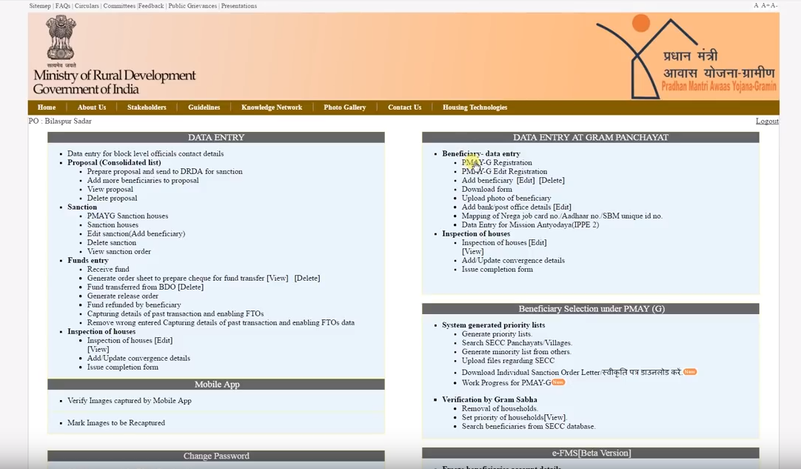
REGISTRATION FOR GRAMIN CONT…

Slide 9
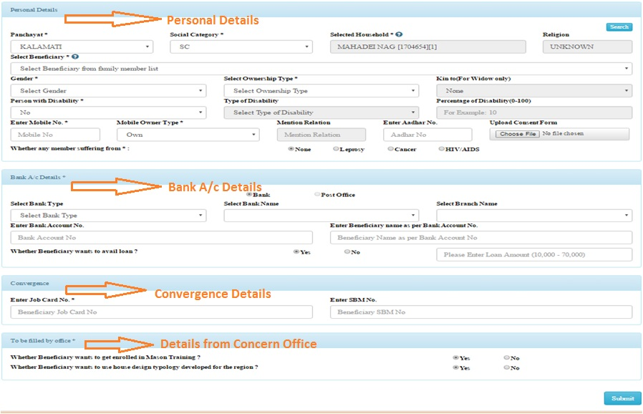
Beneficiary Registration Form

Slide 10
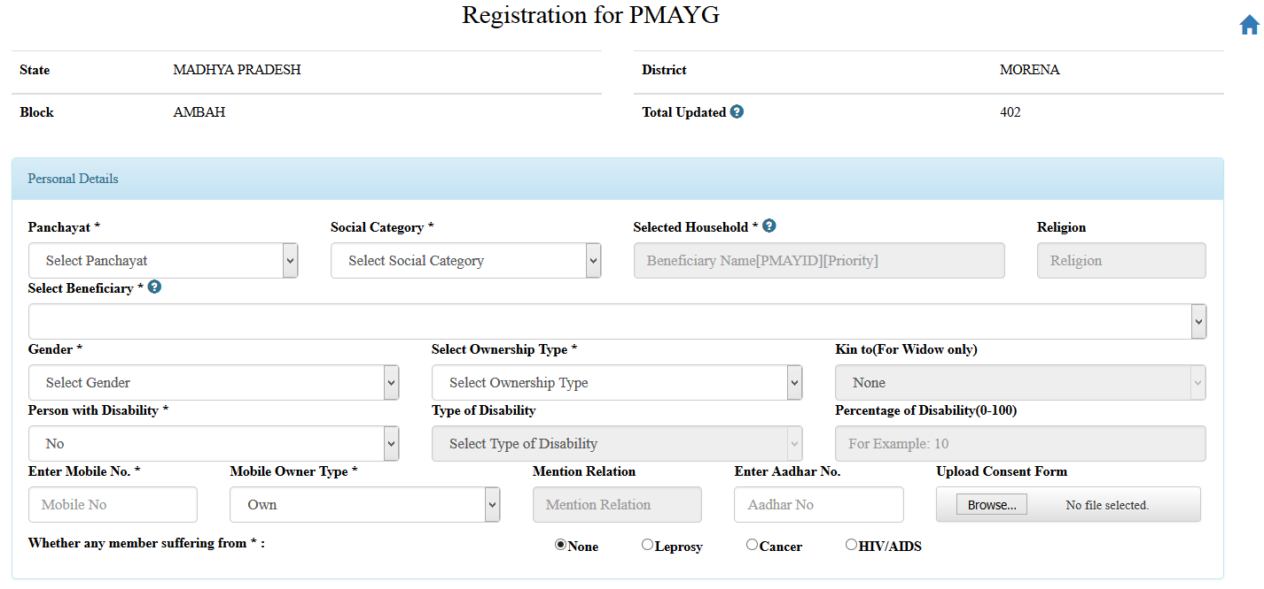
Section 1- Personal Details
To add beneficiary registration details concern panchayat and social category of beneficiary have to select as shown in picture below. On this selection a auto generated “search” button will appear for displaying the list of respective household.

Slide 11
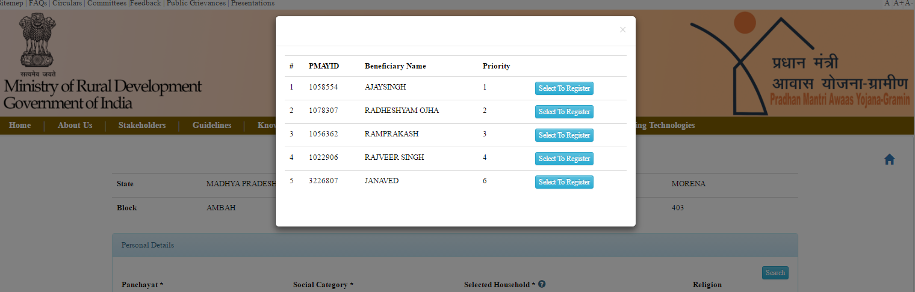
Section 1- Personal Details Cont…
After clicking on “search” button a list of corresponding beneficiary name along with PMAY ID and priority will appear and user can select the beneficiary to register from the list.

Slide 12
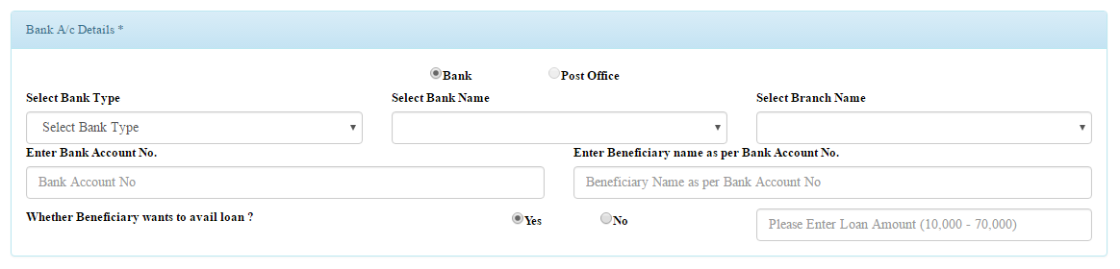
Section 2 - Beneficiary Bank Account Details
To Add Beneficiary Bank Account Details following parameters are required as mentioned below.
  Bank Type
  Bank Name
  Branch Name
  Bank Account Number
  Beneficiary Name as per bank account
  Whether beneficiary want to avail loan(if it is Yes; Loan Amount can be between Rs.10000 to Rs.70000)

Slide 13
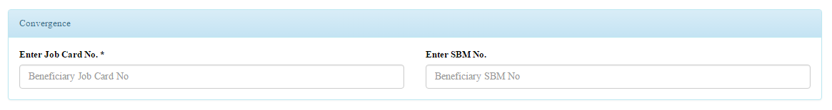
Section 3 - Beneficiary Convergence Details
This section of beneficiary registration require the following details.
The Beneficiary Job Card Number as registered with MGNREGA *.
Beneficiary SBM(Swachh Bharat Mission) Number

Slide 14
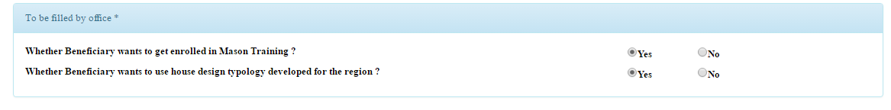
Section 4 - Details filled by concern Office
This section to be filled by the concern office with following parameters.
Whether Beneficiary wants to get enrolled in Mason Training? (Default it is Yes)
Whether Beneficiary wants to use house design typology developed for the region? (Default it is Yes)

Slide 15
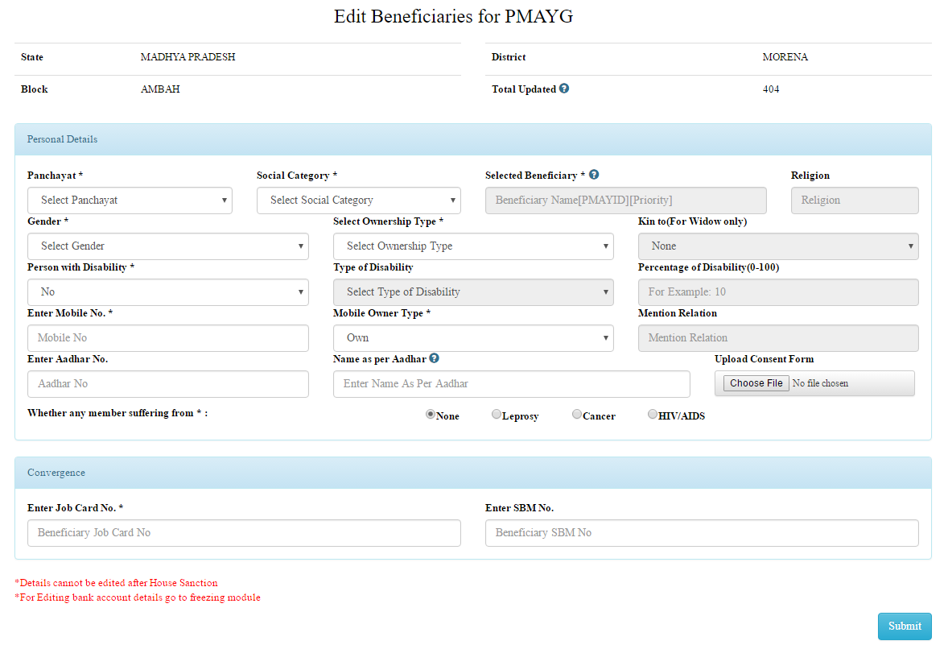
EDIT Beneficiary Registration Form
To edit beneficiary registration details on the basis of Panchayat and social category selection a “search” button will appear. On this selection a auto generated “search” button will appear for displaying the list of respective household.

Slide 16
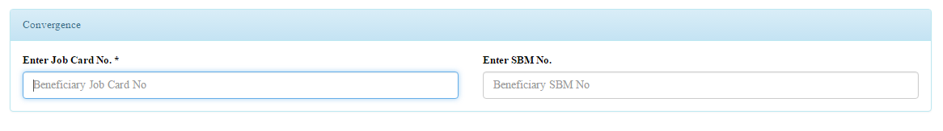
Edit Beneficiary Convergence Details
MGNREGA Job Card Number details of the beneficiary can be edited.
SBM (Swachh Bharat Mission) number can also be edited.

Slide 17
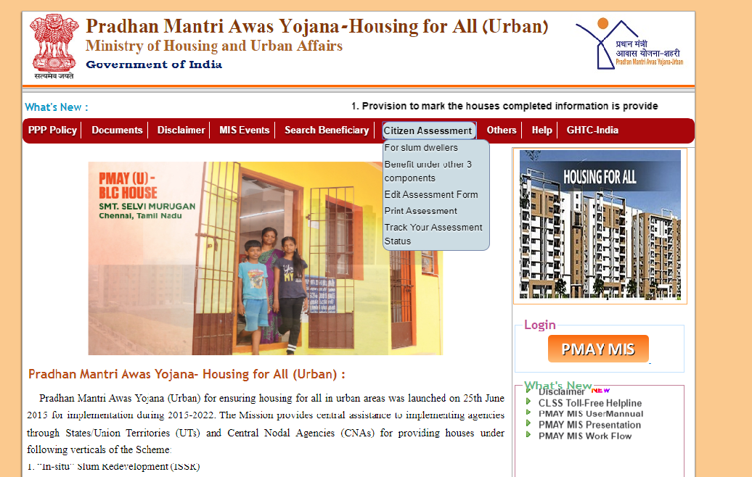
REGISTRATION FOR PMAY -URBAN
Go to http://pmaymis.gov.in/
If you are currently living in slum area, then select “For Slum Dwellers”
otherwise select “Benefits under other 3 Components” from the drop
down menu.

Slide 18
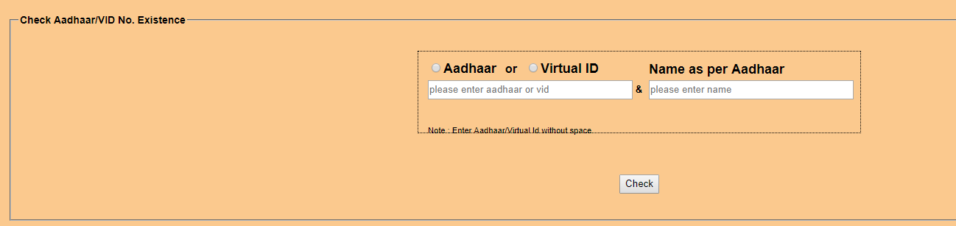
REGISTRATION FOR PMAY –URBAN CONT…
STEP 2: When we select “For slum dwellers” then following screen will appear on screen.

Slide 19
REGISTRATION FOR PMAY –URBAN CONT…
Step 3:If your Aadhar number is correct, a new page will open which will look
like the below image. If your Aadhar number is incorrect,try again by entering
your correct Aadhar number. If you do not have Aadhar number, you will not be able
to apply for PMAY.

Slide 20
REGISTRATION FOR PMAY –URBAN CONT…
STEP 4:
Fill the details correctly including your personal details, contact details, current residential address, Aadhar Number, Bank Account details and income details in the application form.

Slide 21
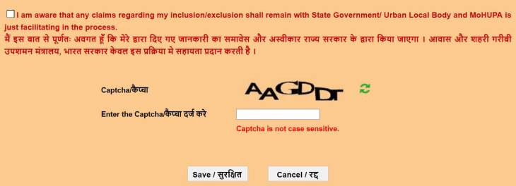
REGISTRATION FOR PMAY –URBAN CONT…
STEP 5: Click the checkbox which says “I am aware of….”
and then click the “Save” Button at the end of application form

Slide 22
REGISTRATION FOR PMAY –URBAN CONT…
STEP 6:
Once you click “Save”, you will see a new screen where a system generated application number will be given to you, you can either print this directly if a printer is attached with your computer or save it for your future reference.

Slide 23
THANK YOU

