Slide 1
AVOID NON-PRODUCTIVE MESSAGE AND MAIL FORWARDS
PRESENTED BY-
KALE BHAKT BALASO
CLASS: D
ROLL NO.: 9

Slide 2
INTRODUCTION
WHAT IS FORWARD?
Forwarding refers to operation of resending content obtained on email or any digital format to different address or addresses.
Non productive message may includes fake news, rumours, sensitive data affecting mobs etc.
Such unproductive email affects organisation, government and society as well.

Slide 3
WhatsApp
15 billion people use it
450 billion users are daily active
100 billion whatsapp call
2 billion minutes per day
55 million video call per day

Slide 4
Measures by whatsapp
WhatsAPP has announced legal action against individuals and companies who misuse app or send message to lot of people in violation of terms and conditions.
Unauthorised usage of whatsapp policy individuals engaged in activities of sending bulk or automated message would face legal action.

Slide 5
PROTO India based startup launched tip line (+91-9643-000-888) to submit misinformation or rumours by whatsapp.This centre will response user if claim made in message shared is verified or not.
Company has made forward difficult to many people at a time in world they had kept limit 20 for forward. In India they had kept just 5 as limit.

Slide 6
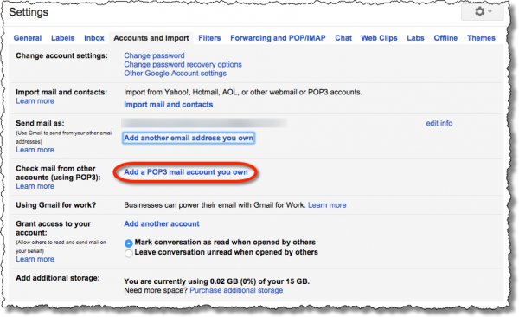
Gmail
Steps to avoid automatic email forwards
1.Go to your Gmail account
2.At top right ,click settings
3.click the forwarding and POP/IMAP tab
4.In forwarding section ,click disable forwarding

Slide 7
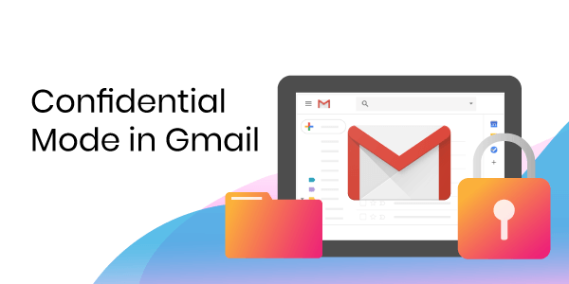
Confidential mode in Gmail
With confidential mode one can prevent the Recipients of messages to copy or print, and even download messages, including attachments.
With this one can also set a message expiration date, revoke message access at any time. Our recipient may also require an SMS verification code to access messages sent by us.

Slide 8
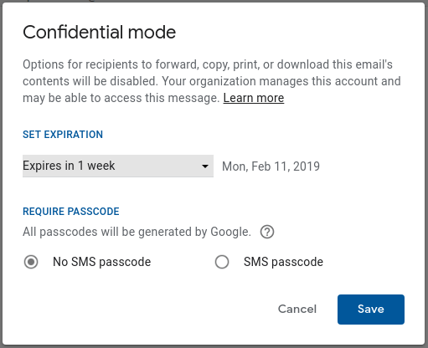

Slide 9
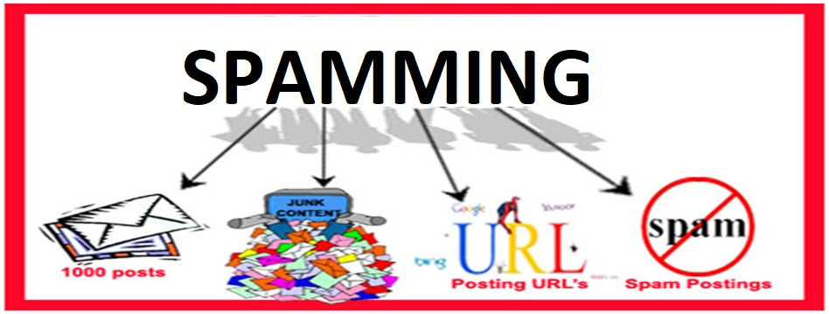
Irrelevant messages sent over the Internet, typically to a large number of users, for the purposes of advertising, phishing, spreading malware, etc.
How to avoid spam
Try to avoid opening spam emails and clicking on links in spam messages.
Don't buy anything from a spammer.
Don't be tempted to reply.
Don't threaten the spammer.
Use a disposable email address.

