Slide 2
POWERPOINT PRESENTATION
Presented by:- Kadam Chaitanya Vasantrao
Class:- D
Roll no.:- D-20

Slide 3
NAME OF THE TOPIC:-
SURF SMARTER

Slide 6
RECENT THREATS TO SURFING

Slide 10
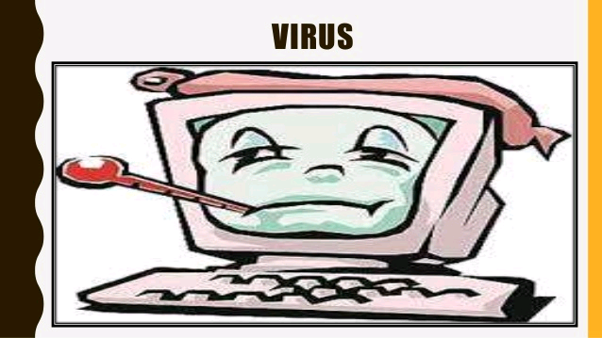

Slide 11
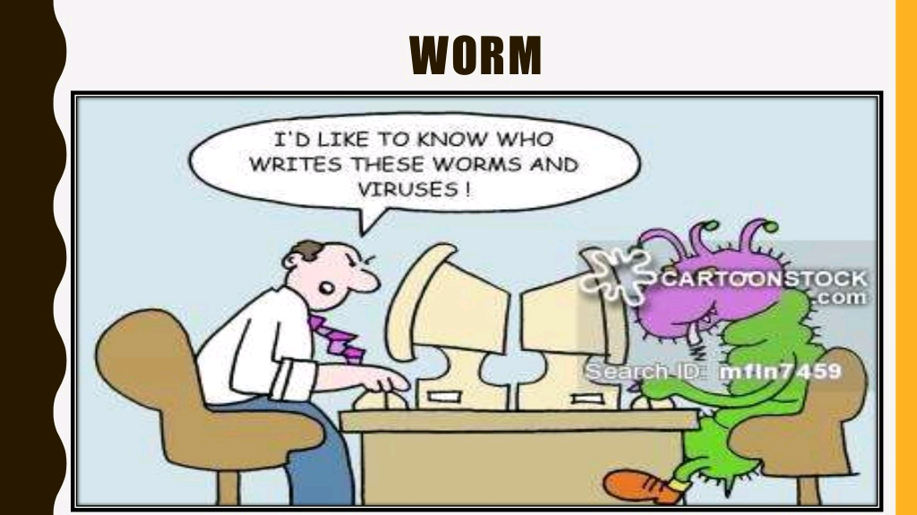

Slide 13
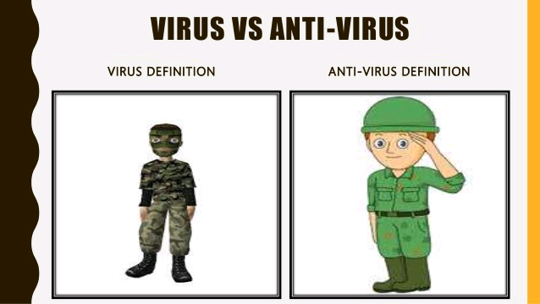

Slide 15
WHAT WE HAVE TO DO:-
Use an up to date and reputable web browser
Be especially careful about using public or shared computers.
Don’t leave your computer unattended while logged on to online banking or other sites where you provide personal information.
Always log out when you are finished to properly end your banking session.
Disable automatic password-save features

