Slide 1
CHECK MY PROJECT REPORT FOR PLAGIARISM USING PLAGIARISM CHECKER
BY
KALPESH JADHAV
ADSD
BATCH-B
ROLL NO.-39

Slide 2
WHAT IS PLAGIARISM
Plagiarism is the “wrongful appropriation” and “stealing and publication” of another author’s “language, thoughts, ideas, or expressions” and the representation of them as one’s own original work.
Plagiarism is considered academic dishonesty and a breach of journalistic ethics.

Slide 3
What is plagiarism checker
Plagiarism checking is the process of locating instances of plagiarism within work or document. The widespread use of computers and the advent of the internet have made it easier to plagiarize the work of others.

Slide 4
Process for plagiarism checking
Go to website or software.
Enter your text or upload file.
Select check plagiarism option.
Then it works automatically.

Slide 5
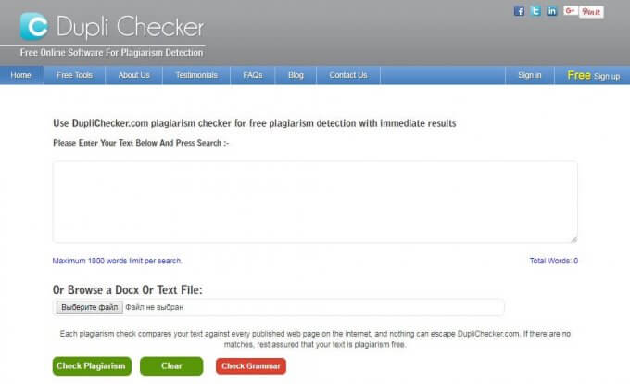

Slide 6
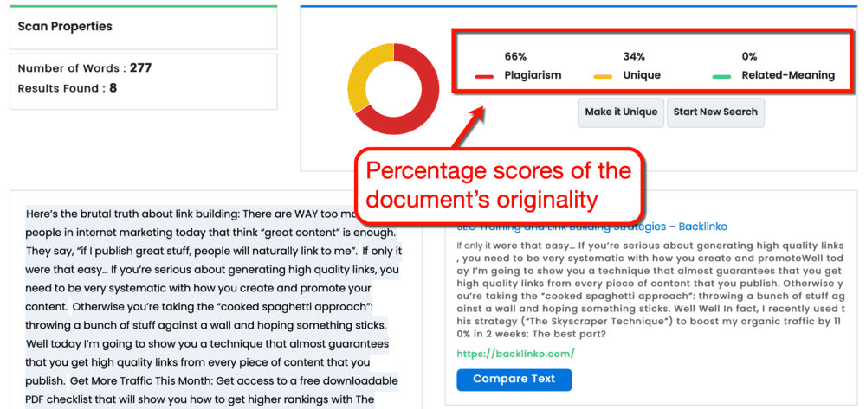

Slide 7
Plagiarism checker sites
Duplichecker.com
Papertater.com
Plagiarisma.com
PlagTracker.com
Plagium.com
CopyLeaks.com
Unplug Checker
Grammarly.com
Plagscan.com

Slide 8
a
THANK YOU

