Slide 1
E-POST
Transforming Indian Postal Service
Deepak Balasaheb Jadhav.
Dy. Director of Industries (Tech.)
Class: B, Roll No: B-20.

Slide 2
VISION AND MISSION OF E-POST
To sustain its position as the largest postal network in the world.
To provide mail parcel, money transfer, banking, insurance and retail services with speed and reliability.
To provide services to the customers on value-for-money basis.
To enable last mile connectivity as a Government of India platform.​

Slide 3
ONLINE SERVICES PROVIDED
E-POST BASICALLY PROVIDES FOUR TYPES OF ONLINE SERVICES
Online Mail related Services.
Online Parcel/Courier Booking and Tracking .
Online Money Transfer (e Money Order).
Online Banking and Insurance .

Slide 4
ONLINE SERVICES PROVIDED -SCREENSHOT

Slide 5
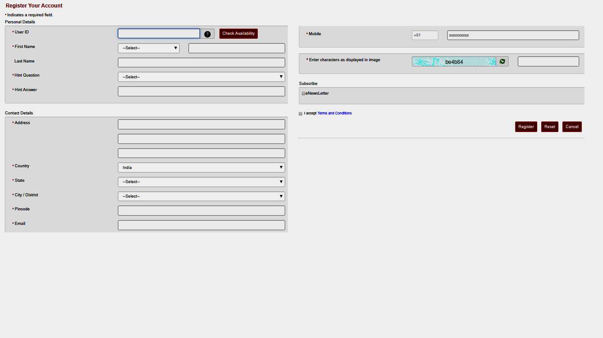
To avail Online Postal Services You need to register on “https://www.indiapost.gov.in”

Slide 6
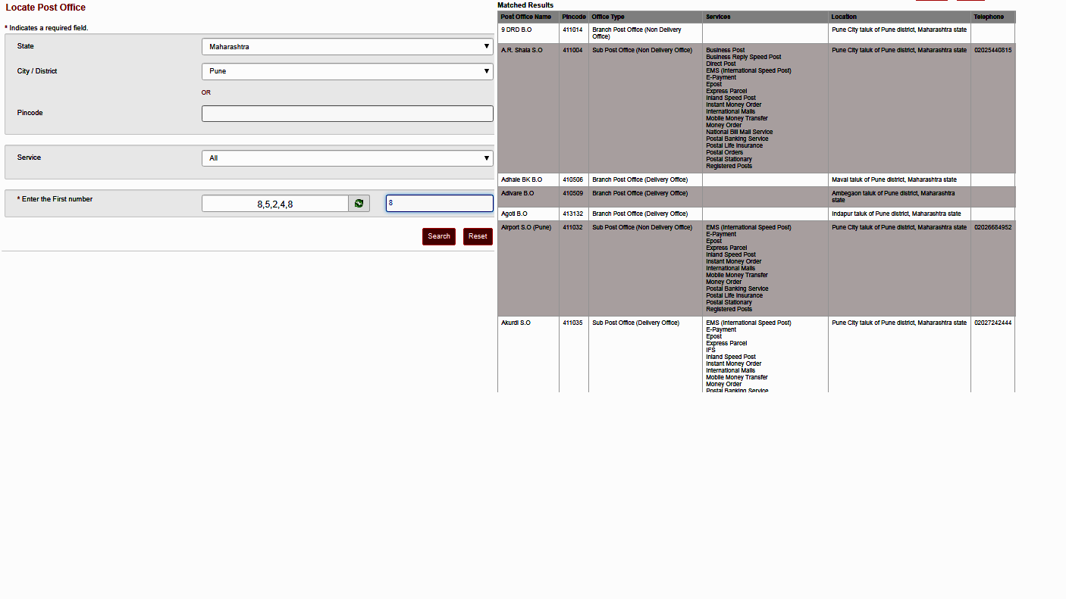
Searching or Locating Post Offices

Slide 7
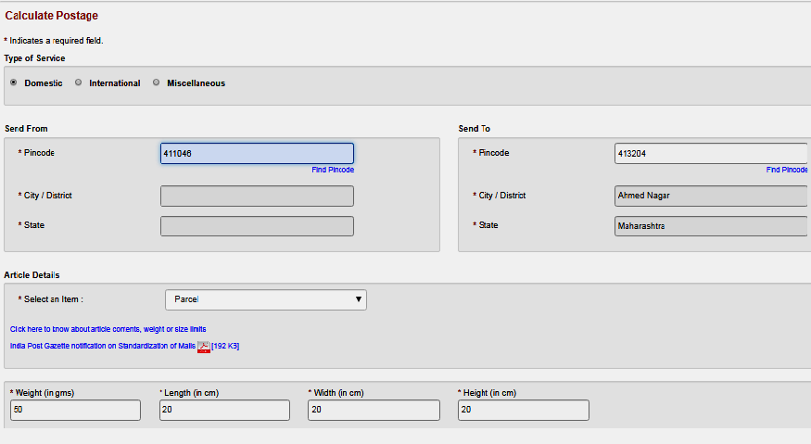
Calculating Postage

