Slide 1
A Presentation on Pay electricity bill online, Pay telephone bill online
INGLE AMOL UTTAMRAO
CLASS-A ROLL NO-08
DEPUTY DIRECTOR OF INDUSTRIES(TECHNICAL)

Slide 2
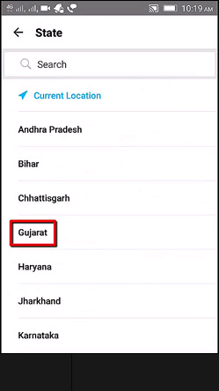
ONLINE ELECTRICTY BILL PAYMENT
Steps to Pay Electricity Bill Online In Paytm
STEP 1: First, if you have a Smartphone then download Paytm app and login on it
STEP 2: click on electricity icon and select your state where you are living.

Slide 3
STEP 3: Select board which is located in your bill paper. (I.e. MGVcl, DGVCL, MGVCL, UGVCL)
STEP 4: Submit customer number that is located in your bill paper.
STEP 5: Must Conform Customer name and then enter amount of electricity bill that you want to pay.

Slide 5
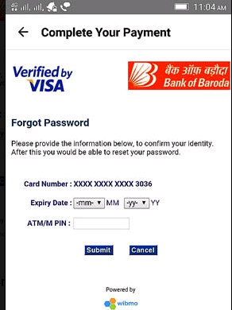
Step 6: Now, complete your payment by using Debit Card or Credit Card or Net Banking or ATM card.

Slide 6
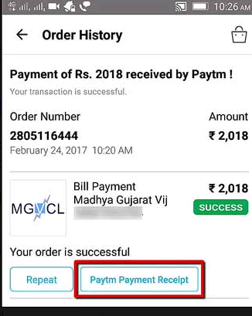
STEP 7: You can see your Electricity bill payment is done successfully.

Slide 7
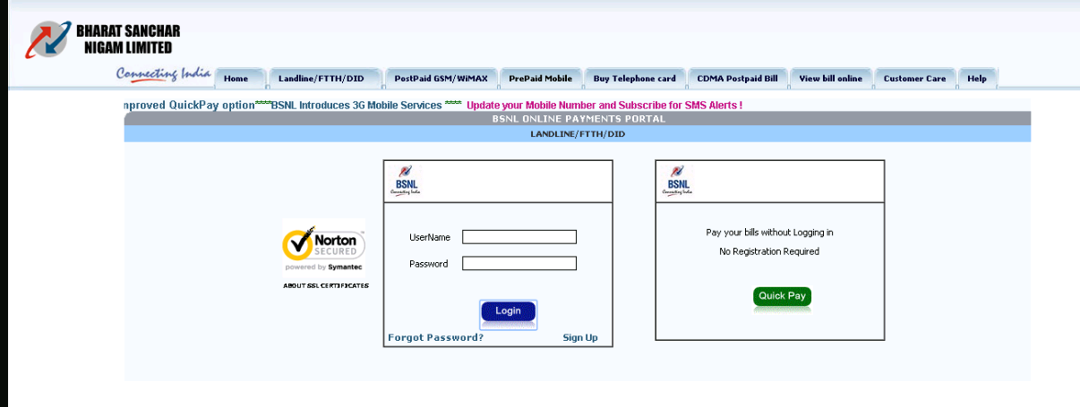
How to pay telephone bill online
Visit website of respective mobile operator
For example BSNL
visit https://portal2.bsnl.in/myportal/

Slide 8
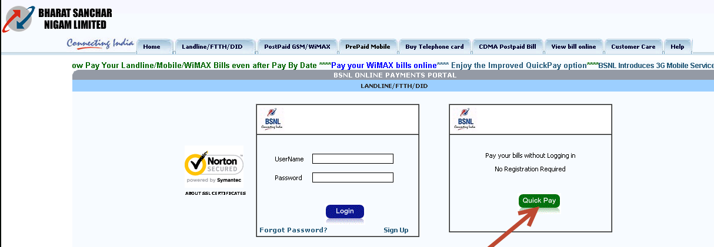
Click on “Quick Pay“.

Slide 9
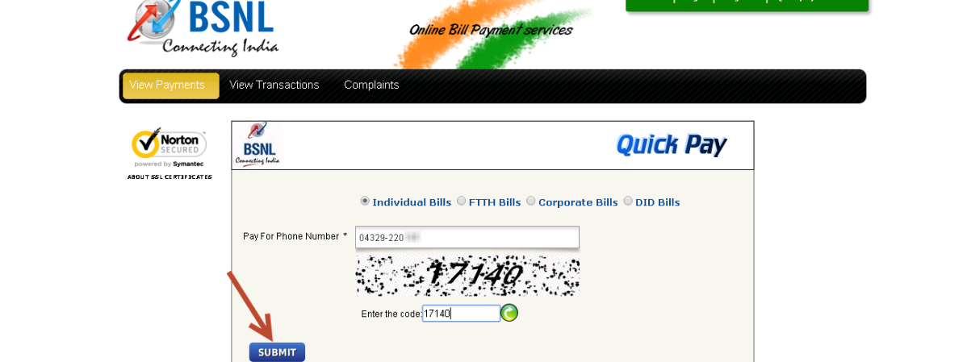
A new page appears, fill land-line number in this format: Std code-Phone number. For ex, 044-2525262. Type the character in the image and click “submit“.

Slide 10
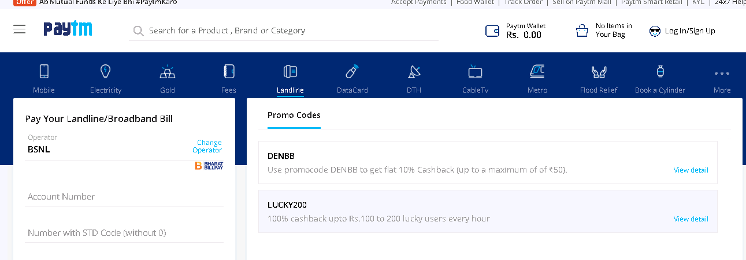
Phone pay bill using mobile app
1) USING PAYTYM
How to Make BSNL Landline/Broadband Bill Payment Online?
Enter your account number.
Enter number with STD Code.

Slide 11
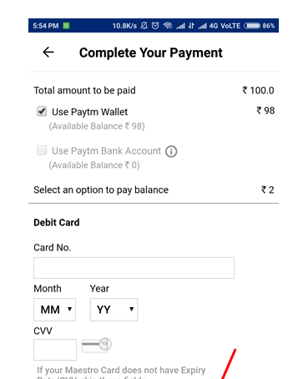
Get the bill or enter the amount.
Pick bill payment promo codes of your choice and get Cashback & other offers.
Choose payment method of your preference i.e. Debit/Credit Card, Net banking or Paytm wallet.

Slide 12
THANK YOU

