Slide 1
Scan Documents and Store Online
By
Uddhav Sheku Holkar
Deputy Chief Executive Officer
Class: B, CPTP-5
Yashada, Pune.

Slide 2
Importance of Scanning Documents
Scanning your documents frees up office space. .
Improves the legibility of old hardcopy records.
Scanned documents can be encrypted, password protected, and securely stored in the cloud.
Document scanning makes it easy to share documents.
Digital files can be organized, indexed and produced quickly.
It prevents excess paper, it benefits the environment as well.
Improved Disaster Recovery, digital images can be backed up to tape or hard drive

Slide 3
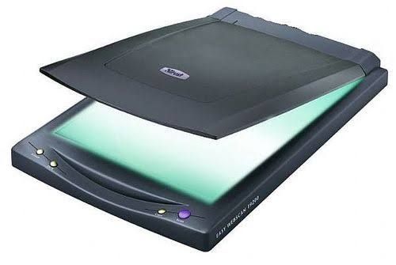
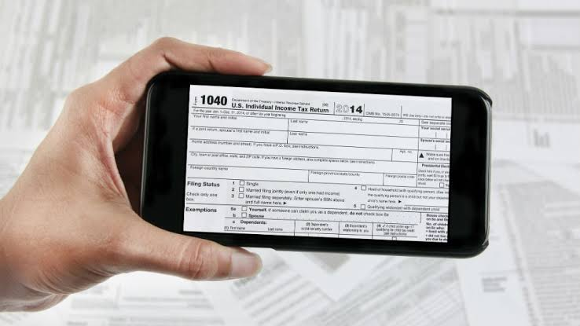
How to scan documents ?
Scanning documents can be possible by two ways
By using scanning device that is scanner.
By using the mobile phone.

Slide 4
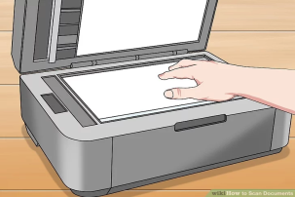
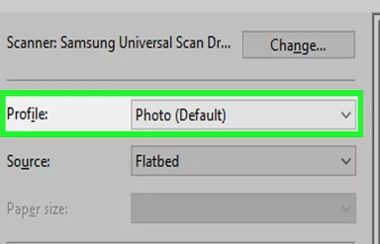
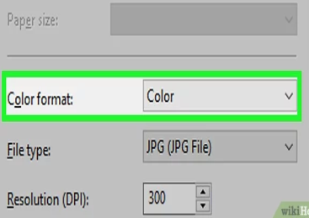
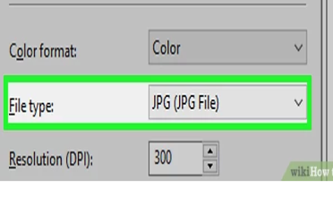
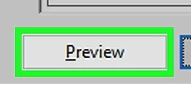
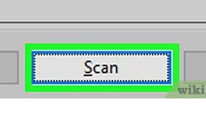
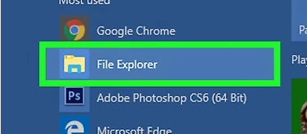
Steps for Scanning document using scanner
1
Place a document face-down in your scanner.
2
Open Start menu on windows
3
Type fax and scan into Start.
4
Click Windows Fax and Scan and Click on new scan
5
Select a type of document.(e.g. photo)
6
Decide on your document's color. (Color or Black & white)
7
Select a file type. (e.g. PDF or JPG)
8
Click Preview.
9
Click Scan.
10
Find your scanned document, Scanned Documents folder.

Slide 5
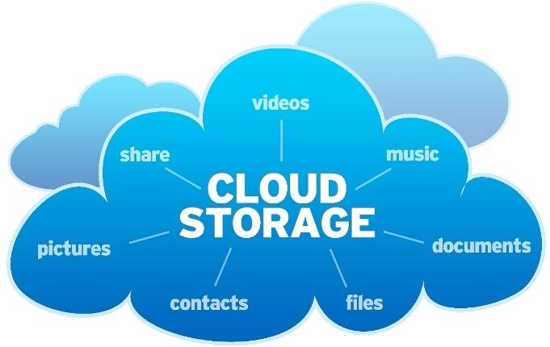
Storing Scanned Document online
Scanned documents can be stored on the cloud store online , such as:-
Google Drive
iDrive
pCloud
Zoolz
Degoo
Mega cloud
OneDrive
iCloud
Box
NextCloud

Slide 6
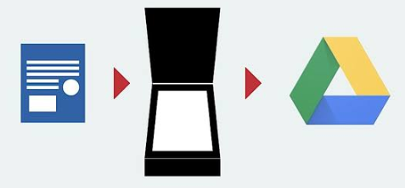
Uploading scanned document on Google Drive
You should have google account to use services of google drive.
Open ‘Google Dirve’.
Select folder where document to be saved.
Click on add(Plus sign).
Click on ‘Upload’.
Select file from ‘file explorer’ to be store online.
Click on that file, file will be saved online in the selected folder.

Slide 7
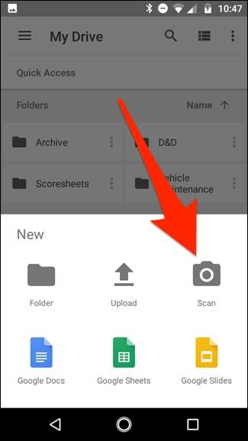
Scanning document using mobile.
Scanning Document using mobile can be possible with the help of number of mobile applications:-
Google Drive app.
Cam Scanner app.
Adobe scan.
Clear Scanner.
Office Lens.
vFlat Mobile Book Scanner
TinyScanner
TurboScan
Smart Doc Scanner
Fast Scanner

Slide 8
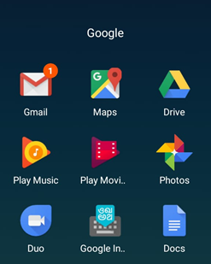
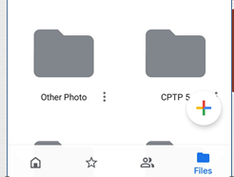
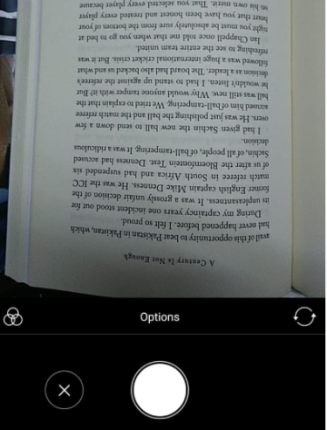
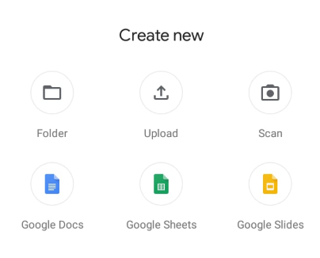
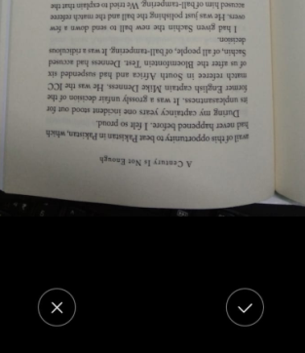
Scanning document using Google Drive App and store online
Open the Google Drive app .
In the bottom right, tap Add
Tap Scan
Take a photo of the document you'd like to scan.
To save the finished document, tap Done

Slide 9
Benefits of Online Data Storage
Employees can work from anywhere
No server maintenance
Data is easily moved
Remote workers
Saves money
No data loss
Security
Client feedback

