Slide 1
RECYCLE YOUR OLD COMPUTER
Presented by Aishwarya Anand Giri
Tahsildar
Batch:D4

Slide 2
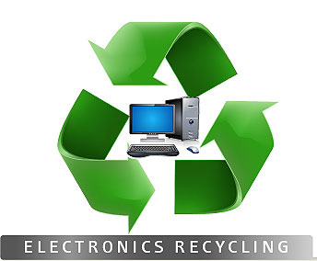
WHY COMPUTER RECYCLING?
Managing plastic waste has become a critical part of our discourse on waste management, and that’s a positive thing.
Electronic products like computer monitors, motherboards, mobile phones and chargers, headphones, television sets, air conditioners and refrigerators have become ubiquitous in the modern age
Hence, e-waste must also enter that critical conversation as it contains heavy metals and other toxic chemicals like mercury, lead, and sulphur that pose a real danger to our environment.

Slide 3
COMPUTER RECYCLING
Computer recycling, electronic recycling or e-waste recycling is the disassembly and separation of components and raw materials of waste electronics. Although the procedures of re-use, donation and repair are not strictly recycling, these are other common sustainable ways to dispose of IT waste.
In 2009, 38% of computers and a quarter of total electronic waste was recycled in the United States, 5% and 3% up from 3 years prior respectively.^{[2]} Since its inception in the early 1990s, more and more devices are recycled worldwide due to increased awareness and investment. Electronic recycling occurs primarily in order to recover valuable rare earth metals and precious metals, which are in short supply, as well as plastics and metals. These are resold or used in new devices after purification, in effect creating a circular economy. Such processes involve specialised facilities and premises, but within the home or ordinary workplace, sound components of damaged or obsolete computers can often be reused, reducing replacement costs.
Recycling is considered environmentally friendly because it prevents hazardous waste, including heavy metals and carcinogens, from entering the atmosphere, landfill or waterways. While electronics consist a small fraction of total waste generated, they are far more dangerousComputer recycling, electronic recycling or e-waste recycling is the disassembly and separation of components and raw materials of waste electronics. Although the procedures of re-use, donation and repair are not strictly recycling, these are other common sustainable ways to dispose of IT waste.

Slide 4
INDIAN SCENARIO
India’s love affair with consumer electronics will likely rage on for years to come. But embracing new technologies brings up a huge question: What do you do with the old stuff?
According to the Associated Chambers of Commerce and Industry of India, the country is expected to produce 3.3 million tonnes of e-waste containing toxic metals and chemicals by the end of 2018.
By 2020, it is likely to reach 5.2 MT, growing at a compound annual growth rate of 30%, says the Ministry of Electronics and Information Technology.
So, we have little choice but to find ways of disposing of this waste which isn’t harmful to the environment.
“Direct contact of harmful materials such as lead, cadmium, chromium, brominated flame retardants or polychlorinated biphenyls (PCBs) and exposure to toxic fumes may cause serious health hazards. Toxic chemicals and heavy metals leaching into soil and water may cause pollution, while toxic fumes reach into the environment and cause air pollution,” says the Ministry of Electronics and Information Technology.

Slide 5
Some important information about computer safety that many people do not know:
1. Deleting a file or application may not fully delete the file, as it is often possible to retrieve deleted files from a computer using special software.
2. There are many components of a computer that will stop a computer from functioning. Just because a computer no longer works does not mean that the memory or storage space are damaged in any way.
3. Traditional waste disposal methods (in other words, your trashcan) are not always safe, and waste may travel through many hands before it makes its way into a landfill.
4. Most people store unprotected vital information, including passwords, credit card information, and personal information, on their hard drive.Hence computer recycling is important.

Slide 6
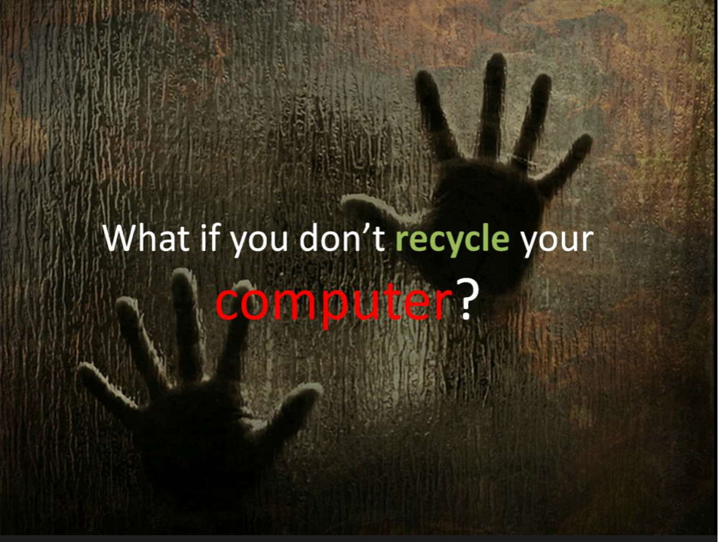

Slide 7
LEAD affects central nervous system,reproductive system and kidneys.
MERCURY causes high blood pressure and affects lungs.
CADMIUM used in phosphours coating on CRT,does kidney damage.
PLASTIC/PVC causes permanent liver damage,nerve damage,immune inaction,skin irritation and birth defects.
ARSENIC causes changes in heart rythem,blood cell production and blood vessels.

Slide 8
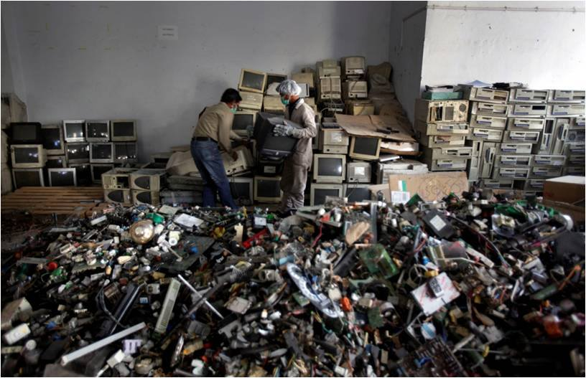
HOW TO RECYCLE YOUR OLD COMPUTER?
For starters, if your computers, refrigerators or microwave are still in working condition, you can donate them to a non-profit. Old computers, for example, can be donated to government schools or non-profits. You must ensure that the product is in a reusable condition.
Similarly, you can sell your used electronics on websites like Olx or Quickr, while several companies like Amazon and Flipkart have exchange offers for mobile phones.

Slide 9
But if your electronic product is entirely out of order, there are specific steps you should never take:
1) Do not mix your e-waste like remote control batteries with regular waste.
2) Never dismantle your electronic products by yourself.
3) Never sell or give away your e-waste to your local scrap dealer/ragpicker who function in the informal and unorganised market.
Here’s what you can do, instead:
1) Give your e-waste to the nearest authorised e-waste collection centres/recyclers.
2) Call the producer/ manufacturer of your product for e-waste collection

Slide 10
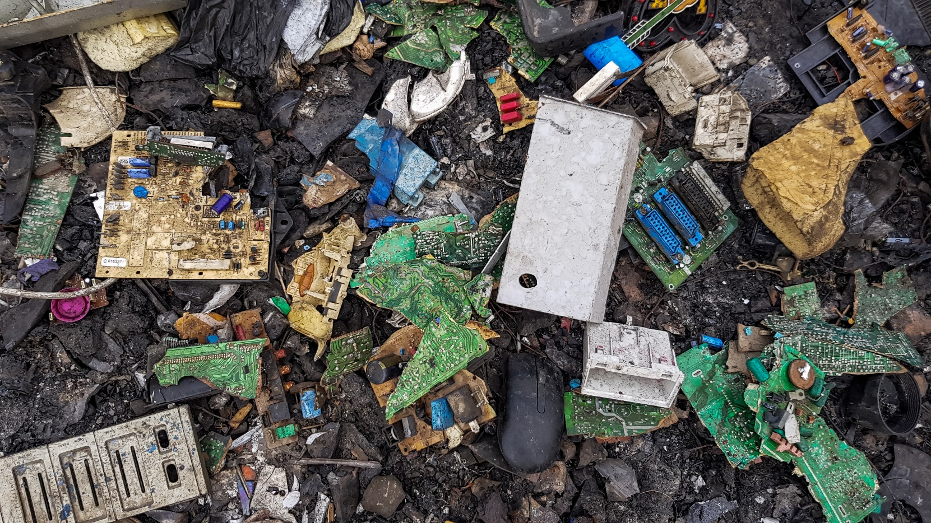
Under the Extended Producer Responsibility, which is a policy approach, manufacturers of laptops, mobile phones or microwaves are responsible to channel e-waste and ensure that it is managed in a way which is environmentally sound.

Slide 11
This means it’s incumbent on the producer to set up collection centres (for example, Lava mobile phone) or develop a take-back system.
“The producers have to meet targets, which should be 20% of the waste generated by their sales. This will increase by 10% annually for the next five years. The law also says that the responsibility of producers is not confined to waste collection, but also to ensure that the waste reaches the authorised recycler/dismantler,” says this Down to Earth report.
So, can give your waste away to?

Slide 12
Here are five organisations that you can approach.
1) Bengaluru has multiple government, non-profit and resident welfare associations that you can approach with your e-waste.
For example, Saahas, a sustainable waste management non-profit, will take your waste at collection centres across the city if you have more than 10kgs of e-waste.
You can call them between 9.30am to 6 pm or write to them
In Hyderabad, you have a simple and efficient Internet of Things (IoT)-based platform, called Sanshodhan E-waste Exchange. It enables corporations across India and societies in the city of Hyderabad to transfer their e-waste to authorised recyclers.
2) Karma Recycling: This Delhi-based startup buys old mobile devices and sells repaired ones at a much cheaper rate.
As The Better India has reported, “All a user has to do is go to the website, pick the brand and model of the smartphone, laptop or tablet he/she wants to sell, and answer some basic questions about the condition of the device. The website uses algorithms that give users an estimate based on the state of the phone. Once the customer agrees to sell the device, people from Karma Recycling go, pick it up and send it to one of their service centres – either in Delhi or Bangalore.”
Thus far it has purchased over 5.5 lakh devices and paid out Rs 15 crore to its customers.

Slide 13
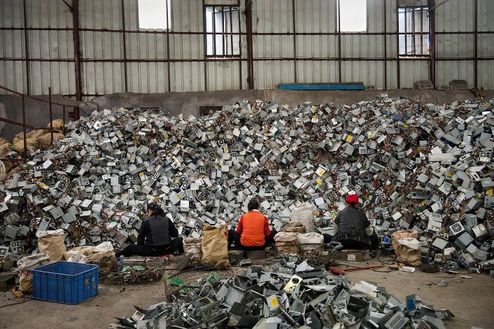
3) Namo E-Waste: This Faridabad-based e-waste recycling startup was awarded the Best Green Startup of the year 2015-16 in the Clean and Green India awards by Franchise India.
It collects all sorts of electronic waste and recycles them into different products. It collects from companies, institutions, organisations and housing societies as well across 12 states and union territories.
“We check the electronic item and segregate it into repairable and irreparable assets. The irreparable ones are then sent for dismantling — we segregate it into different materials, like plastic, metal and precious metal. Then comes the last process — recycling. Shredding, electrolysis, separation and other non-hazardous methods of segregation are part of this process. The harmful substances are taken out during recycling and sent to government-approved dumping sites where they are incinerated,” says Akshay Jain, founder of Namo eWaste Management, speaking to Edex Live

Slide 14
4) ExtraCarbon: This Gurugram-based startup, founded in 2013, links customers to authorised scrap dealers through their apps across nine cities in North India.
“It picks up all recycled goods, from bottles and books to electronics. Customers are paid in cash and shopping credits. ExtraCarbon then sells recycling materials to government-certified waste processors. Reselling makes up 70 per cent of the company’s revenue,” says this report in The Hindu. It collects approximately 6,000 tonnes of e-waste and other waste in a year
5) Cerebra Integrated Technologies: Boasting of having one of the largest e-waste facilities in India, this Bengaluru-based entity offers repair, refurbishment and reuse of all electronic and electrical equipment.
“To protect yourself and your company from potential data loss, our commercial components shredder ensures the efficient destruction of hard drives, prototype units, processors, chips and other sensitive storage media devices. With CEREBRA, you can be confident that the records, files, and programs which may still reside on surplus or outdated equipment will never be found on the secondary market, in the hands of thieves – or the research labs of your competitors,” says this description on the company website.

Slide 15
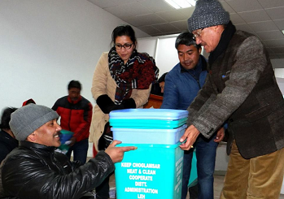
Innovative Lessons India Can Learn From This IAS Officer who Managed Leh’s Waste
The Leh district administration under Deputy Commissioner Avny Lavasa, started ‘Project Tsangda,’ a sustainable waste management initiative in rural and semi-rural areas of the district on December 12, 2017.
‘Tsangda’ or ‘Stangda’ means cleanliness in the local Bothi language.
The local Rural Development Department and the Leh Autonomous Hill Development Council (LAHDC) collaborated with them on this project.
By any measure, Project Tsangda has proven to be a real success. Besides getting local communities heavily invested, the initiative has also found its way into a recent list of ‘Best Practices’ from around India collated by the Ministry of Drinking Water and Sanitation.

Slide 16
“Dry waste is sold to scrap dealers, or reused to make recyclable products. Paper and cloth waste are used for making decorative items, curtains, toys, cushion covers, etc. Alcohol bottles and other broken glasses are reused in the construction of buildings. Selling this dry waste to construction companies has worked well for us. We are also shredding the plastic and selling it to Pradhan Mantri Gram Sadak Yojana (PMGSY), mandated to utilising hazardous plastic refuse for road construction. This also generates a good amount of revenue for the administration to run the project,” says Lavasa.
Finally, what Project Tsangda can also teach the rest of India is that waste management does not entirely mean focussing on garbage. Smart and innovative governance practices can also greatly assist the process of waste management.

Slide 17


