Slide 1
Open a net banking account
By
Shital Ghawate
Roll no-A7
Prob. ACST
CPTP6,Yashada

Slide 2
Need of net bank account
Balance enquiry
Transfer of funds
Online payment of bills
Transaction details of account
Online shopping

Slide 3
Dos and don'ts while activating a net bank account-
Keep your ATM card with you.
Enter the same mobile number in the registration form that you have previously mentioned in the account opening form.
Keep your passbook and cheque-book with you. You will get most information like account number, CIF number and branch details from Passbook.
Never reply to anyone about bank details or net banking user id, password or OTP over phone or email.

Slide 4
Ways to open a net bank account-
Offline(Visit bank)
Online(Use of internet)

Slide 5
Step 1-Go to the homepage of SBI netbanking, onlinesbi.com

Slide 6
Step 2-Enter Account details

Slide 7
Step 3-Enter OTP(one time password) received on your registered mobile number.

Slide 8
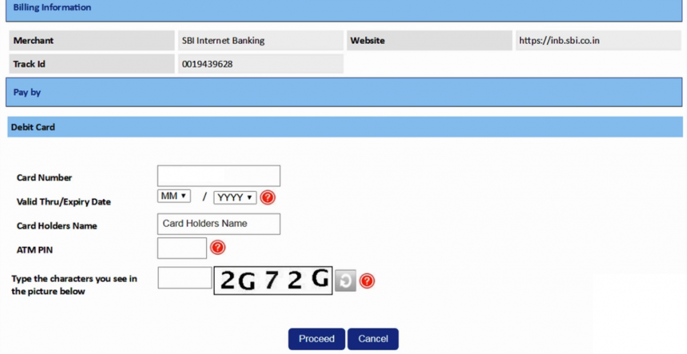
Step 4-Enter ATM card details

Slide 9
Step5-Enter password (The password should be eight characters long, a combination of upper and lower case letters, at least one number and one special character)

Slide 10
Step 6- Log In

Slide 11
Profile-

Slide 12
Thank you

