Slide 1
Apply for National scholarship
Mr. Maheshkumar S. Ghare
Assistant Commissioner of State Tax
Batch – CPTP 6
Roll No.- B29

Slide 2
Objective Of NSP
Providing a Simplified, Mission-oriented, Accountable, Responsive, and Transparent (SMART) System for faster & effective disbursal of scholarships applications Timely disbursement of scholarships to students.
Provide a common portal for various scholarships schemes of Central & State Governments.
Create a transparent database of scholars.
Avoid duplication in processing.
Application of direct benefit transfer (DBT).

Slide 3
Scope of NSP
NSP Covers Scholarship scheme by following ministry and Departments
Ministry of Minority Affairs
Ministry of Home Affairs
Ministry of Tribal Affairs
Ministry Social Justice & Empowerment
Ministry Labour & Employment
States and UTs Scholarship Schemes

Slide 4

Apply for national Scholarship
Application Process in brief
Pre-requisites
Educational documents of student
Student's Bank account number and IFSC code of the bank branch
Aadhaar number of the Student
If Institute/School is different from domicile state of the applicant, then Bonafide student certificate from Institute / School.

Slide 5
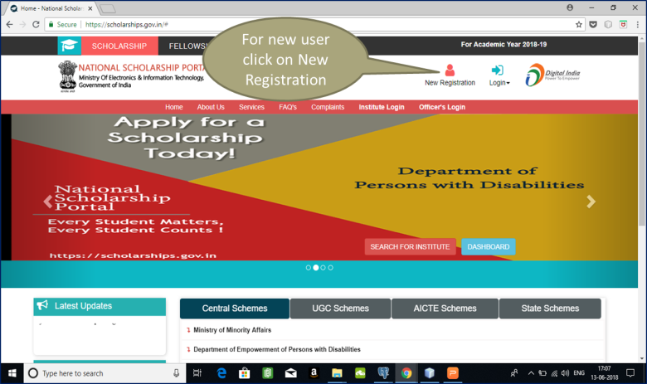
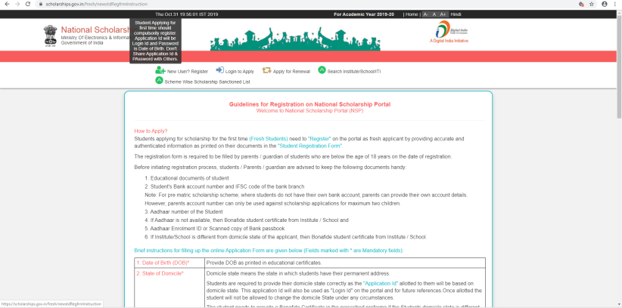
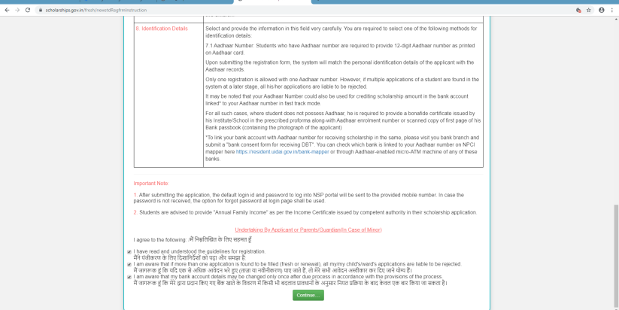
Registering Yourself
Navigate to https://scholarships.gov.in/
Click on New Registration
Read Guideline for Registration

Slide 6
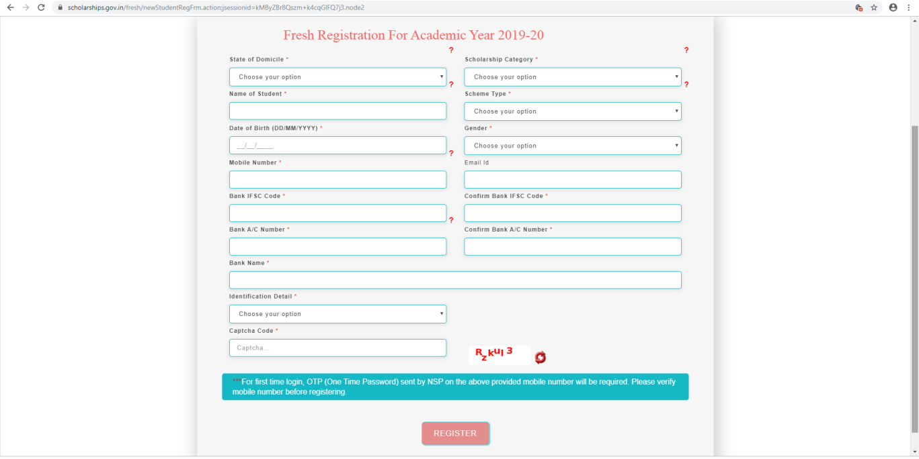
Registering Yourself
Application ID
After entering all details and submitting the information, you will be provided with a Application ID and Password.
The Application ID and Password is sent to the applicant’s registered mobile number for future reference.

Slide 7
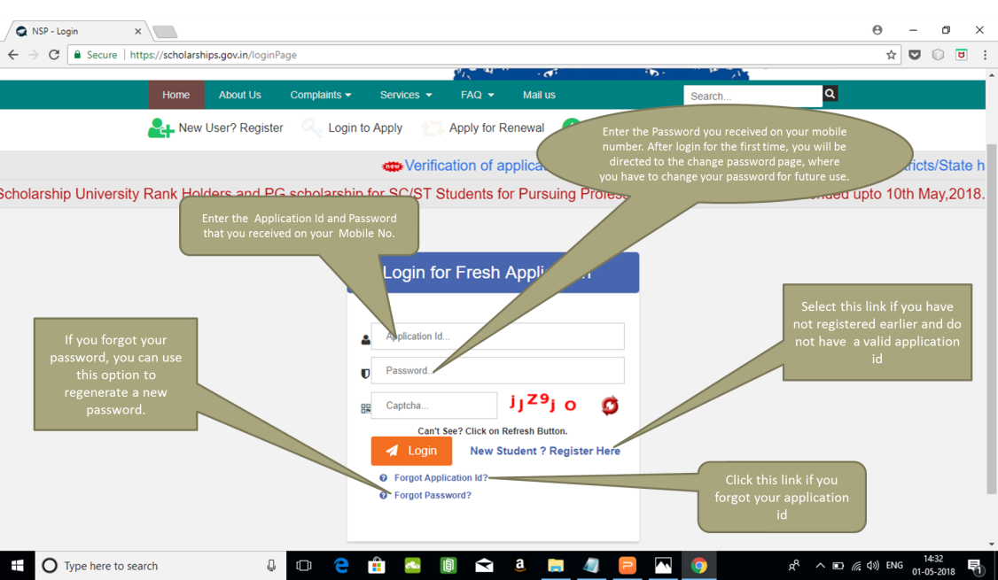
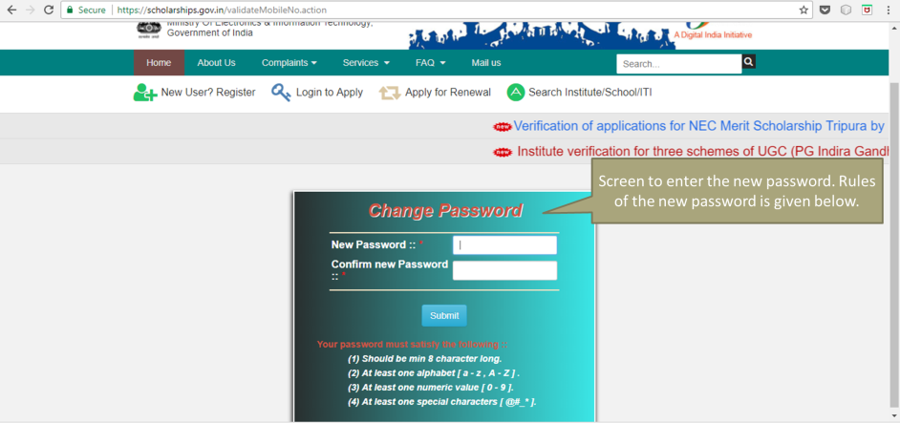
Logging into the National Scholarship Portal
After successfully completing the registration process, log into the Portal using your Application ID and Password that is shared through SMS.

Slide 8
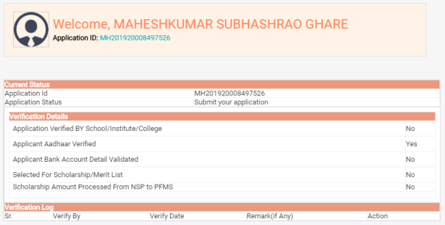
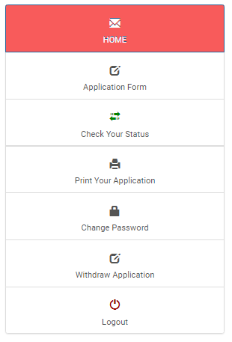
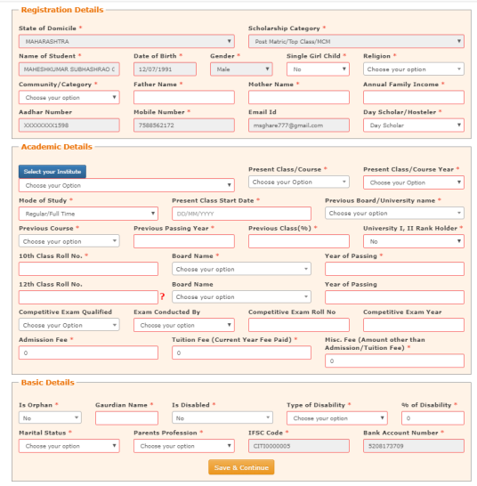
Filling the National Scholarship Portal Application Form
It displays your application status and verification details
Fill in your present as well as previous academic details as well as basic details.

Slide 9
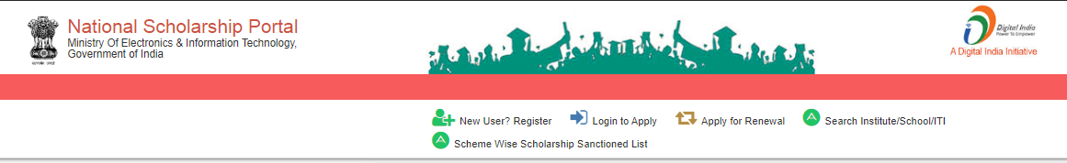
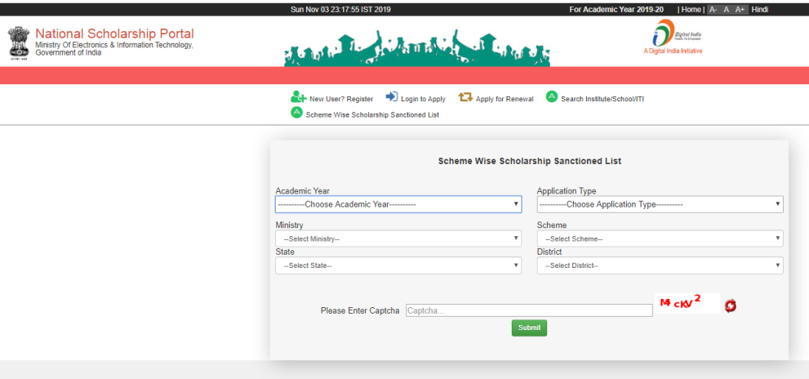
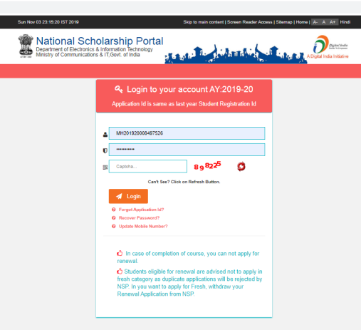
Other Services

Slide 10
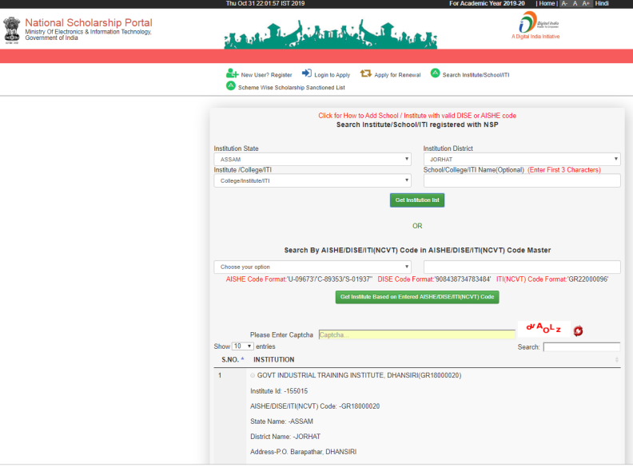
Other Services
To Search institutes/school/ITI registered with NSP

Slide 11
Advantages Of NSP
Simplified process for students
All scholarships information is made available under a common umbrella.
Single integrated application for all scholarships
Improved Transparency
The system suggests the schemes for which a student is eligible.
Duplication is reduced to a great extent.
Helps in Standardization
Master data for institutions and courses at pan India level.
Processing of scholarships.
NSP serves as a decision support system (DSS) for various Ministries & Departments as updated information is available on demand.
Comprehensive MIS system to facilitate monitoring every stage of scholarships disbursal i.e. from the student registration to the delivery of funds.

Slide 12
Thank You

