Slide 1
Check My Land Records in Government Records
Gaurav bhalagatiya
Tahasildar

Slide 2
What is Land Records?
"Land Records" itself is a generic expression and can include records such as, the register of lands, Records of Rights (RoRs), tenancy and crop inspection register, mutation register, disputed cases register, etc. It can also include geological information regarding the shape, size, soil-type of the land; and economic information related to irrigation and crops

Slide 3
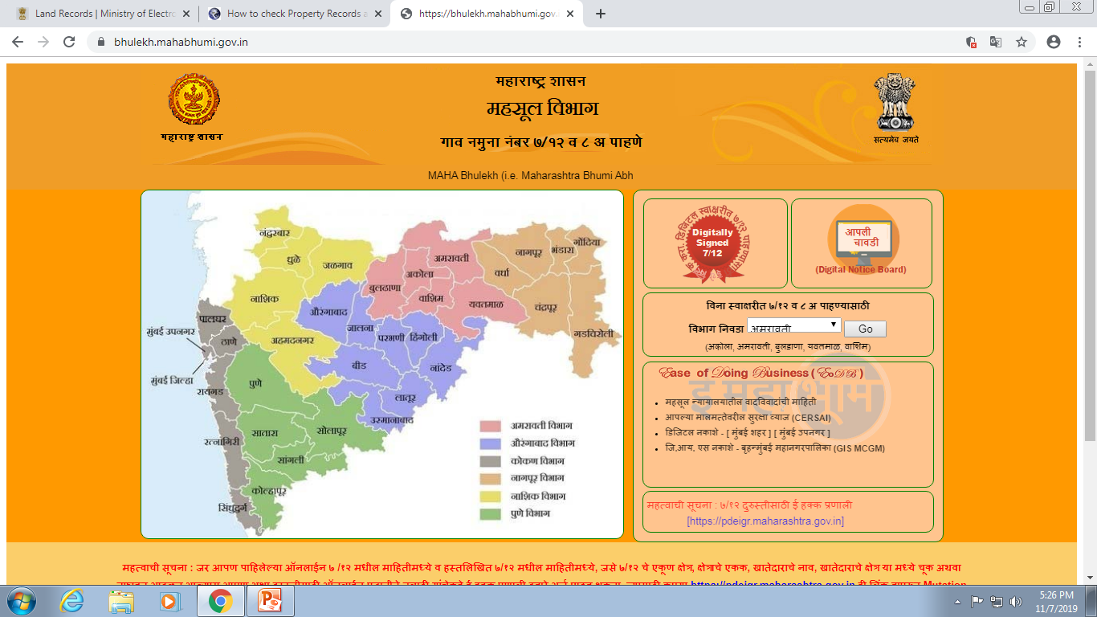
How to check land records?
Step1:Visit official land record site of Maharashtra bhulekh.mahabhumi.gov.in

Slide 4
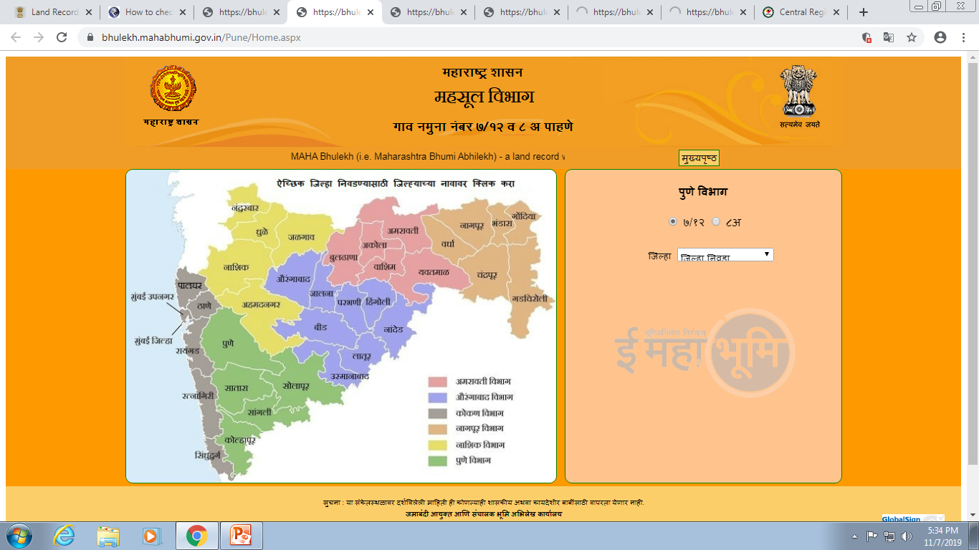
Step2
You need to select a division

Slide 5
Step 3
You need to select a district , taluka and village

Slide 6
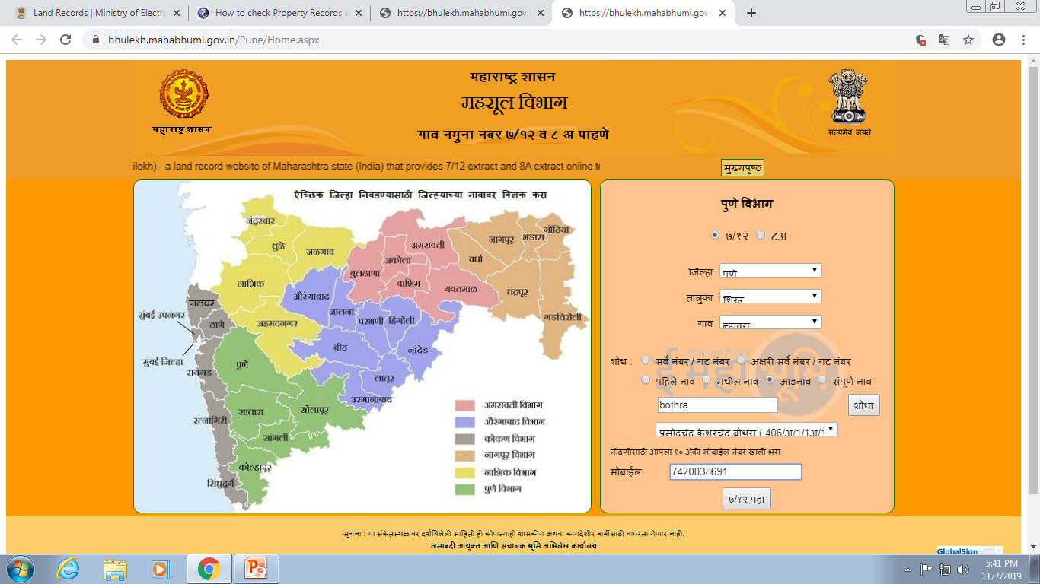
Step 4
Now you can search 7/12 record of land by entering survey number or by entering a name.

