Slide 1
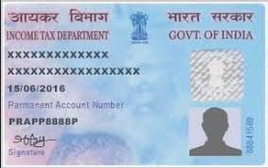
Online Pan Card Application
Nitin B.Ganapure
Prob. Assistant Commissioner of police
Roll Number = B-5, CPTP 5 , Class - B

Slide 2
What is Pan?
The Permanent Account Number (PAN) card, issued by the Income tax Department.
The card was issued in order to prevent tax evasion by individuals and entities as it links all financial transactions made by a particular individual or entity.
PAN, or permanent account number, is a unique 10-digit alphanumeric identity allotted to each taxpayer by the Income Tax Department under the supervision of the Central Board of Direct Taxes. It also serves as an identity proof

Slide 3
Who can apply for Pan?
All persons who are required to file a return of income, even on be half of others, must have a PAN.
Any person, who intends to enter into economic or financial transactions where quoting PAN is mandatory, must also have a PAN.
Section 160 of IT Act, 1961 provides that Details of representative assesses have to be provided in item 14 of the application for PAN

Slide 4
Steps to apply for PAN Card online:
Step 1: Go to the official website of NSDL i.e. www.onlineservices.nsdl.com.
Step 2: A page will open, under Application Type select New Pan- Indian Citizen (Form 49A).
Step 3: Select the category of PAN card you need.
Step 4: Fill in your personal details like name, date of birth, mobile number, etc
Step 5: Enter the captcha code and click submit Step.

Slide 5
Step 7: After clicking the submit button, a token number will be generated. You will be required to click on the link to continue with your PAN application
Step 7: A new page will appear and it will show you three options: 1. Submit digitally through e-KYC and e- Sign (paperless) 2. Submit scanned image through e-Sign 3. Forward application documents physically.
Step 8: The most common and preferred is scanned image through e-sign
Step 9: After selecting the option, enter your details such as Adhaar Card number, parents name, etc. click next

Slide 6
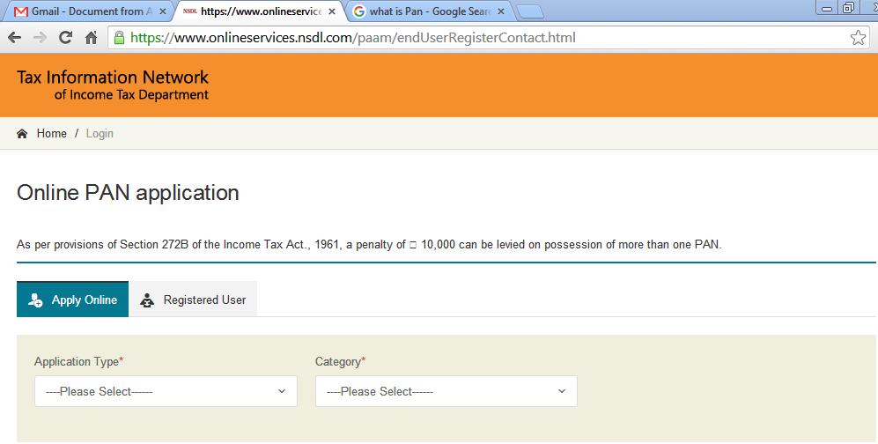
Step - 1
Step – 2

Slide 7
Step – 3

Slide 9
Personal Details

Slide 10
Step 10: This step requires you to fill in your name, date of birth, address etc. After filling all the details click Next.
Step 11: In the next step, you will be required to enter your area code, AO (assessing officer) type, range code, and AO number Click next.
Step 12: Select the documents you have submitted as proof of age and residence from the drop-down menu, fill in the required detail and then click submit.
Step 13: Once your documents are uploaded you will be directed to the payment page, you can choose one of the many online payment methods. The fee for PAN card application if Rs. 115.

Slide 11
Contact and Other Details

Slide 12
AO Code

Slide 13
Document Details

Slide 14
Declaration

Slide 15
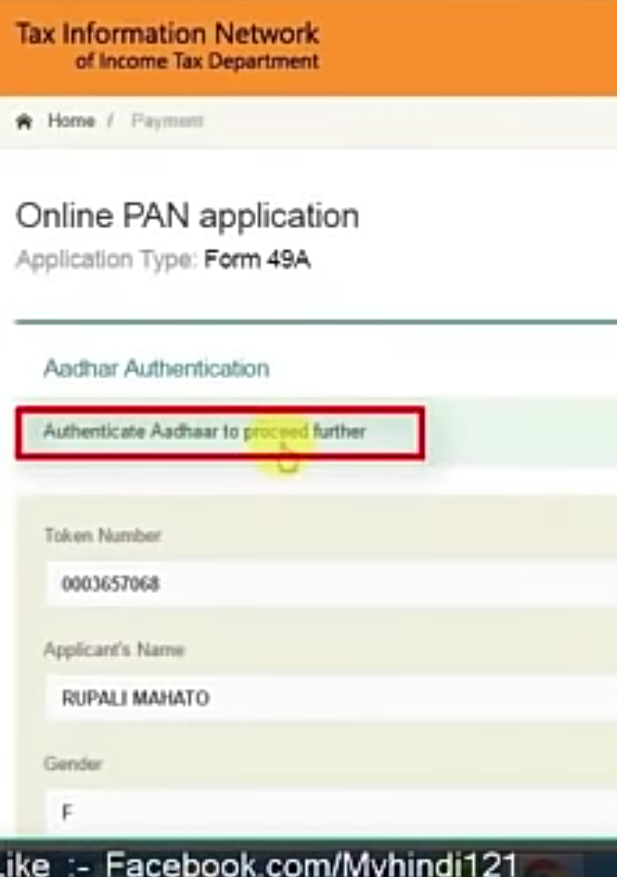
Adhar Authentication
Mode of payment Selection

Slide 16
Step 14: Once you have made the payment, you will be required to go through the Aadhaar authentication process, or submit documents via e-sign or to physically send the documents to NSDL. You will also receive an email acknowledgment from NSDL about your application.
Step 15: Your Pan Card will be couriered to you once the application has been processed. Keep the acknowledgment number with you.

Slide 17
OTP Verification

Slide 18
Final Submitted Form

