Slide 1

Video conferencing to save time and resources
presented by Vikas Laxman Gambare
Assistant commissioner of Sales tax

Slide 2
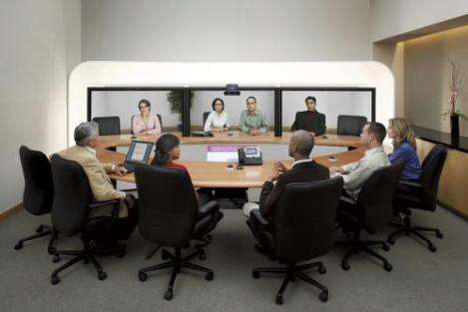
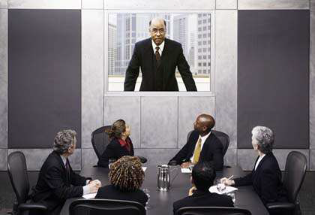
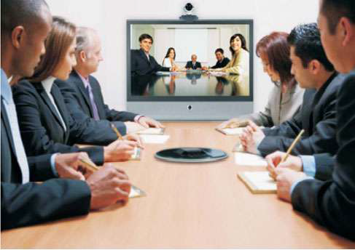
WHAT IS VIDEO CONFERENCING?
‘A video conference is a live, visual connection between two or more people residing in separate locations for the purpose of communication. ’

Slide 3
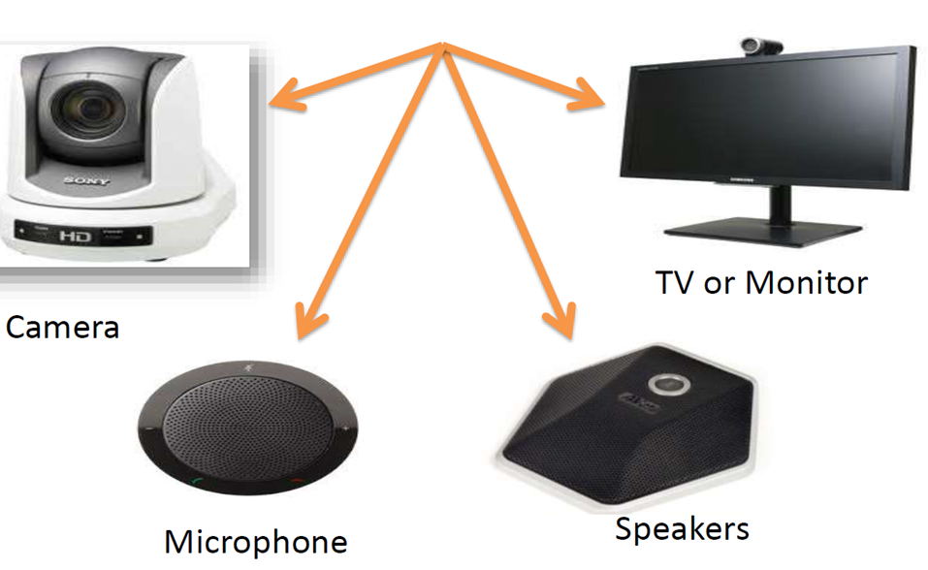
COMPONENTS OF A VIDEO CONFERENCING

Slide 4
HOW IT SAVES TIME AND RESOURCES
Can improve work quality
Reduce costs
Improves communication
Groups can meet more frequently
Critical meetings can be conducted in less time
More faculty and staff can be involved

Slide 5
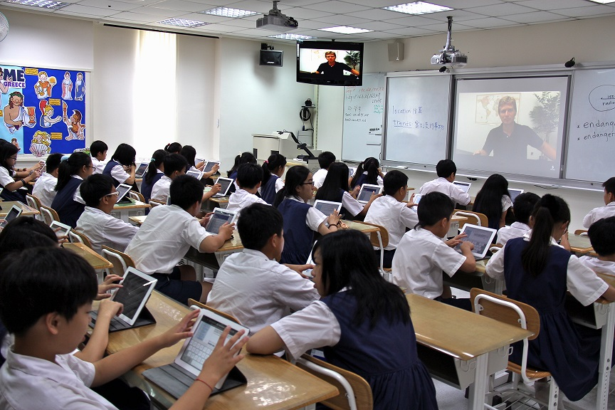
EXAMPLES OF VIDEO CONFERENCING
e-LEARNING

Slide 6
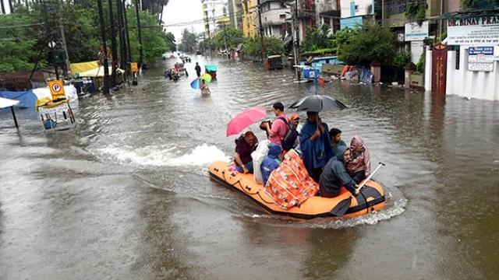
EXAMPLES OF VIDEO CONFERENCING
IN DISASTER

Slide 7
EXAMPLES OF VIDEO CONFERENCING
medicine and health

Slide 8
Other Usage OF VIDEO CONFERENCING
Use in sign language communications
on media relations
on business

Slide 9
LIMITATIONS
Initial cost of the equipment is high.
Availability of high speed internet is must.
Digital literacy is must.
Physical touch is not available.
Monitoring is not easy.

Slide 10
STILL IT IS EMERGING TOOL FOR BETTER WORLD …

Slide 11


