Slide 1
Topic: How to Scan images Using CamScanner App
Name: Pooja Tanaji Gaikwad Designation: Deputy Collector Batch: CPTP 6 Class: A Roll No: A11

Slide 2
What is CamScanner?
CamScanner is a mobile App.
Allows IOS and Android devices to be used as image scanners.
Basically you can scan any document using this device.

Slide 4
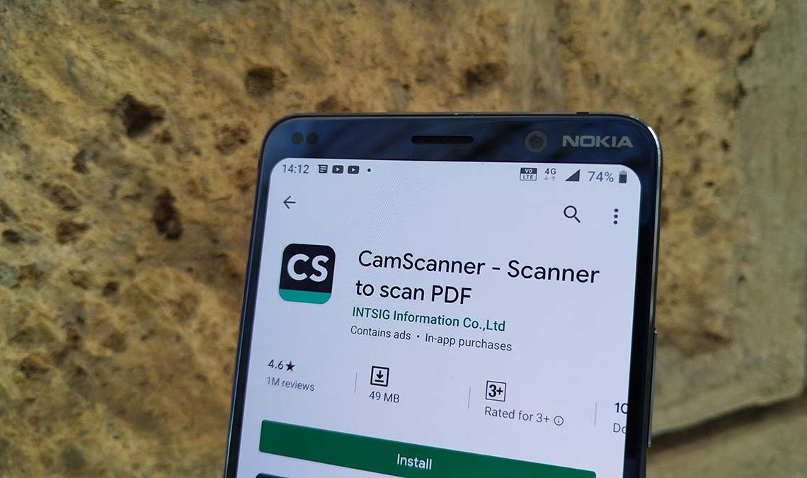

Slide 5
Is Cam Scanner Free
Cam Scanner has 3 subscription
Basic – this is free of cost
Premium- $4.99/per month
Bussiness- $9.99/per month
Mostly basic is used mostly free of cost by many users.

Slide 6
How to use CamScan
Step
Snap a picture which you need to scan using mobile camera from the App

Slide 7
How to use CamScan
Step 2
Adjsut the corner/outlines of the images clicked to scan

Slide 8
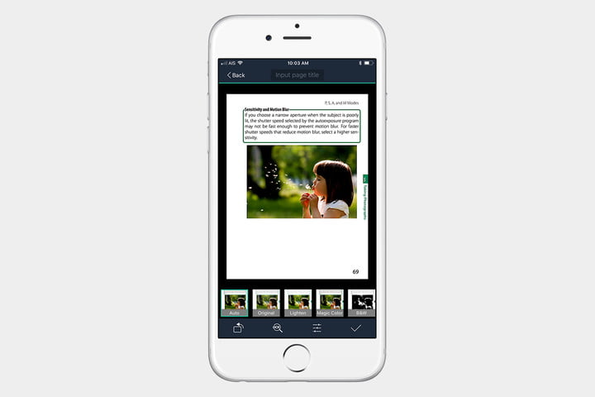
How to use CamScan
Step 3
Select the font to give better effect to the image.
Font includes Original, Lighten, Magic Colour, Gray Mode B&W

Slide 9
How to use CamScan
Step 4
Save the image and Share.

Slide 10
Benfits of CamScanner
Cost effective
Time Saving
Easy to Use
Used Worldwide

