Slide 1
USE BHIM APPLICATION
PRESENTED BY:
RAVI JAYANT ITEWAD.
ASSISTANT COMMISSIONER OF STATE TAX.
CPTP 5.
CLASS A.

Slide 2
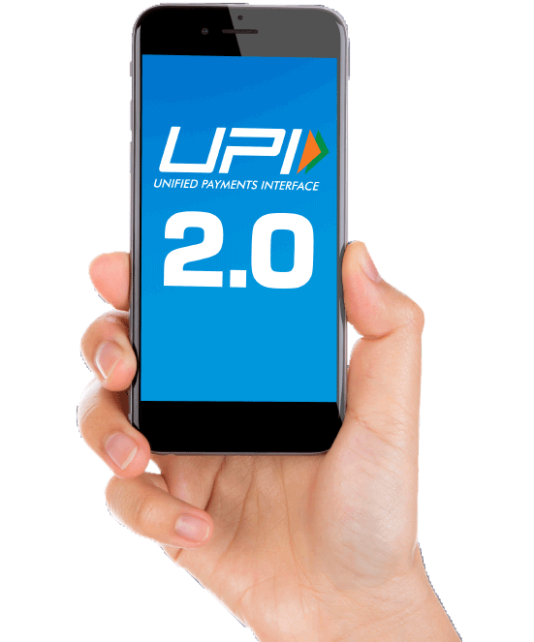
What is BHIM app ?
Bharat Interface for Money(BHIM).
A mobile payment application developed by National Payments Corporation of India(NPCI),based on Unified Payments Interface(UPI).
It will allow to send or request money for making digital payments.
Drive towards cashless transactions.

Slide 3
Features of BHIM app
Send or request money : Send money by entering Virtual Payment Address (UPI ID), Account number and QR Scan.
Scan & Pay: Pay by scanning the QR code through Scan & Pay or generate your QR code to let others make easy payments to you.
Transactions: Check your transaction history and also pending UPI collect requests (if any) You can raise complaint for the declined transactions by clicking on report issue in transactions.

Slide 4
Bill payments: Bills such as Electricity ,Gas , mobile recharge , broadband and landline postpaid can be paid .
Language: Currently BHIM is available in 13 languages, i.e., Hindi, English, Tamil, Telugu, Malayalam, Bengali, Odia , Kannada, Gujarati, Marathi, Assamese and Bengali.

Slide 5
Steps to use BHIM app
Step 1: Download and Install BHIM app from Google Play store/Apple App Store.
Step 2: Select your preferred language.
Step 3: Select SIM card which has the mobile number registered with your respective bank.
Step 4: Set the application passcode required to enter the app.
Step 5: Link your bank accounts using bank account option.

Slide 6
Step 6: Set your UPI PIN by providing last 6 digits of debit card and expiry date of debit card.
Step 7: Click on send and enter UPI ID or Aadhaar number. You can also Scan & Pay the QR of the person to whom you want to send money.
Step 8: Enter the UPI Pin you set earlier to authenticate the transaction.
Step 9: Check transaction history to see the status of the transaction.

Slide 7
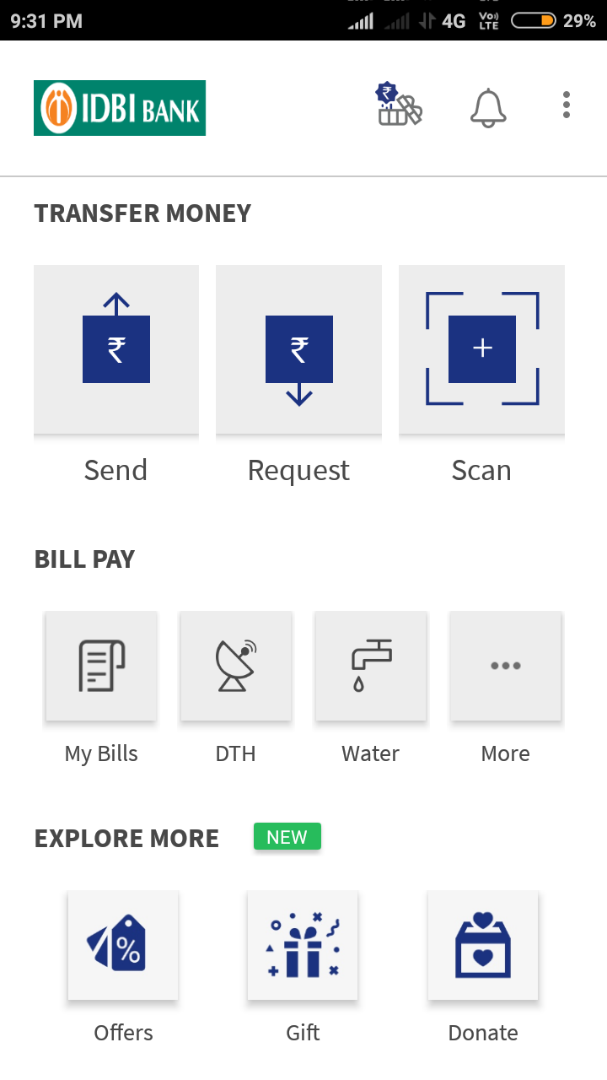
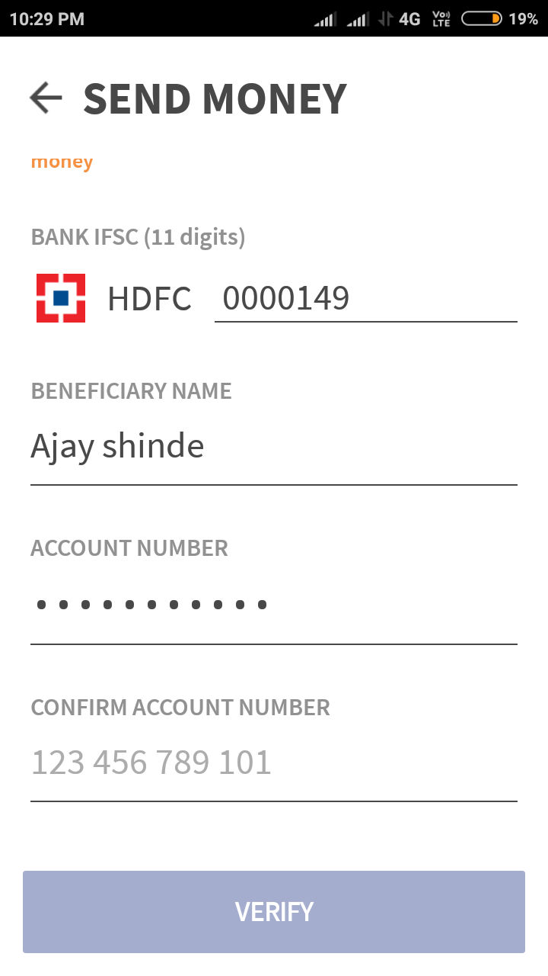

Slide 8
