Slide 1
Importance of ideal posture while using computer
-Mr.Pramod Laxman Duke
Cadre-A.C.S.T
Roll No.- D11

Slide 2
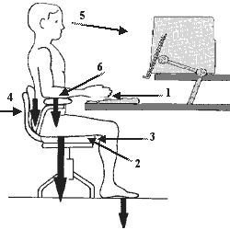
How to seat on computers?
Seat height
Feet flat on floor
Thighs comfortable on the seat pan
Backrest
Adjust the backrest angle 90° - 110° for most work actions
Lumbar Support
Feel for the deepest part of the low back curve
Adjust the height of the lumbar support to match the deepest part of the curve
Adjust the lumbar support tension for comfort

Slide 3
Importance of ideal posture while using computer

Slide 4
Importance of ideal posture while using computer
Office Chair
Familiarise yourself with your chair adjustments
Seat height adjustments
Back height
Lumbar adjustment
Seat tilt adjustment
Arms are not recommended for computer based tasks
How the chair should be?

Slide 5
Importance of ideal posture while using computer
Seat pan adjustment
MUST ALWAYS place backside as far back into the chair as possible and adjust position from there
Thighs comfortable on the seat pan
Tilt is best adjusted forward (front down) for concentrated work at the desk as it brings you close into the workspace
Seat tilted back (seat front upwards) may be used for conversation / non workstation tasks

Slide 6
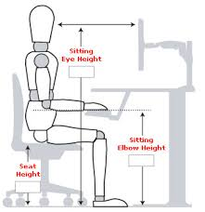
Importance of ideal posture while using computer
Office Chair and the Desk
Move into the desk; Re-adjust your seat height to ensure that the elbows are just slightly lower than the wrists and the shoulders feel comfortable (keyboarding)
The feet should sit comfortably on the floor; if your feet are not able to take some weight on the floor, then a footrest may be required
Remove all under desk clutter – there should be no obstructions to allow free movement of feet and legs

Slide 7
Benefits of correct posture
It helps to reduce any back and neck problems.
Sitting in incorrect positions leads to constricted blood vessels and joints. This can further trigger headaches. Correct posture eliminates all such problems.
Correct posture means you do not have additional pressure on other body parts.
It reduces the fatigue and helps to keep you fit and fine

Slide 8
Thank you

