Slide 1
Yogesh prabhakar Dhongade (Prob. Asst. Director Finance & Account Service) Batch A Roll no. 36 Apply For

Slide 2
Launch Date 9 may 2015 Life Insurance Scheme No Investment Component Promotes Financial Inclusion

Slide 3
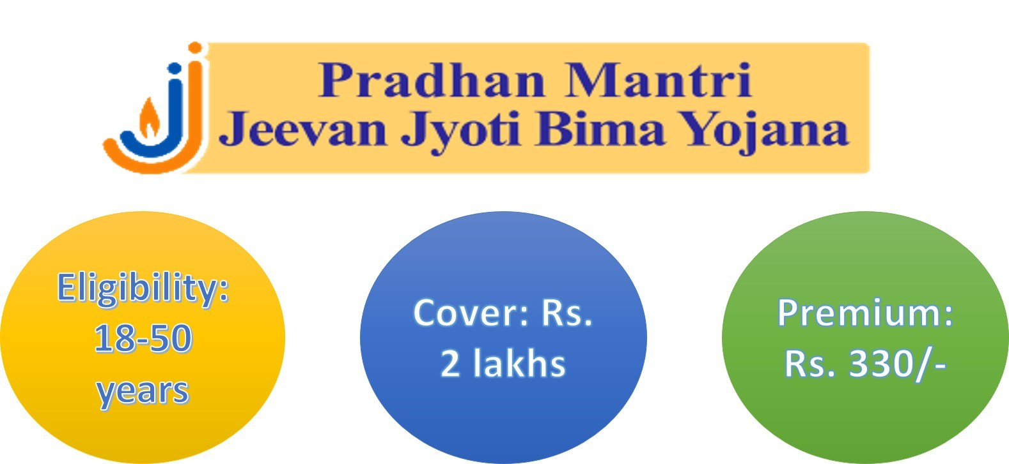

Slide 4
* To Provide 1 year life insurance Scheme.
* Premium to Insurance co. 289/- per annum
* Rs.30/- bank charges.
* Rs.11/- administrative Expenses
* Risk cover after the first 45 days

Slide 5
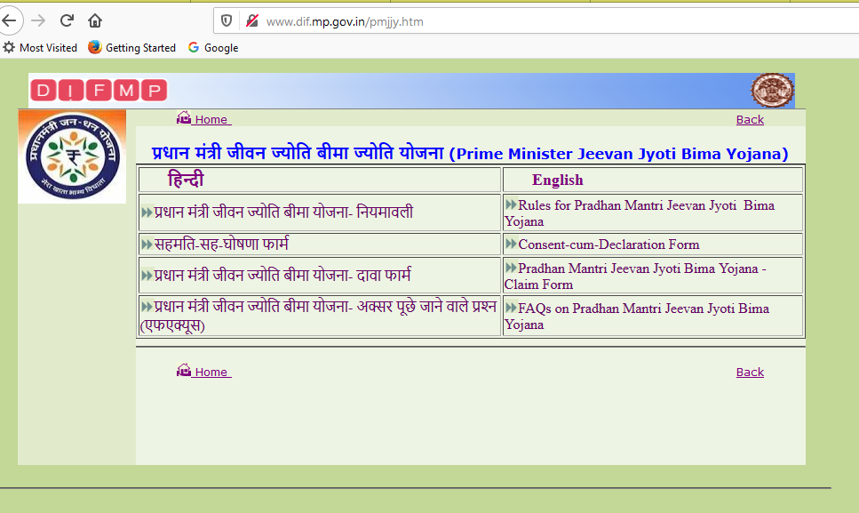
http://www.dif.mp.gov.in/pmjjy.htm

Slide 6
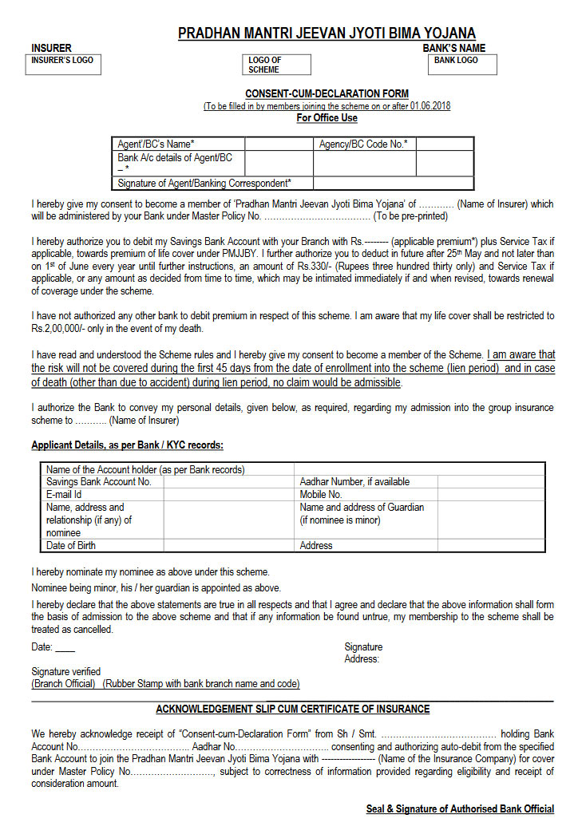
http://www.dif.mp.gov.in/pmjjy.htm

Slide 7
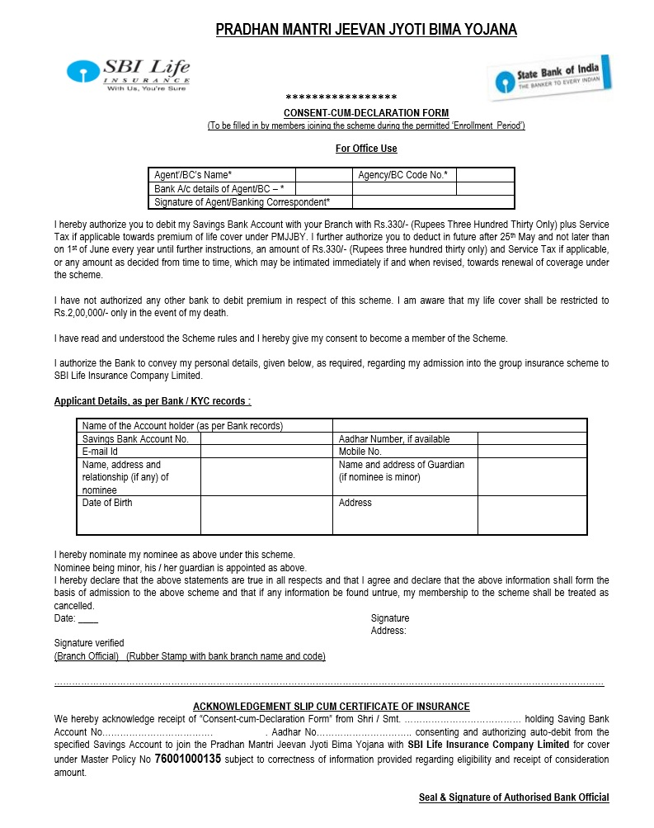
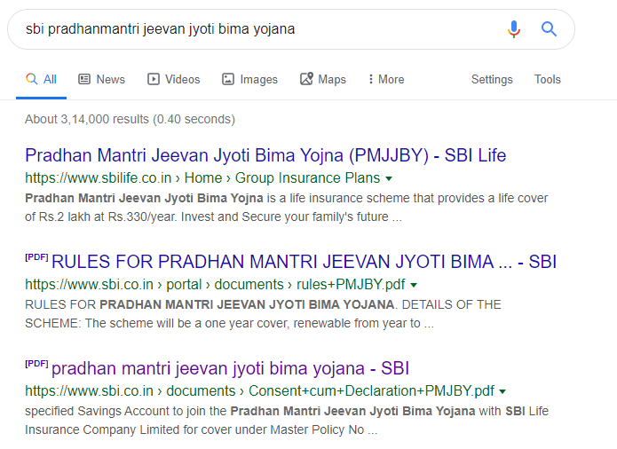

Slide 8
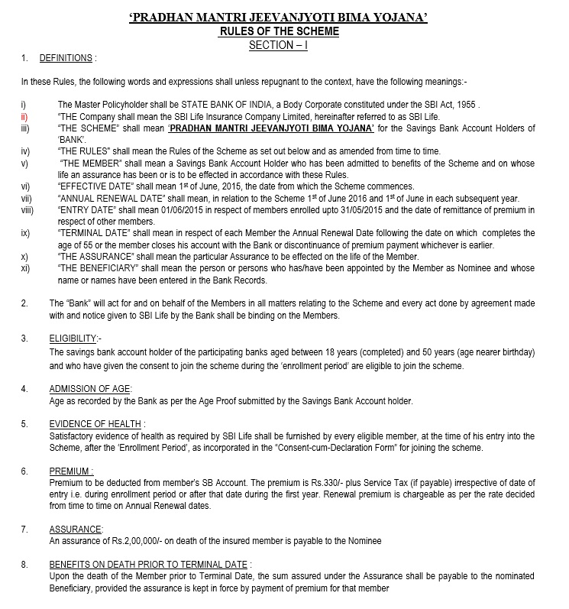

Slide 9
बिमा योजना के साथ स्वस्थ और मस्त राहिये
Thank You
Yogesh Prabhakar Dhongade
(MFAS)

