Slide 1
The legal consequences of displaying and distributing pirated music/videos
By: Dikshant Deshpande
Tahsildar-2018
Batch B

Slide 2

What is piracy ?
The unauthorised use or reproduction of copyrighted or parented materials.

Slide 3
Disadvantages of Piracy
Loss of profit
Piracy Demotivates stakeholders
Free file-sharing sites often transmit viruses and ad-ware
Quality degradation
Something that is very easily available is usually of a lesser value

Slide 4
Protection from piracy
Copyright act 1957
Cinematograph act 1952
Intellectual Property Rights

Slide 5
Rights under copyright law
Copyright is the soul of film audio visual recording literature in book forms an computer software industry
The author of a copyrighted work enjoys the following exclusive economic rights:
Right to reproduce
Right to publish
To adapt and translate
To perform in public
To assign the copyright to another party

Slide 6
Legal consequences under copyright act
Under the Indian Copyright Act 1957.
with fines ranging upto Rs 3 lacs.
punishment upto 3 years imprisonment.

Slide 7
Legal consequences under IT act
Amendment to IT Act section 69A where onus on blocking pirated sites are on the ISP’s and working alongside international forums like ICANN

Slide 8
Cinematograph act and IPR
Amendment to the Cinematograph Act, 1952
Penal provisions of a three-year jail term OR Rs 10 lakh fine OR both.

Slide 9
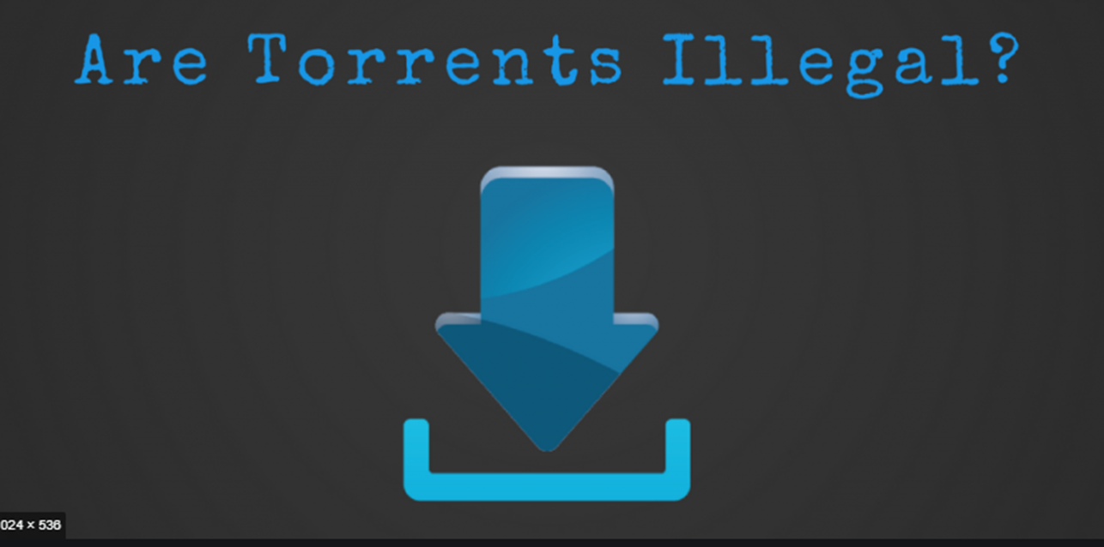

Slide 10


