Slide 1
IT SKILL ASSIGNMENT
NAME : OMKAR BALASAHEB DESHMUKH
CADRE : Deputy Collector (Probationary)
SUBJECT : Personalizing Desktop, Changing the Desktop Background, Applying a Screen Saver, Applying Themes.

Slide 2
DESKTOP PERSONALIZATION
Meaning :any adjustment to the user interface that deviates from the default installation settings may be considered to be a personalization.
Purpose :To improve personal comfort, enhace visual behaviour and individual choice.
Involves Desktop backgrounds ,windows color-scheme, screen-saver and sound.

Slide 3
How to access personalize option ?
Right click anywhere on Desktop.
Select Personalize option from given list
Opening of window will displays option like Desktop Background,Color,sound & screen saver

Slide 5
Selecting Desktop background
Click on Desktop Background option at bottom
It will display various pictures available.
Click on Desktop background one like
Option to rotate desktop background at specific time limit.
One can also download pictures from internet and using browse option can select the same
Click on save changes option.

Slide 6
Screen-Saver
computer program that blanks the screen or fills it with moving images or patterns when the computer is not in use.
Original-To prevent phosphor burn-in on CRT and plasma computer monitors (hence the name).
Basic layer of security.
Processing for distributed computing projects.
Selection different screen-saver and timimg when screen-saver is applied.

Slide 7
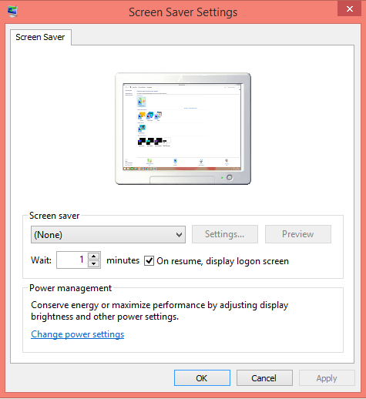

Slide 8
Applying Themes.
Right click the Start menu and select Settings.
Choose Personalization from the Windows Settings menu
Click on themes options to select it.
One can also select themes from online store of Windows .

Slide 9


