Slide 1
Wel- come
NAME :- Darekar Sangita Prakash
Cadre:- Assistant Commissioner
Of Sales Tax
Class :- A

Slide 2
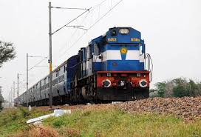
Book Train Tickets Online

Slide 3
Benefits Of Online
Booking
Provide convenience to travellers.
Increases security, speed and accuracy.
Results are received very quickly.
Customer services can not only be satisfied but also enhanced to the extent that one can obtain or cancel a reservation from anywhere.

Slide 4

Simple Steps For Online
Railway Ticket Booking
Step 1: Visit the IRCTC e-ticketing website: www.irctc.co.in.
Step 2: Login to the IRCTC website by using user id, password.
Step 3: You can either login with OTP facility or by entering the
captcha code. If opting the OTP facility, enter the One
Time Password (OTP) sent on the registered mobile number to log in.

Slide 5
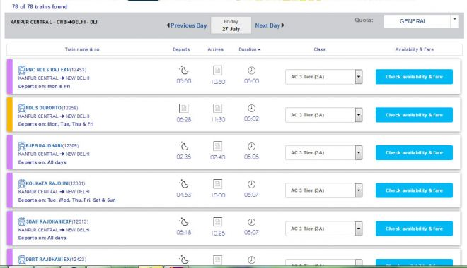
Step 4: Fill the railway stations between which you wish to
travel, ‘source station’ and ‘destination station’ on the ‘Book Your
Ticket’ on the homepage of the IRCTC website.
Step 5: Enter the date of journey and class of travel.
Step 6: Click on ‘Find Trains’.
Step 7: The list of trains available on the selected route will be shown.

Slide 6
Step 8: Click on ‘check availability and fare’ to check the seat
availability and fare of the selected class, sleeper class,
3 tier, 2 tier, 1 AC, Chair Car, Executive Car, etc.
Step 9: Select the train with which you want to travel,
subject to the availability of the train tickets, and click on ‘Book Now’.
Step 10: Confirm train ticket booking by clicking on ‘Ok’ on
the new dialogue box.

Slide 7
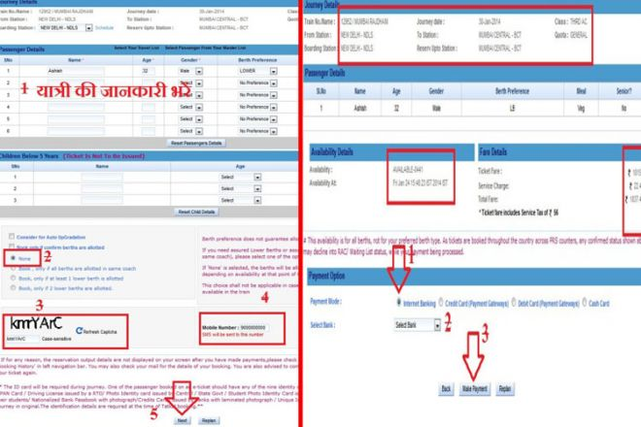
Step 11: Enter passenger details such as name, age, gender,
food choice, seat preference, mobile number, preferred coach id (if any).
Enter the details of the child, if travelling with children below
5 years of age.

Slide 8
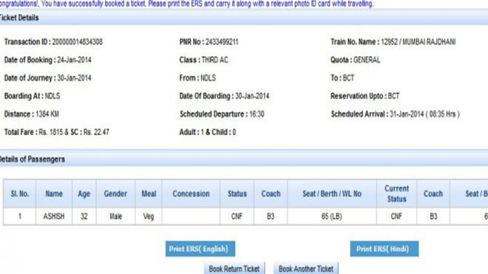
Step 12: Enter the verification code and click on ‘Continue Booking’.
Step 13: Click on ‘Continue Booking’ again on the review booking page.
Step 14: Select the payment method from the options available such
as credit card, debit card, net banking, mobile wallet and pay the
required amount on payment window.

Slide 9


