Slide 1
Put my important files on CD or DVD
Supriya Maroti Dange
(Deputy collector)
Class: A

Slide 2
What is CD/DVD:
Compact Disc/Digital Versatile Disc.
It is a portable storage medium that can be used to record, store and play back audio, video and other data in digital form.
Storage capacity of CD is 700Mb but the DVD can store 7 times more data than CD i.e. 4.7Gb.

Slide 3
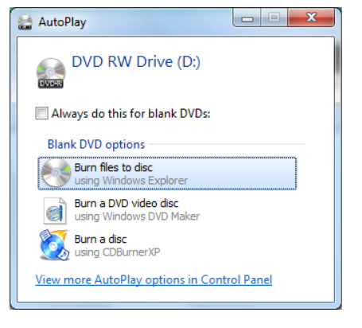
Step 1: Insert a disc :
➔ Select ‘Burn files to disc’ option from an AutoPlay window which appears after you insert a disc.

Slide 4
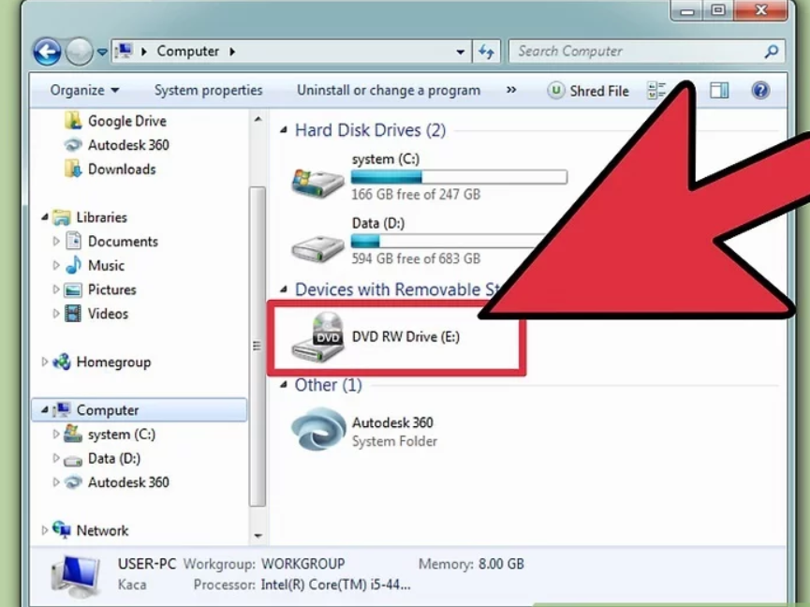
Step 2: Open DVD RW drive
Go to my computer.
Open DVD RW drive.

Slide 5
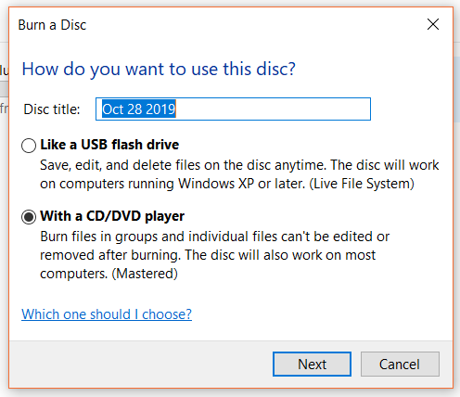
Step 3: Give the disc a name :
This can help you identify what's on this disc later.
By default name is current date.

Slide 6
Step 4: Choose your format
➔Like a USB flash drive:
It allows you to add, edit
and delete files on the disc
➔With a CD/DVD player:
Once file added to the disc,
it can’t be changed.

Slide 7
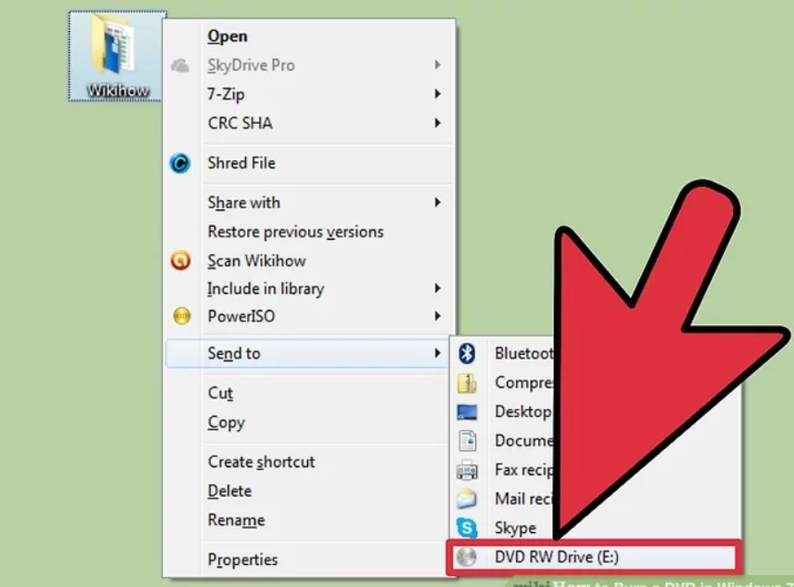
Step 5: Add files to the disc:
Once you've selected your disc format, you can start adding files to the disc.
Right-click on a file or folder and select "Send to" and then your disc drive.
  OR
Click and drag files into the blank DVD's window.

Slide 8
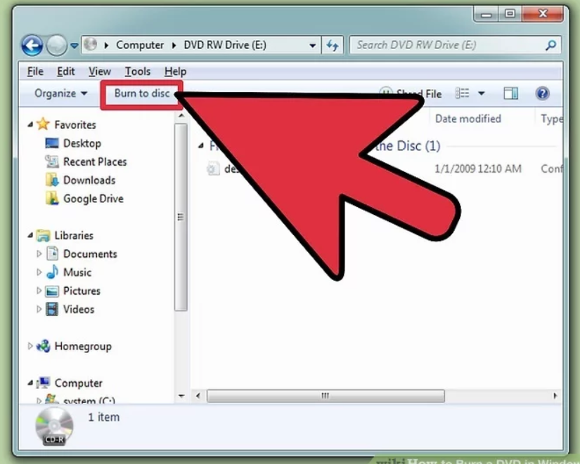
Step 6: Finish the disc.
When you're done adding files to your disc, you can finish the process by burning the disc.

Slide 9
Step 7 :
Once disc is burned, it cannot be modified later i.e. we cannot add any file or edit any file in the disc.
When burning gets completed then the disc is ready to use.
Remove the disc.

Slide 10
THANK YOU…

