Slide 2
USE GOOGLE DRIVE
TO STORE
MY IMPORTANT FILES
Presented By:- Miss. Swati Kisan Dabhade
Designation:- Deputy Collector
Class:- B
Roll No:- B02

Slide 3
INTRODUCTION
WHAT IS IT?
GOOGLE DRIVE is a file storage and sychronization service developed by Google launched on April 24,2012. it is a cloud storage service which allows users to store files on their servers, synchronize files across devices, and share files. A basic Google Drive account is free and gives you 15GB of storage.

Slide 4
HOW TO SAVE FILES ON GOOGLE DRIVE?
STEPS
Open Gmail Account
Google Apps
Drive
New/My Drive
Upload Files
Select File
File Saved

Slide 5
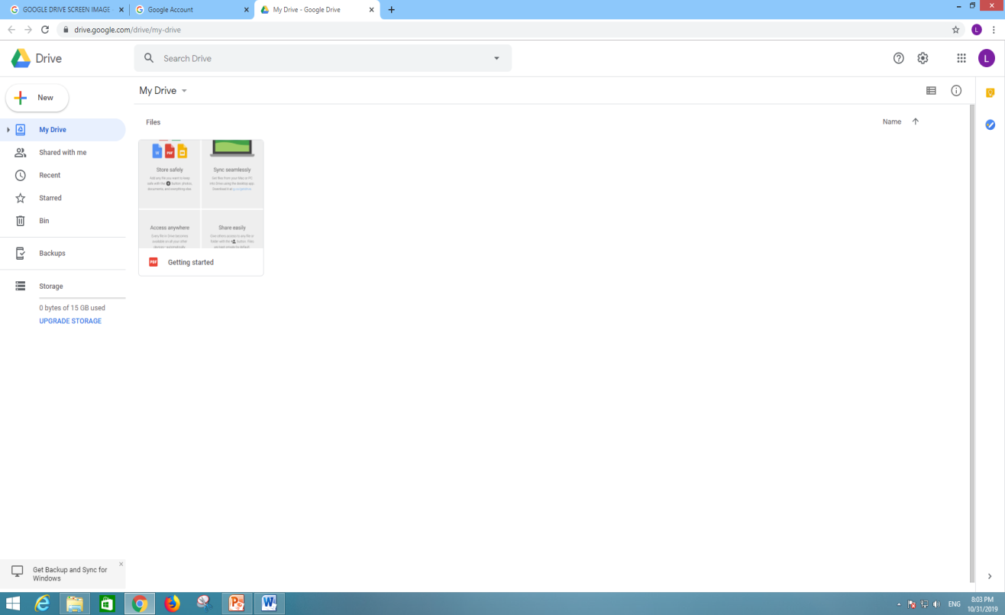
Drive

Slide 6
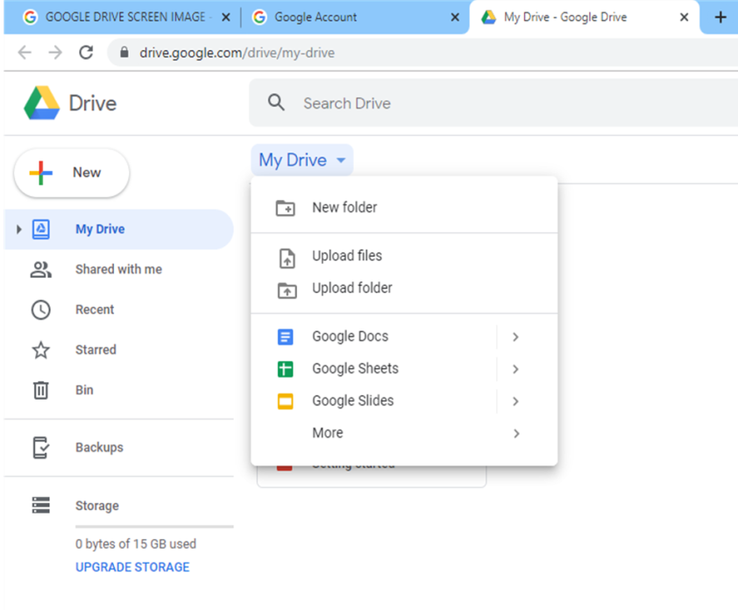
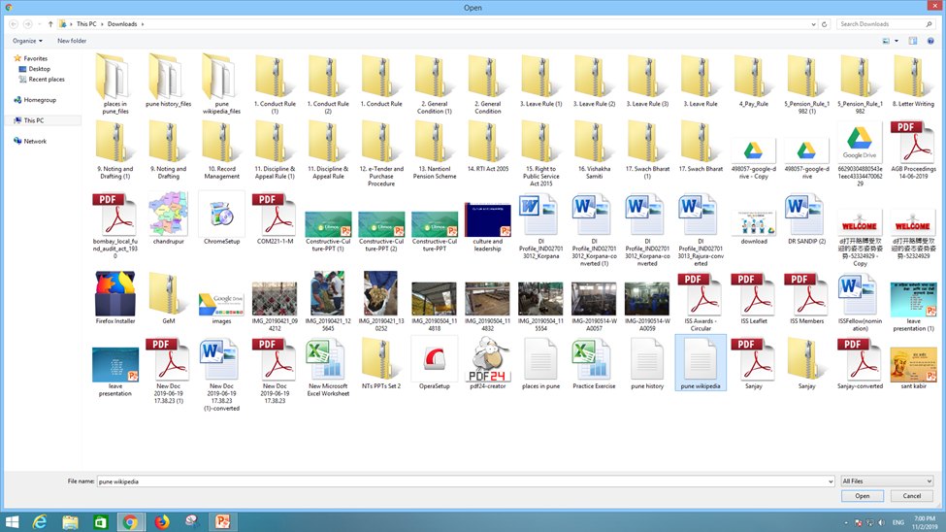
FOR SAVING FILES ON GOOGLE DRIVE,
CLICK ON NEW/MY DRIVE
SELECT UPLOAD FILES OPTION
CHOOSE FILE AND CLICK ON OPEN.

Slide 7
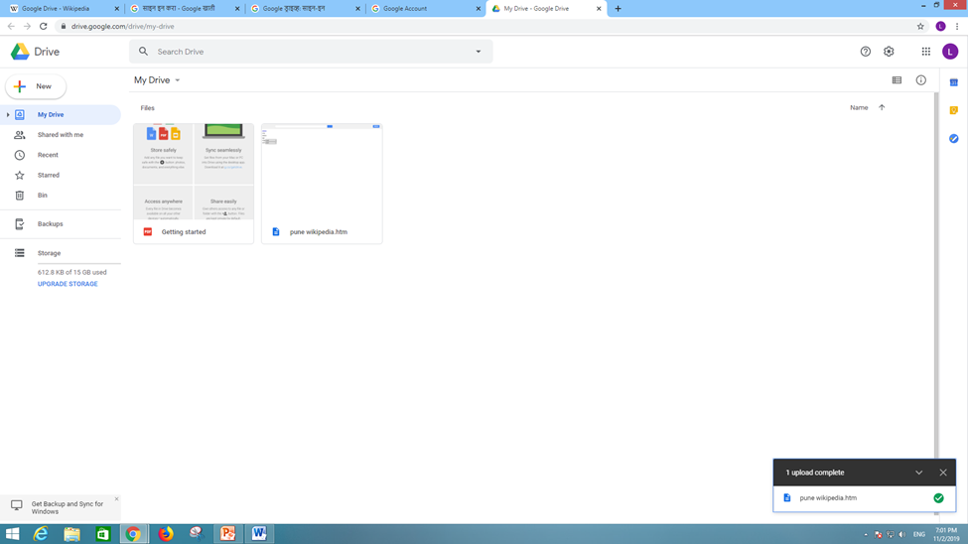
YOUR FILE IS UPLOADED

Slide 8
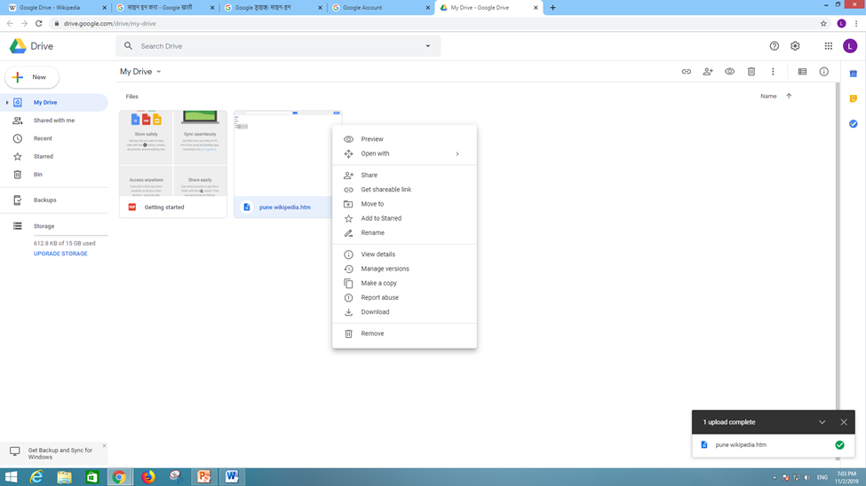
SHARE, RENAME AMD MANY MORE……

Slide 9
Backup Your Precious Files
Access your files everywhere
You can edit and make changes to the files
Able to access with various devices
Easy to search your files
View any types of file
Share your files with your friends
15GB Disk Space and It’s FREE!

Slide 10
HOW TO USE GOOGLE DRIVE MORE SAFELY
SECURE YOUR CONNECTION
PROTECT YOUR PASSWORD
SHARE WISELY
LOG OUT YOUR ACCOUNT WHENEVER NECESSARY

