Slide 1
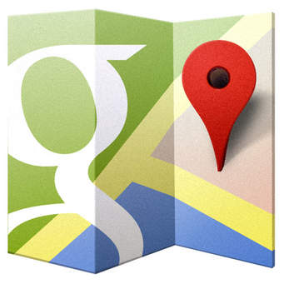
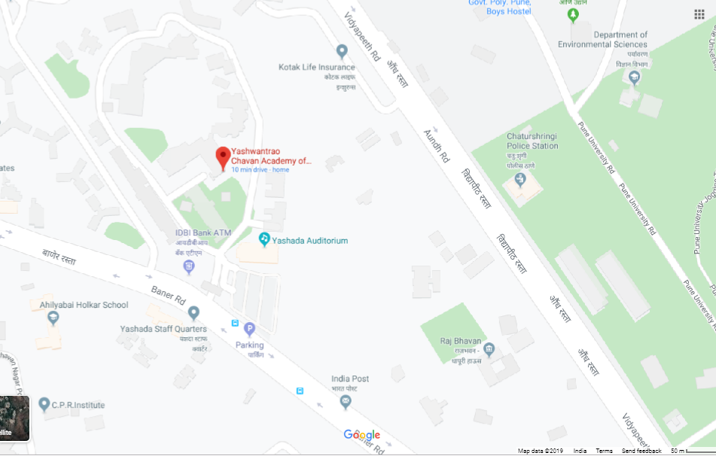
USE OF GOOGLE MAPS
Name - Rahul Ramesh Chaure
Cadre- ACST
Class – A
Roll.No- 39

Slide 2
WHAT IS GOOGLE MAPS ?
launched in 2005
web mapping service and technology supported by Google that can be used on desktop computers and smart phones
provide various map information including satellite images, street view, weather, traffic, business locations and more
Google Maps' satellite view is a "top-down" or "birds eye" view; most of the high-resolution imagery of cities is aerial photography

Slide 3
History
Google Maps first started as a C++ program designed by two Danish brothers, Lars and Jens Eilstrup Rasmussen, at the Sydney-based company Where 2 Technologies
It was first designed to be separately downloaded by users, but the company later pitched the idea for a purely Web-based product to Google management, changing the method of distribution.[
In October 2004, the company was acquired by Google Inc. where it transformed into the web application Google Maps
n September 2004, Google acquired ZipDash, a company that provided realtime traffic analysis

Slide 4
How to use google maps
On your Android phone or tablet, open the Google Maps app
Search for a place or tap it on the map.In the bottom right, tap Directions. If you touch and hold the button instead, you’ll start navigation and can skip steps 4-6
To add additional destinations, go to the top right and tap More. Add STOP You can add up to 9 stops. When you are finished, tap Done.
Choose one of the following :
Driving, Transit Walking , Rides, Cycling
If other routes are available, they will be shown in gray on the map. To follow an alternate route, tap the gray line . To start navigation, tap Start . If you see “Searching for GPS,” your phone is trying to get a GPS signal. For example, you might be in or near a tunnel, parking garage, or other location where there’s no GPS signal.
To stop or cancel navigation, go to the bottom left and tap Close

Slide 5
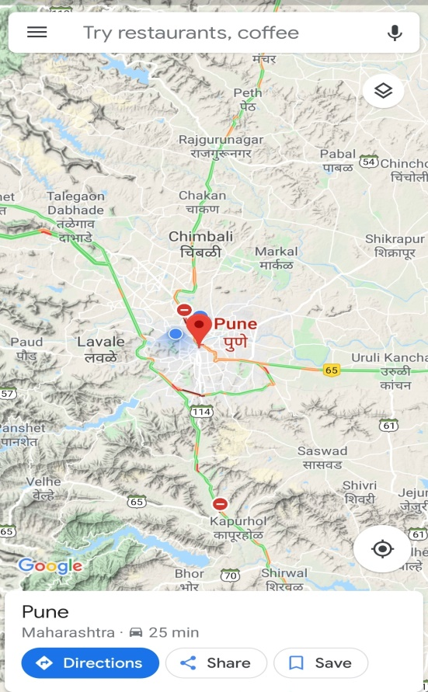
USE IN A MOBILE
STEP 2 – select destination and search
STEP 1- Select google map

Slide 6
Advantages of Using the Google Maps
Google Maps provides the layout of roads, the locations of cities and towns, state boundaries, geographical features, restaurant reviews and satellite images
You can share Maps with family, friends and colleagues, which makes gatherings easier to plan and coordinate.
The Google Maps website gives you directions for trips by car, bike, foot or public transportation. The service has local bus and train schedules for many cities including bus and stop numbers and transfer points. For longer trips, Google provides airline information including ticket price and carriers that serve your destination
Google began offering traffic data as a colored overlay on top of roads and motorways to represent the speed of traffic. Crowdsourcing is used to obtain the GPS-determined locations of a large number of cellphone users, from which live traffic maps are produced

Slide 7
Disadvantages of Using the Google Maps
Limited Accuracy : Information in Google Maps may have errors. Occasionally, ambiguities and flaws in location data may produce a route that doesn't take you to the destination you expect. Google Maps does not have up-to-the-minute information on unusual conditions, such as roads damaged by weather, blocked by street fairs or altered by recent construction work.
Use by Criminals :The convenience afforded by Google Maps is not lost on thieves. Street View images can spot belongings momentarily exposed through windows or open doors.
Offensive and Shocking Material :The extra information that Google Maps provides, including Street View images and material from the public, sometimes has content Google has to remove. The Street View camera, for example, occasionally captures images of criminal behavior as it passes along country roads and through neighborhoods. Disturbing images and off-color and even racist public comments and references have appeared on the maps themselves.

Slide 8
CONCLUSION
People nowadays are familiar with technology. With the development of smart phones, Google Maps, which is an essential and portable tool on directing, is getting more important and commonly-used.
It is also embedded in many websites and applications that people are able to use it for different purposes, e.g. finding restaurants nearby and making taxi calls.
It is likely that Google Maps will have a larger coverage of users in the near future as mapping technology is getting accessible to everyone with the aid of Internet.
Google Maps is one of the innovations in the decade that brings great improvements to our lives.

Slide 9
THANK YOU…..
.

