Slide 1
Disk Cleanup and Defragmenter
By
Abhijeet Satishrao Chikhalikar
Class C Roll No 36

Slide 2
What is Disk Cleanup ?
After installation of operating system, disk clean up is used to delete unnecessary files of the hard disk
There are a lot of files stored on the hard disk during the installation of Windows and programs, some of them can be deleted safely afterwards (like the folder Windows.old with the files of the old Windows installation and the history of the browser). Most of these files can be deleted using the Disk Cleanup tool.

Slide 3
How to use Disk Cleanup ?
1)Right clicking the Windows partition (the C: partition in most cases) in the Windows Explorer
2)Select Properties, tab General, button Disk Cleanup, option Files from all users on this computer.
3) On the first tab select all categories of files and delete them by clicking OK.

Slide 4
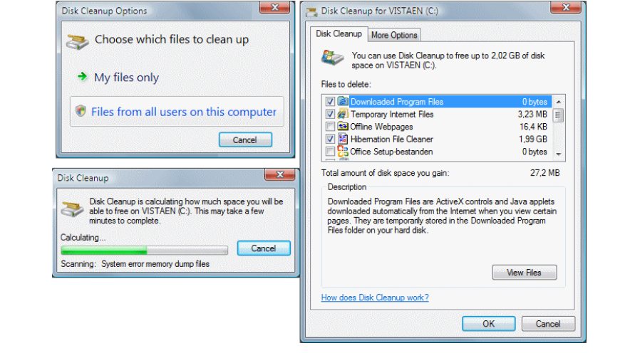

Slide 5
Disk Cleanup does not delete all files.
Afterwards there are still many hidden files which are not deleted (for example check the properties of the folder for temporary internet files).
Deleting the browsing history (the temporary internet files and cookies included) is done more effectively using the Internet Options in the Control Panel, button Delete, button Delete files and button Delete cookies.
This procedure has to be done for each user account separately.

Slide 6
Disk Defragmentation
A partition which is fragmented contains many files which are split up in fragments.
This is done when there is not enough space to store a file as a whole , Therefore a file is fragmented into small fragments.
If the fragmented files are used frequently by the system, it will take relatively a lot of time to read them which will delay the processing.
Defragmenting the hard disk will defrag those files which can improve the system performance significantly.

Slide 7
By default, defragmenting takes place daily as a background task.
When the automatic defragmentation is disabled it is also possible to start the defragmenting manually by the clicking
1) start menu
2) All Programs,
3) Accessories
4) System Tools,
5) sub Disk Defragmenter.

Slide 8
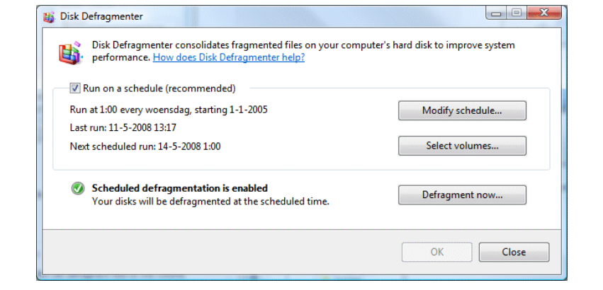

Slide 9
Click the button Defragment now in the Disk defragmenter window to start the defrag of all partitions manually.
The button Select volumes is used for selecting/deselecting partitions to defrag.

Slide 10


