Slide 1
SAFE DOWNLOADING
By
Chemate Abhijeet Bhausaheb
(ACST)
Roll no-D18

Slide 2
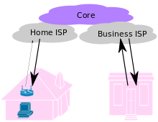
What is Download?
Download means to receive data from a remote system, typically a server.
Downloading generally transfers entire files for local storage and later use.

Slide 3
What we Download?
Acts
GRs
Reports
Softwares
Movies
Songs
Pictures

Slide 4
Need of Safe Downloading
To protect our Data.
To avoid Virus attack.
To avoid Identity Theft.
Safeguard against Financial Frauds.
Protection against Spyware.
Protection against Adware.

Slide 5
How to Download Safely
Check the Website Address.
HTTPS
LOCK SYMBOL
Use Of Security Applications
Active Virus and Malware Scanners.
Active Firewall.
Avoid download programs and installers.
Potentially Unwanted Programs

Slide 6
Know the difference between freeware, shareware, trialware, open source and free download.
Use trusted Download Websites.
Download music only from paid sites.
iTunes
Napster

Slide 7
Download executable files (.exe) with extreme caution.
Use trusted Download websites.
Types of websites
Certified and Trustworthy.
Not Certified but Trustworthy.
Not Recommended.

