Slide 1
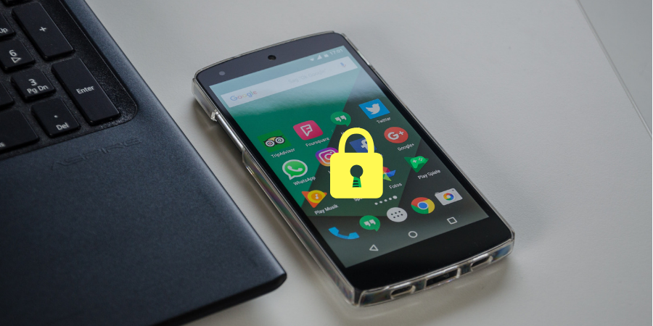
Use App Locker Tools for Mobile Apps
Presented By
Dr. Vandana Chaudhari
(ACST Class-C 6)

Slide 2
What is app locker?
AppLock is an AppLocker (App Protector) that will lock and protect apps using a password or pattern and fingerprint.
AppLock can lock, Social Media apps, Messaging apps, Gallery, Contacts, Settings and any app you want.

Slide 3
Keep Mobile Secure!!!
As technology grows day by day, it may be possible that your information may be control by some one else.
Smartphone,tablets,having your personal data,Email,social information,camera,pics may be hacked by instruction.
There exist few apps available in market to secure your phone and safeguard your privacy.

Slide 5
Why App Lock?
Smartphone nowadays contains a lot of sensitive data.
our banking apps, note taking apps, gallery, apps, etc. need to be secure from prying eyes.
Also, when we handover device to kid we might want to prevent him from accessing apps on your phone.

Slide 6
How do I lock my apps?
An app locker for android can provide atmost security from unwanted access. Although some devices come with a built in app locker, most android devices don’t.
Thankfully there is no shortage of app locker for android in the play store

Slide 7
Various types of app lock application in play store

Slide 8
Steps to use app lock
To lock an app on your mobile. You will need to download an app locker from the google play store.
An app locker will allow you to create a PIN or pattern that will be required whenever the app is opened.

