Slide 1
I T Skill Assignment CPTP Batch B
Name of OT :- CHOBE VIJAYKUMAR BHAUSAHEB
Roll No :- B 13
TOPIC :- Apply for Marriage Certificate Online
Abled Guidance : Hon Sh Rajendra Pawar Sir & Smt Sandhya Jagtap Madam.

Slide 2
FACTS
1. Marriage Registration is to be done at Sub Registrar office.
2. It is registered under Marriage Registration Act 1998.
3. Sub Registrar office ordinarily at Permanent Residence of Either Bride or Groom can register Marriage.
4. For this “Form D” is to be submitted before Sub Registrar of the concerned office.
5. Both Bride & Groom must have completed 18 years of age.

Slide 3
DOCUMENTS
Parties Involved | Proof of Residence | Proof of Age | Photo | Other
1.Bride | Ration Card/Aadhar Card/Voter ID / Certificate of Residence by Competent Authority. | Birth Certificate/ SSC Cert/ Bonafide Cert/ School L.C. | Before Marriage | Aadhar card is compulsory.
2.Groom | Ration Card/Aadhar Card/Voter ID / Certificate of Residence by Competent Authority. | Birth Certificate/ SSC Cert/ Bonafide Cert/ School L.C. | Before Marriage | Aadhar card is compulsory.
3. Of 3 Witness | Ration Card/Aadhar Card/Voter ID / Certificate of Residence by Competent Authority. | Not Required | Any showing present Status. | Aadhar card is compulsory.

Slide 4
Actual Process of Registration
1. Both Bride & Groom has to be present in Sub Registrar Office on date given.
2. 3 Witnesses has to appear before the Authority to sign “Form D”.
3.If any one of Two is Divorcee/Widow/Widower- Then Court of Divorce/ Death Certificate of previous partner is must.
4. Requisite fee with Court fee Stamp of Rs.100 has to be attached with attested documents.

Slide 5
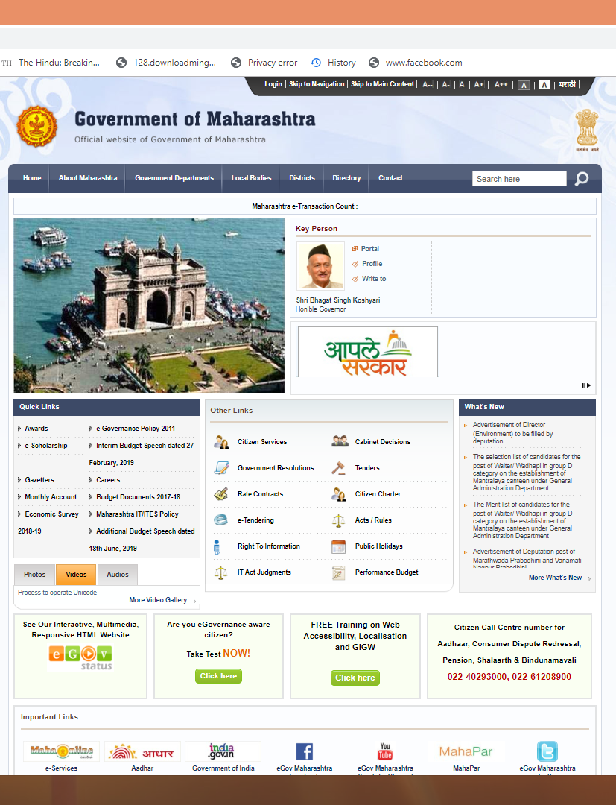
For Getting Copy of Marriage Certificate LOGIN TO AAPLE SARKAR PORTAL OF GOVERNMENT OF MAHARASHTRA
Step : 1
From google search,
go to Home Page of
AAPLE SARKAR portal.

Slide 6
Step : 2 Select Aaple Sarkar Seva Kendra

Slide 7
Step : 3 Prepare Login Id & Password.

Slide 8
Step : 4 Select Icon of Inspector General of Registration.

Slide 9
Step : 5 Select radio button of Certified Copies of Marriage Certificate.

Slide 10
Step : 6 First Fill Application by clicking on icon “Application Entry”.

Slide 11
Step : 6 Fill All the details. JDR office has to be selected where the actual marriage is registered.

Slide 12
Step : 7 Select the option Hard Copy/ Soft Copy.

Slide 13
Step : 7 Check All the information filled correctly & submit.

Slide 14
Step : 7 On successful submission will get ackowledgment & get it download.

Slide 15
Step : 8 Take print out of ackowlegment for reference.

Slide 16
Marriage Certificate

Slide 17
Thank You…
If Any QUERY…
MY MOBILE NO ---9518377018
ROOM NO D -47

