Slide 1
Apply for Pradhanmantri Mudra Yojana Online
Presentation by
Hemant Pralhad Bhingardeve
Deputy Chief Executive Officer CPTP6

Slide 2
Introduction
Formally launched in the 2015 Union budget of India
The MUDRA scheme or the Pradhan Mantri Mudra Yojana (PMMY) was aimed at providing financial assistance to the small scale entrepreneurs
located in remote areas, outside the access of regular areas of banking functionality.
Help entrepreneurs, start-ups restricted by a sufficient budget for running business.
Fulfilling all the Funding needs of existing Non Corporate Small Business.

Slide 3
PMMY - Features
Types of Mudra Loan
Shishu- upto Rs. 50,000/-
Kishore- above 50,000/- and upto Rs.5 lakh
Tarun- above Rs.5 lakh and upto Rs.10 lakh
Interest rate not beyond 12% per annum
Simplified application form , No collateral
Working capital accessed through MUDRA RuPay card
No processing fee & margin money on Shishu loans

Slide 4
How to Apply for Mudra Loan
STEP 1: Firstly, approach any of those bank that are listed by the scheme.
STEP 2: Then provide complete business detail.
STEP 3: Categorisation of your business into mention three categories.
STEP 4: Then filling up the Mudra form for loan, along with current account opening in the bank.

Slide 5
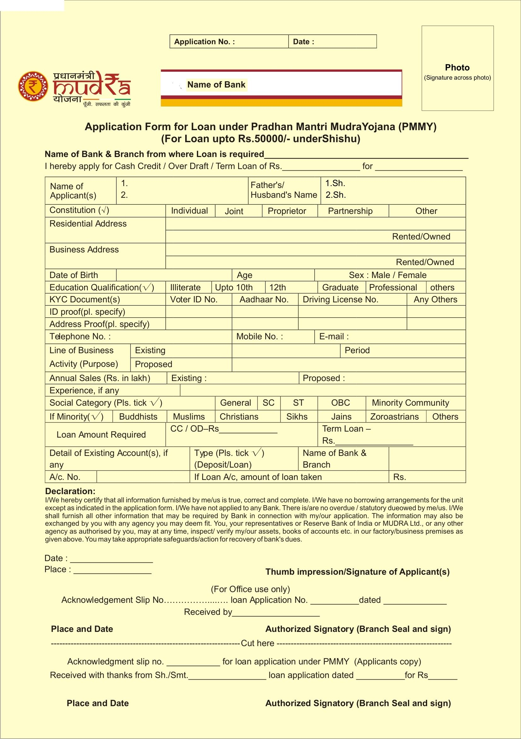

Slide 6
e-mudra : Smart Technological platform
To be owned & operated by MUDRA
Will receive, store, analyse & disburse all data on lenders, borrowers & repayments
Using NUUP (National Unified Ussd Platform) : the existing multilingual mobile banking platform of NPCI (National Payment Corporation of India) *99# , works offline also
MIS: information down to the level of individual borrower

Slide 7
e-mudra : Smart Technological platform
Creates credit history for each individual over time using:
Unique Id (ADHAAR no. when permitted/others)
All transactions through e-mudra platform
Mobile /DTH recharge history, Electricity bill history
National Skill database
Enables flexi repayments using mobile prepaid vouchers
Recommends larger & easier loans for prompt re-payers

Slide 8
PMMY with e-mudra: Process Flow
Borrower
Dials *99# /App & chooses PMMY option
e-mudra
Analysis of user data: eKYC, Other database
Bank
Field verification & sanction/reject within 07 days
Enters Unique ID/ADHAAR no. ,Amount applied for, Consent to share data with the platform
Requisition to bank branch with Analysis report
sms to borrower: application receipt, sanction/rejection, repayment reminders
Uploads all data on e-mudra
Credits amount into borrowers account, issues RuPay card
Borrower
Uses the disbursed amount as per his/her need
Daily/flexible repayment option using mobile recharge coupons in addition to traditional methods

Slide 9
Supplementary measures
Financial Literacy Campaign:
Mobile banking, Savings, Types of loan, Project preparation
Campus loan programs: self-employment
Handholding
Market linkage: e-commerce
Monitoring loan utilisation: Bank Mitras
Success stories, Recognition & Rewar

Slide 10
“The key to ending extreme poverty is to enable the poorest of the poor to get their foot on the ladder of development . . . the poorest of the poor are stuck beneath it. They lack the minimum amount of capital necessary to get a foothold, and therefore need a boost up to the first rung.” - Jeffrey Sachs
THANK YOU

