Slide 1
Register complaint on consumer forum
By
YOGIRAJ BHAGAT
Assistant Commissioner of State Tax
CPTP 5 (Class B)

Slide 2
WHO IS CONSUMER?
A Consumer is a person who purchases a product or avails a service for a consideration, either for his personal use or to earn his livelihood by means of self employment. The consideration may be:
Paid
Promised
Partly paid and partly promised .
It also includes a beneficiary of such goods/services when such use is made with the approval of such person.

Slide 3
Consumer rights
Right to Safety
Right to Information
Right to Choose
Right to be Heard
Right to Redressal
Right to Consumer Education

Slide 4
Factors Responsible for exploitation of consumers
Limited Information
Limited Supplies
Limited Competition
Illiteracy

Slide 5
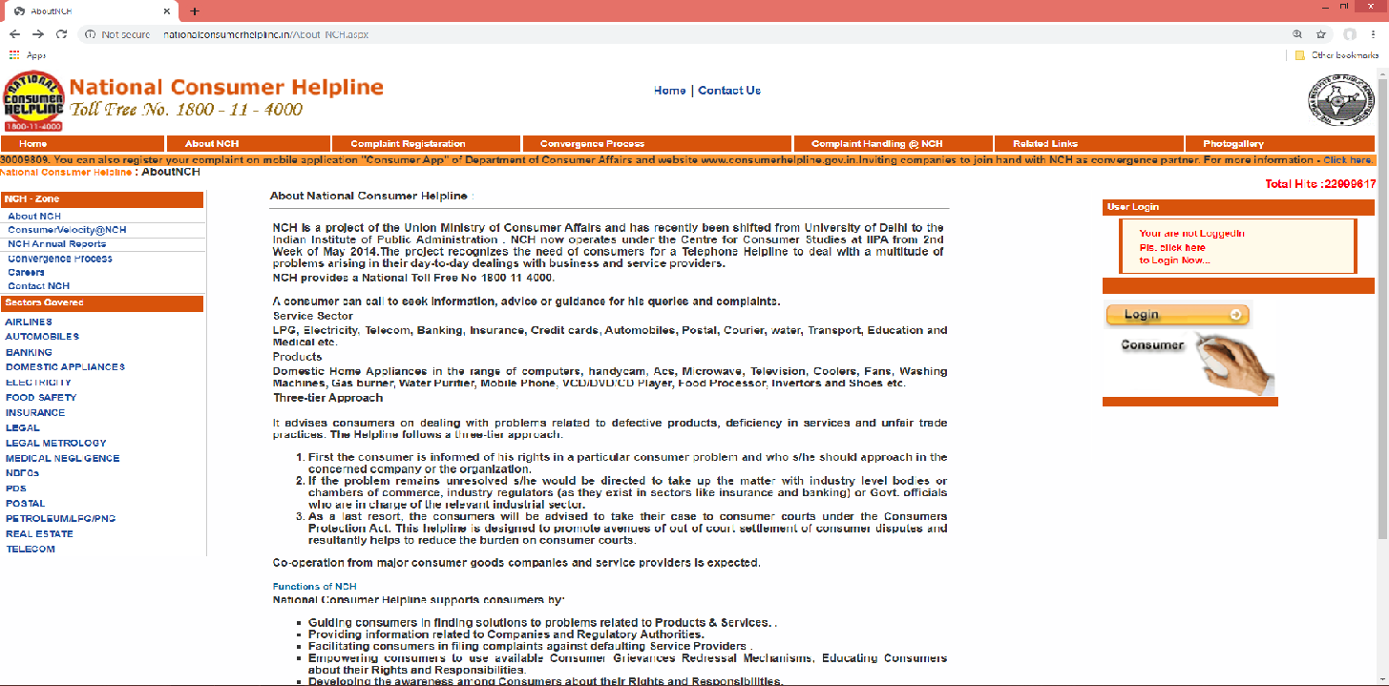
How to register complaint on consumer forum ?
Step 1- http://www.nationalconsumerhelpline.in

Slide 6
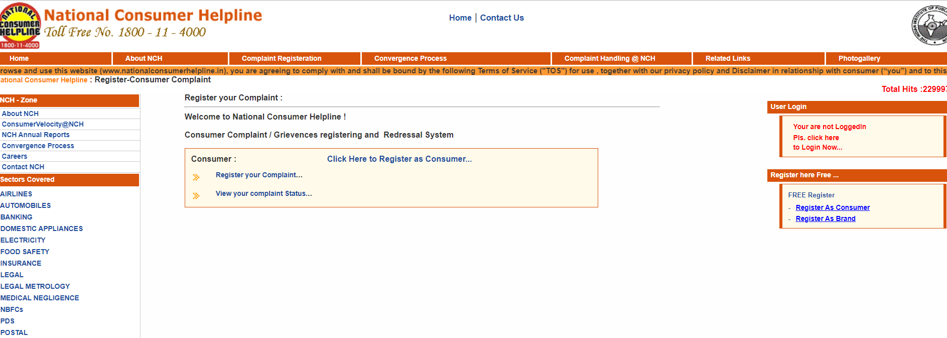
Step 2- Complaint Registration

Slide 7
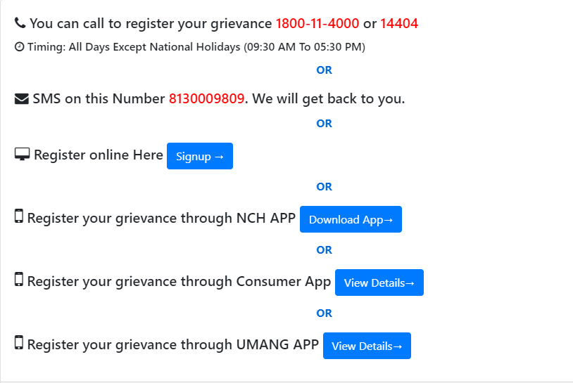
Step 3- Register your complaint

Slide 8
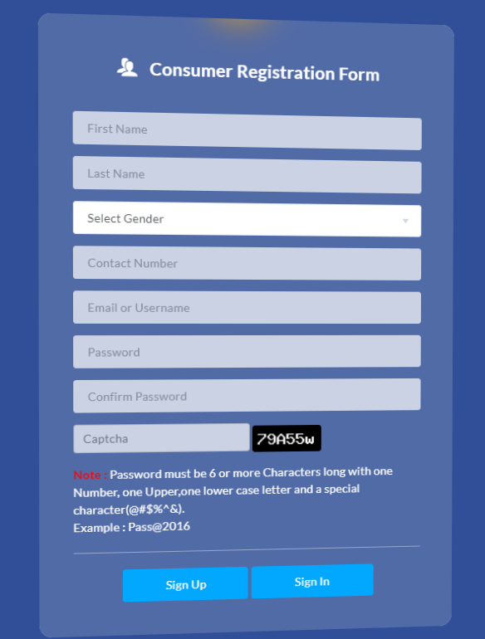
Step 4- Create an Account

Slide 9
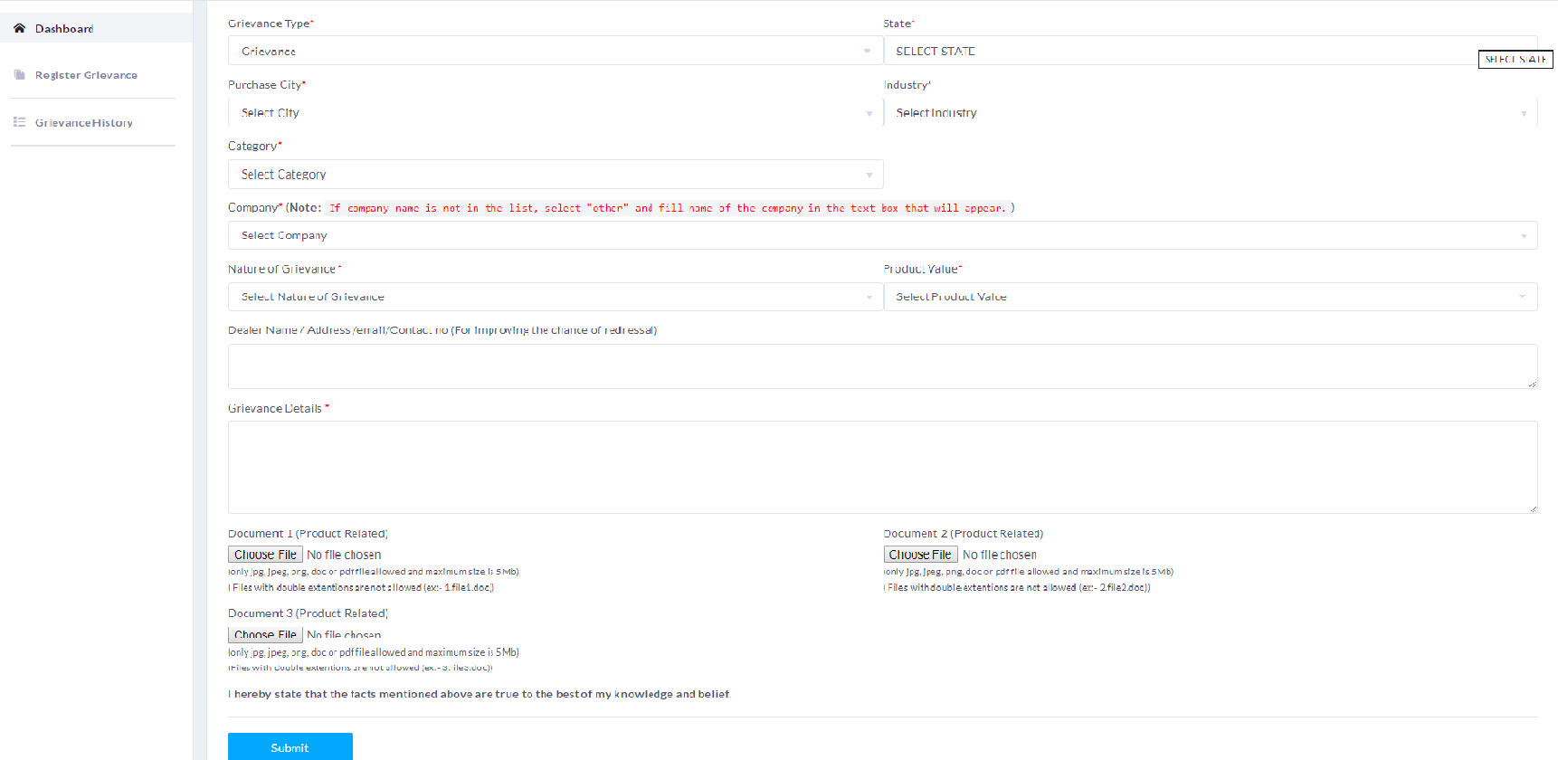
Step 5- fill up a Grievance Registration Form

Slide 10
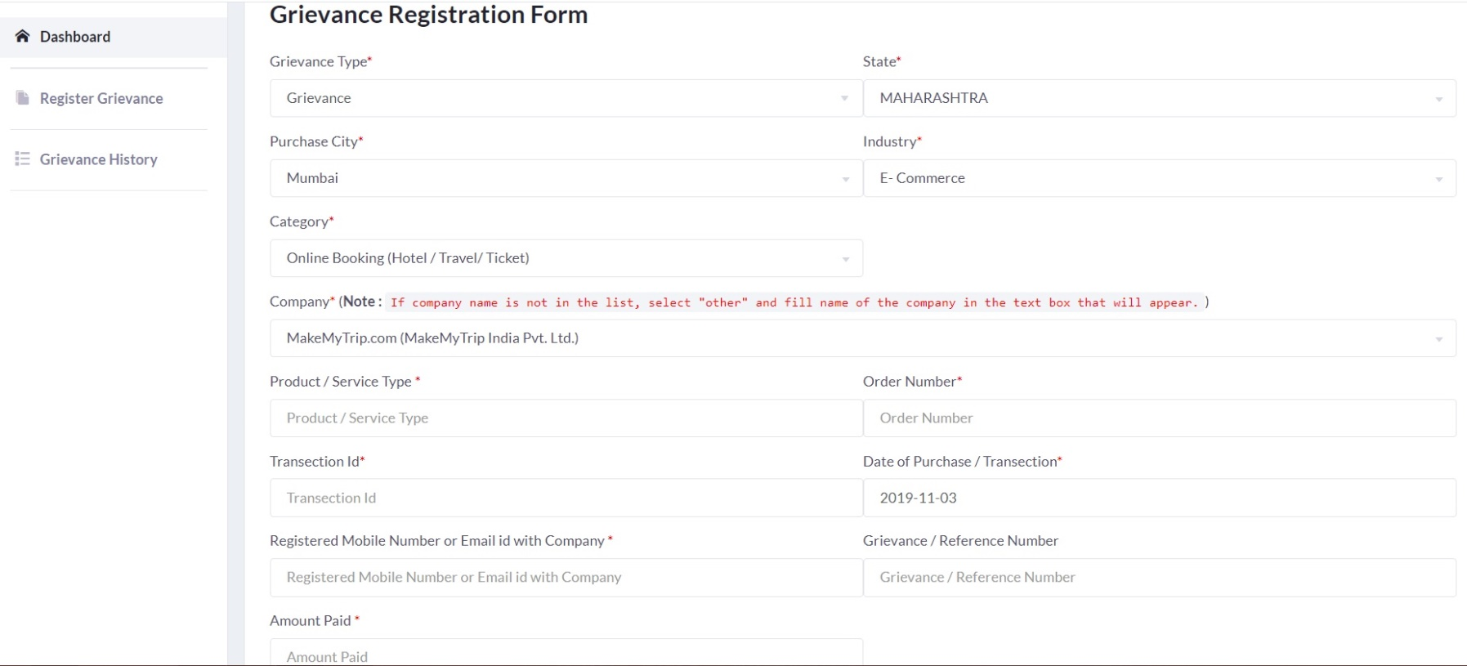
Complaint

Slide 11
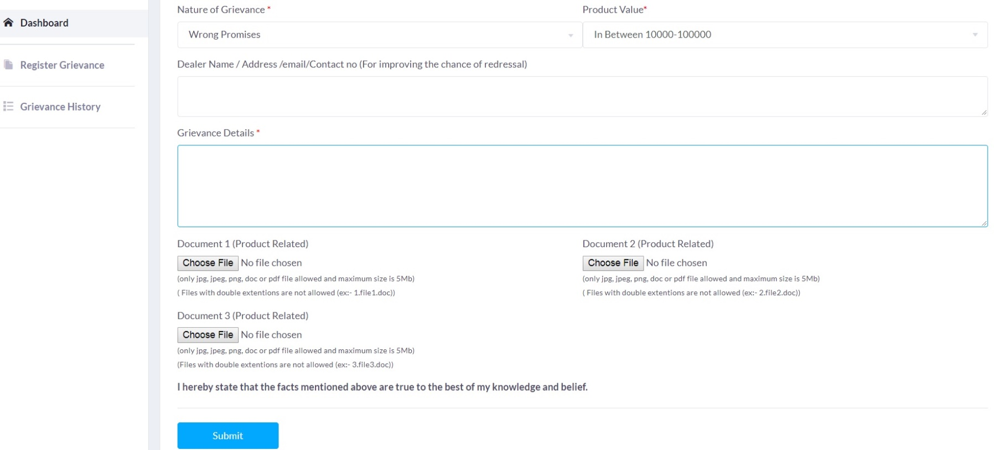
Complaint

Slide 12
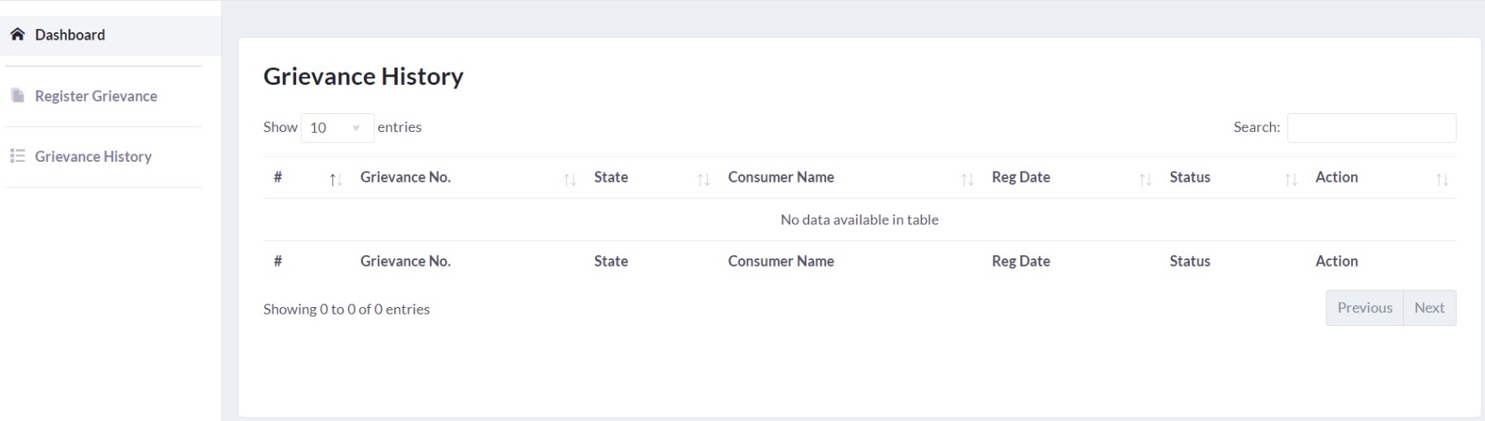
Step 6- Grievance History

Slide 13
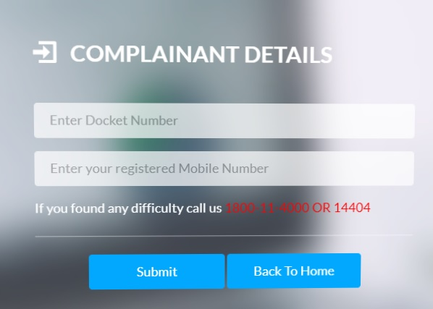
Step 7 – view your complaint status

Slide 14
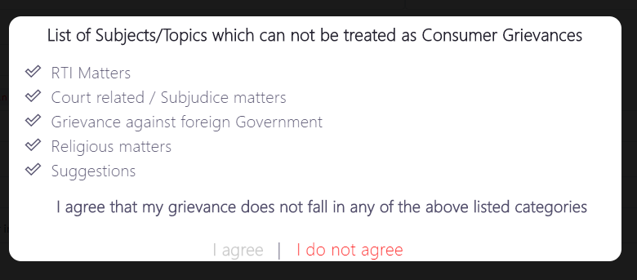
To Register complaint online

Slide 15


