Slide 1
CYBER SECURITY- HACKING
PRESENTED BY-
SHITAL BANDGAR
CLASS: D
ROLL NO.: 24

Slide 2
Introduction
The term of cyber security is used to refer to the security offered through online services to protect your online information.
In computers and computer networks an attack is any attempt to expose, alter, disable, destroy, steal or gain unauthorized access to or make unauthorized use of an asset.
A cyberattack is any type of offensive maneuver that targets computer information systems, infrastructures, computer networks, or personal computer devices. An attacker is a person or process that attempts to access data, functions or other restricted areas of the system without authorization, potentially with malicious intent.[

Slide 3
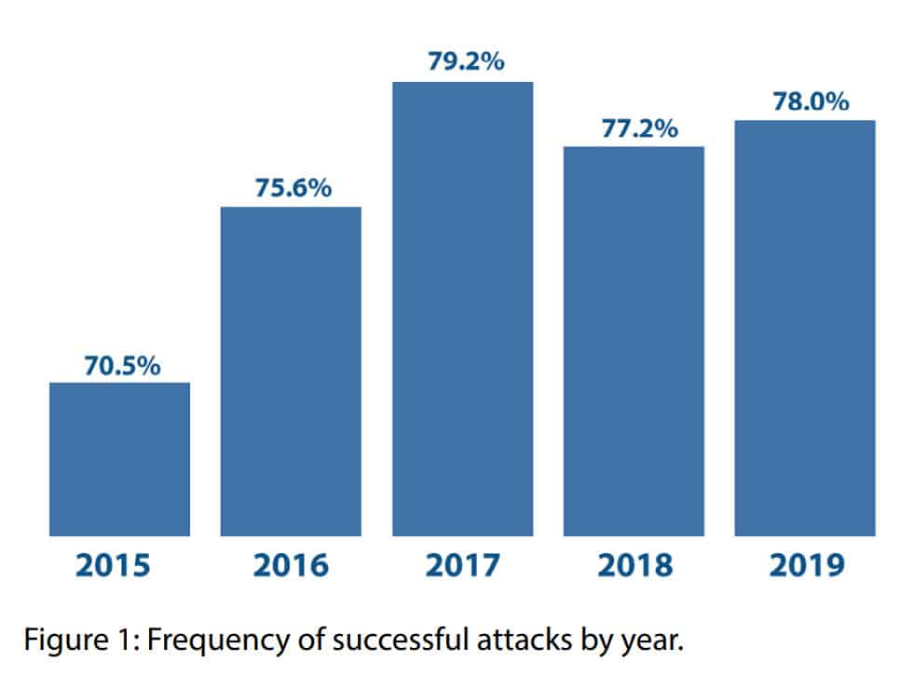
Frequecy of cyber attacks in world:

Slide 4
What is HACKING?
Exmine something minutely.
The rapid crafting of new program or making of
changes to existing, usually complicated software.
Hacking can also refer to non-malicious activities, usually involving unusual or improvised alterations to equipment or processes.

Slide 5
TYPES OF HACKER
WHITE HAT HACKER
BLACK HAT HACKER
GOOD GUYES
USE THEIR SKILLS FOR SECURITY
DON’T USE THEIR SKILLS FOR ILLEGAL PURPOSE
BAD GUYES
USE THEIR SKILLS MILLICIOUSLY FOR PERSONAL GAIN

Slide 6
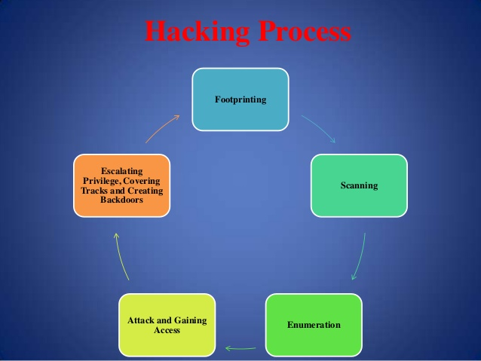

Slide 7
WHAT SHOULD DO AFTER HACKING?
Isolate Your Computer
Shutdown and Remove the Hard Drive
Scan Your Drive for Infection and Malware
Backup Your Important Files From the Previously Infected Drive
Move Your Drive Back to Your PC
Completely Wipe Your Old Hard Drive
Reload the Operating System From Trusted Media and Install Updates​

Slide 8
WHAT SHOULD DO AFTER HACKING?
Reinstall Anti-Virus, Anti-Spyware, and Other Security Software
Scan Your Data Backup Disks for Viruses
Make a ​Complete Backup of Your System

Slide 9
HOW TO SECURE YOUR DATA?
#1: Back up early and often
#2: Use file-level and share-level security
#3: Password-protect documents
#4: Use EFS encryption
#5: Use disk encryption

Slide 10
HOW TO SECURE YOUR DATA?
#6: Make use of a public key infrastructure
#7: Hide data with steganography
#8: Protect data in transit with IP security
#9: Secure wireless transmissions
#10: Use rights management to retain control

Slide 11
Legal Protection:
In India Information and Technology Act 2000 was enacted and amended in 2008 covering different types of crimes under cyber law.
Article 66 A. Hacking is an offence.
Penulty : Shall be punished with imprisonment upto 3 year or fine which may extends up to 2 lakh rupees or with both.

Slide 12
Conclusion:
Cybercrime: Yes or No? In my opinion, any sort of crime (online or offline) should never be tolerated. The safety and well-being of citizens should be safeguarded. Everyone deserves a right to live in a secure environment, no matter in real-life or on the Internet.

Slide 13
Cyber-criminals come up with more effective hacking methods day-by-day
Companies have to make sure their security measures are kept updated and consistent
To conclude, I hope that with the combined efforts of companies, banks and the authorities, we can see a drop in cyber-crime rates in 2019!

