Slide 1
Avail LPG Services Online
By
Akash Amrit Awatare
Dy.Collector(2018)

Slide 2
Why LPG services Online?
1.No need to visit Service provider
2.Avoid long queue
3. Offering you the flexibility and convenience
4. anytime, from anywhere, when you are on the move, on a holiday or at home through multiple modes

Slide 3
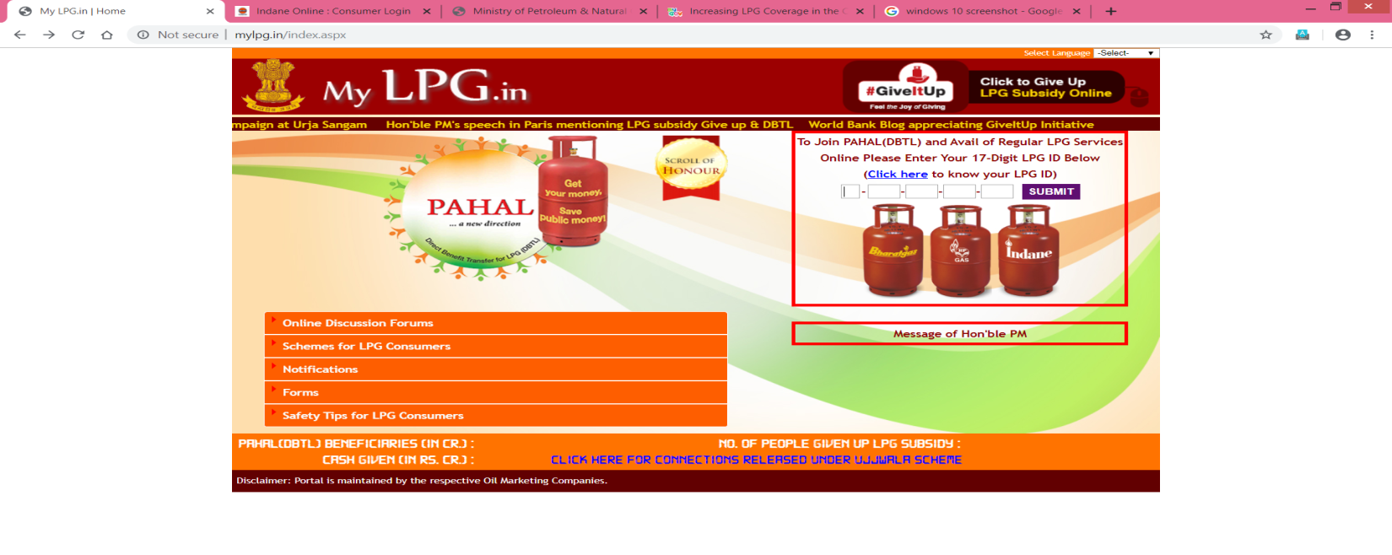
If you are first time customer
Step1: Registration
Request For New Connection

Slide 4
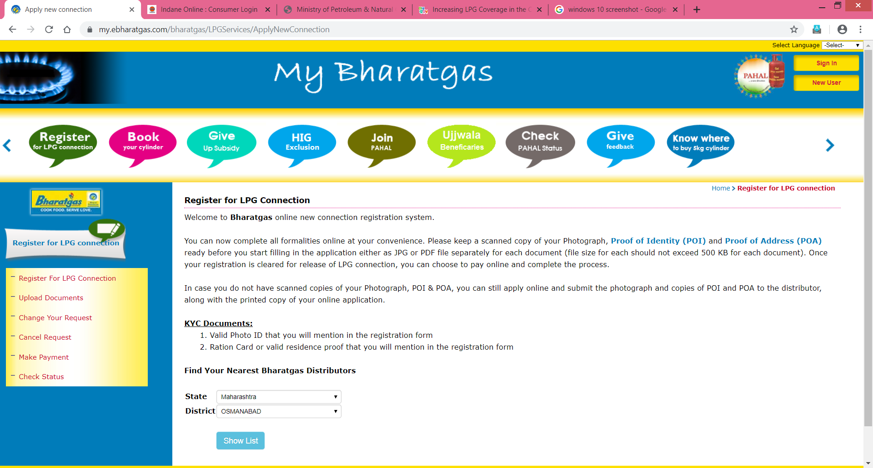

Slide 5
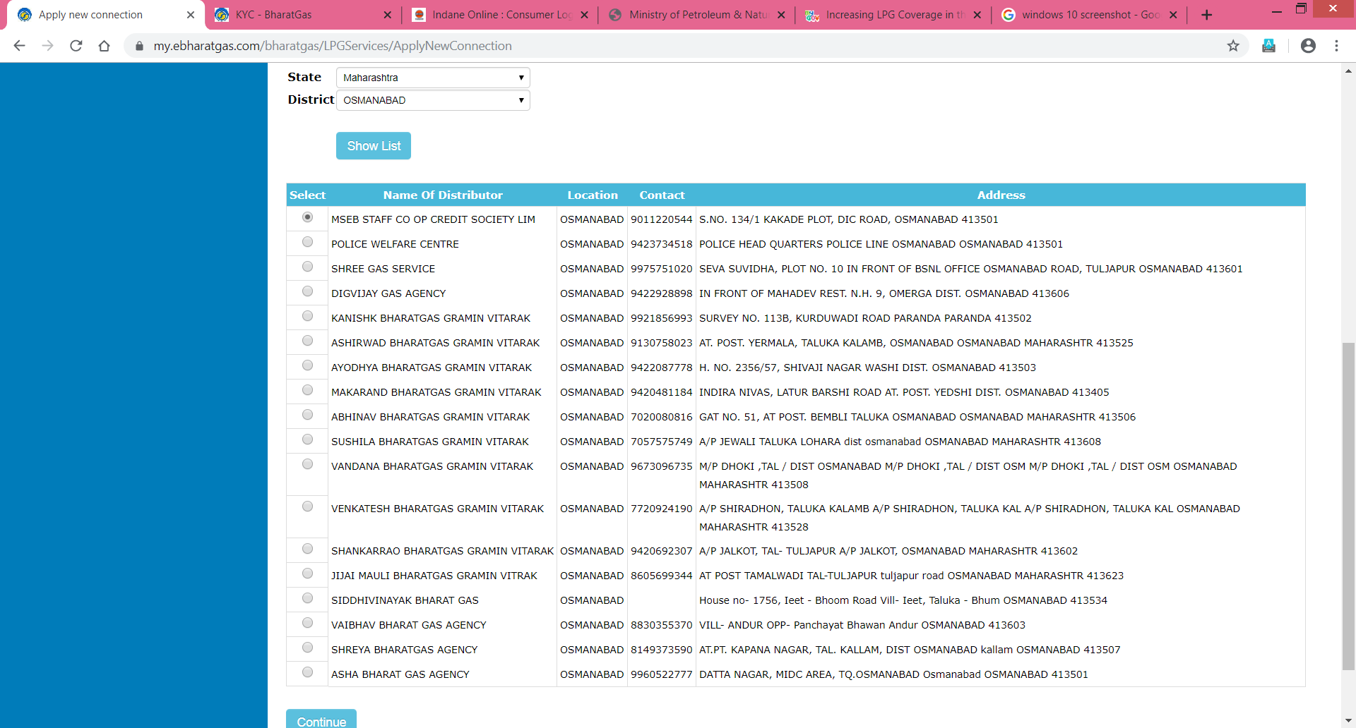

Slide 6
Know Your Customer (KYC)

Slide 7
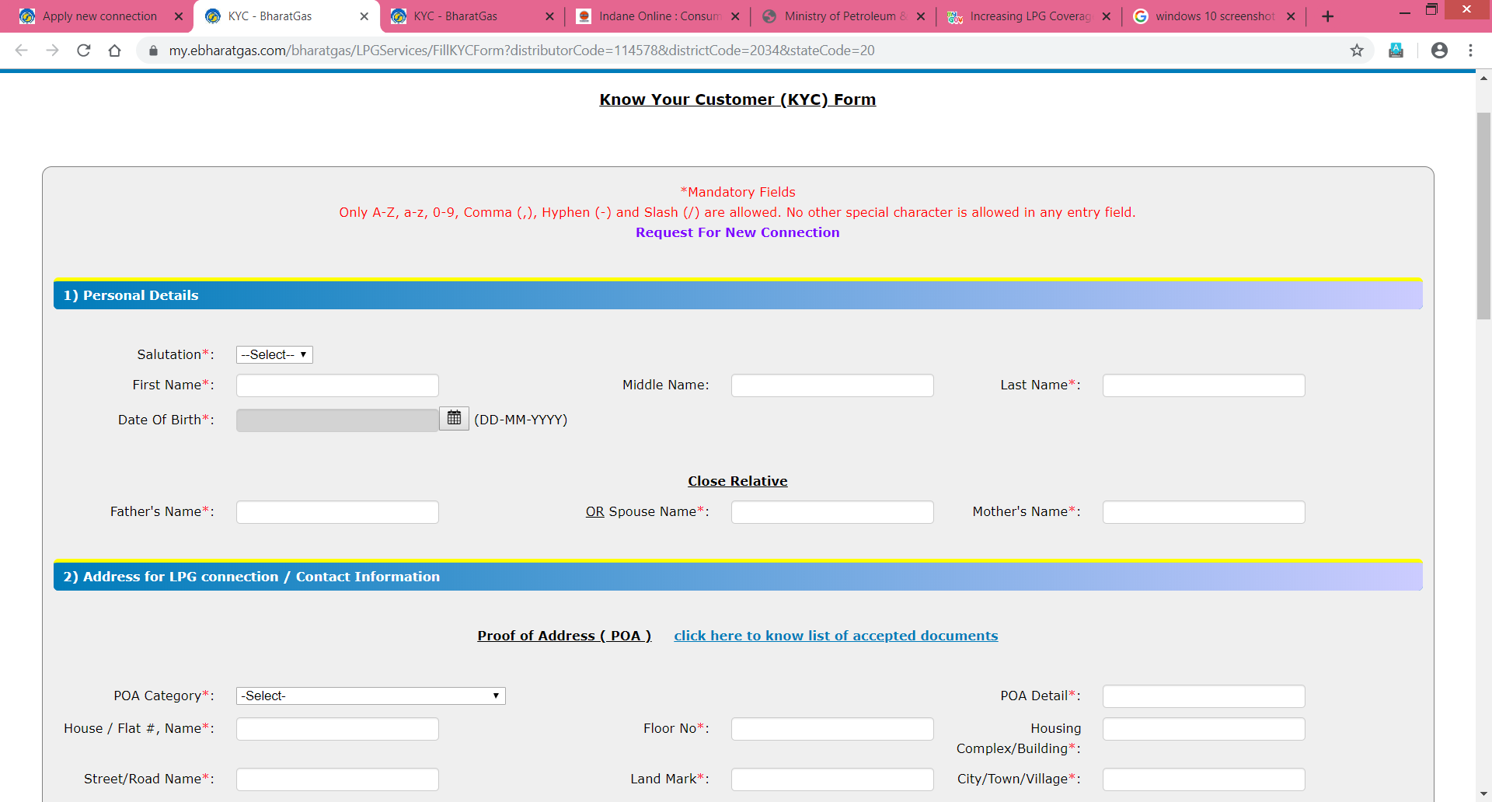

Slide 8
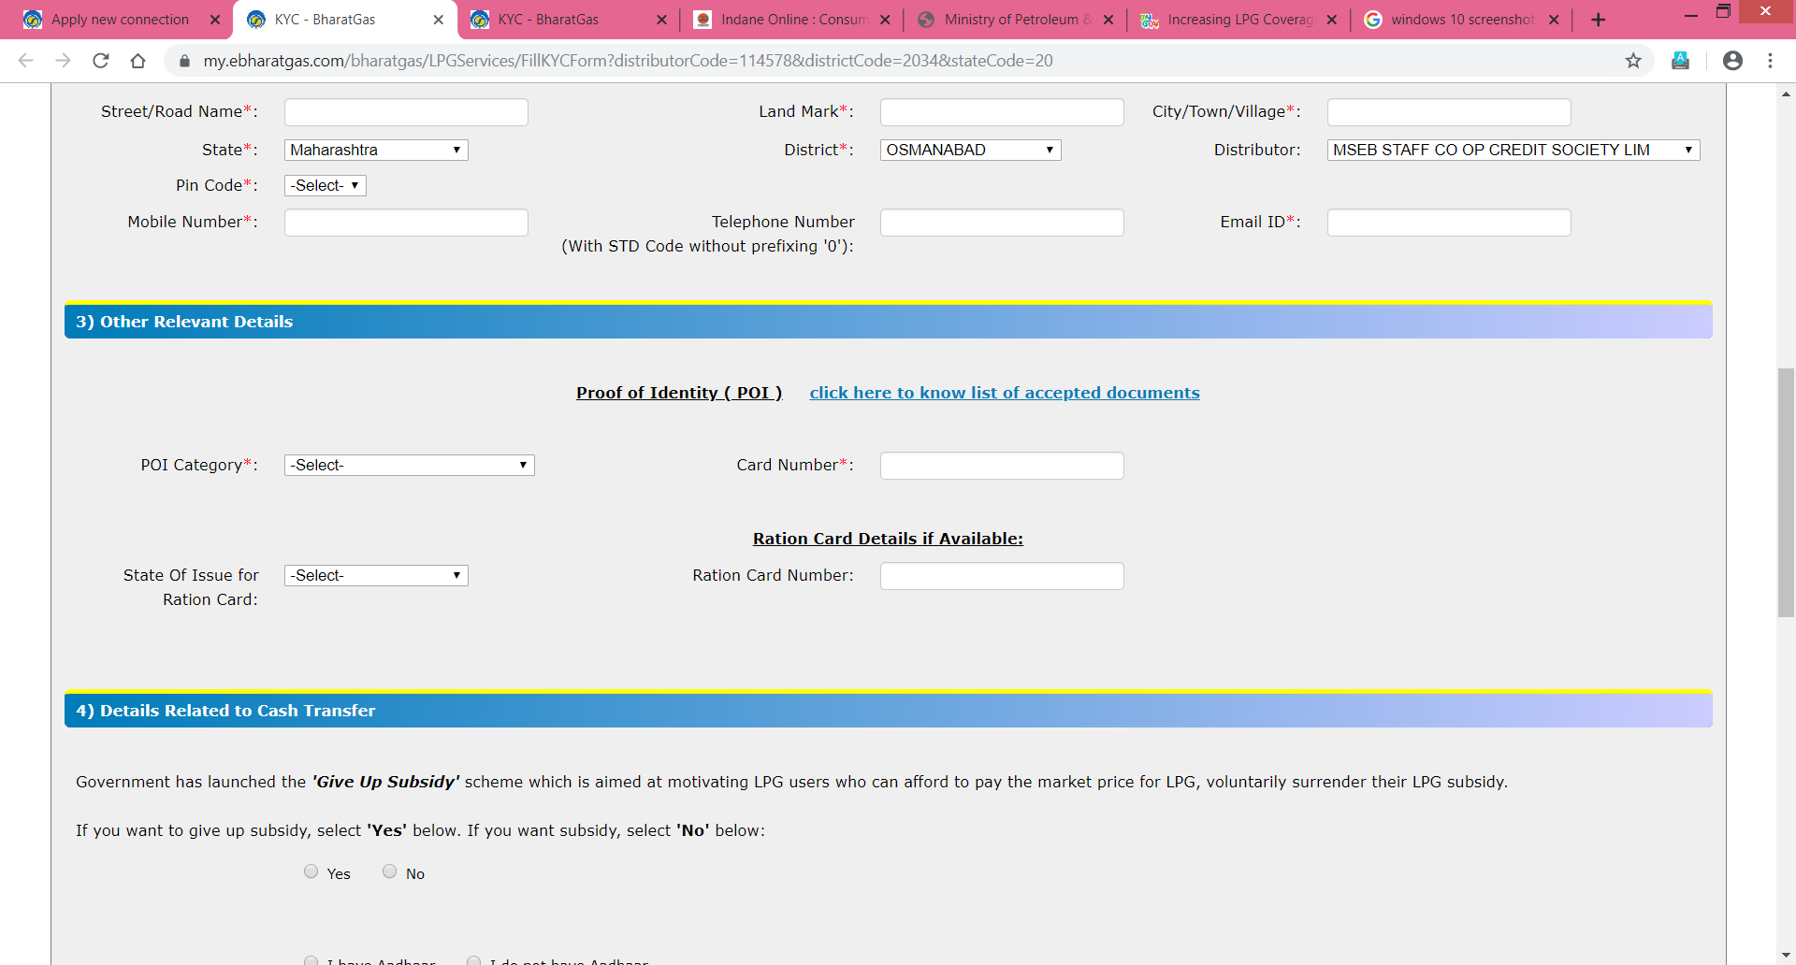

Slide 9
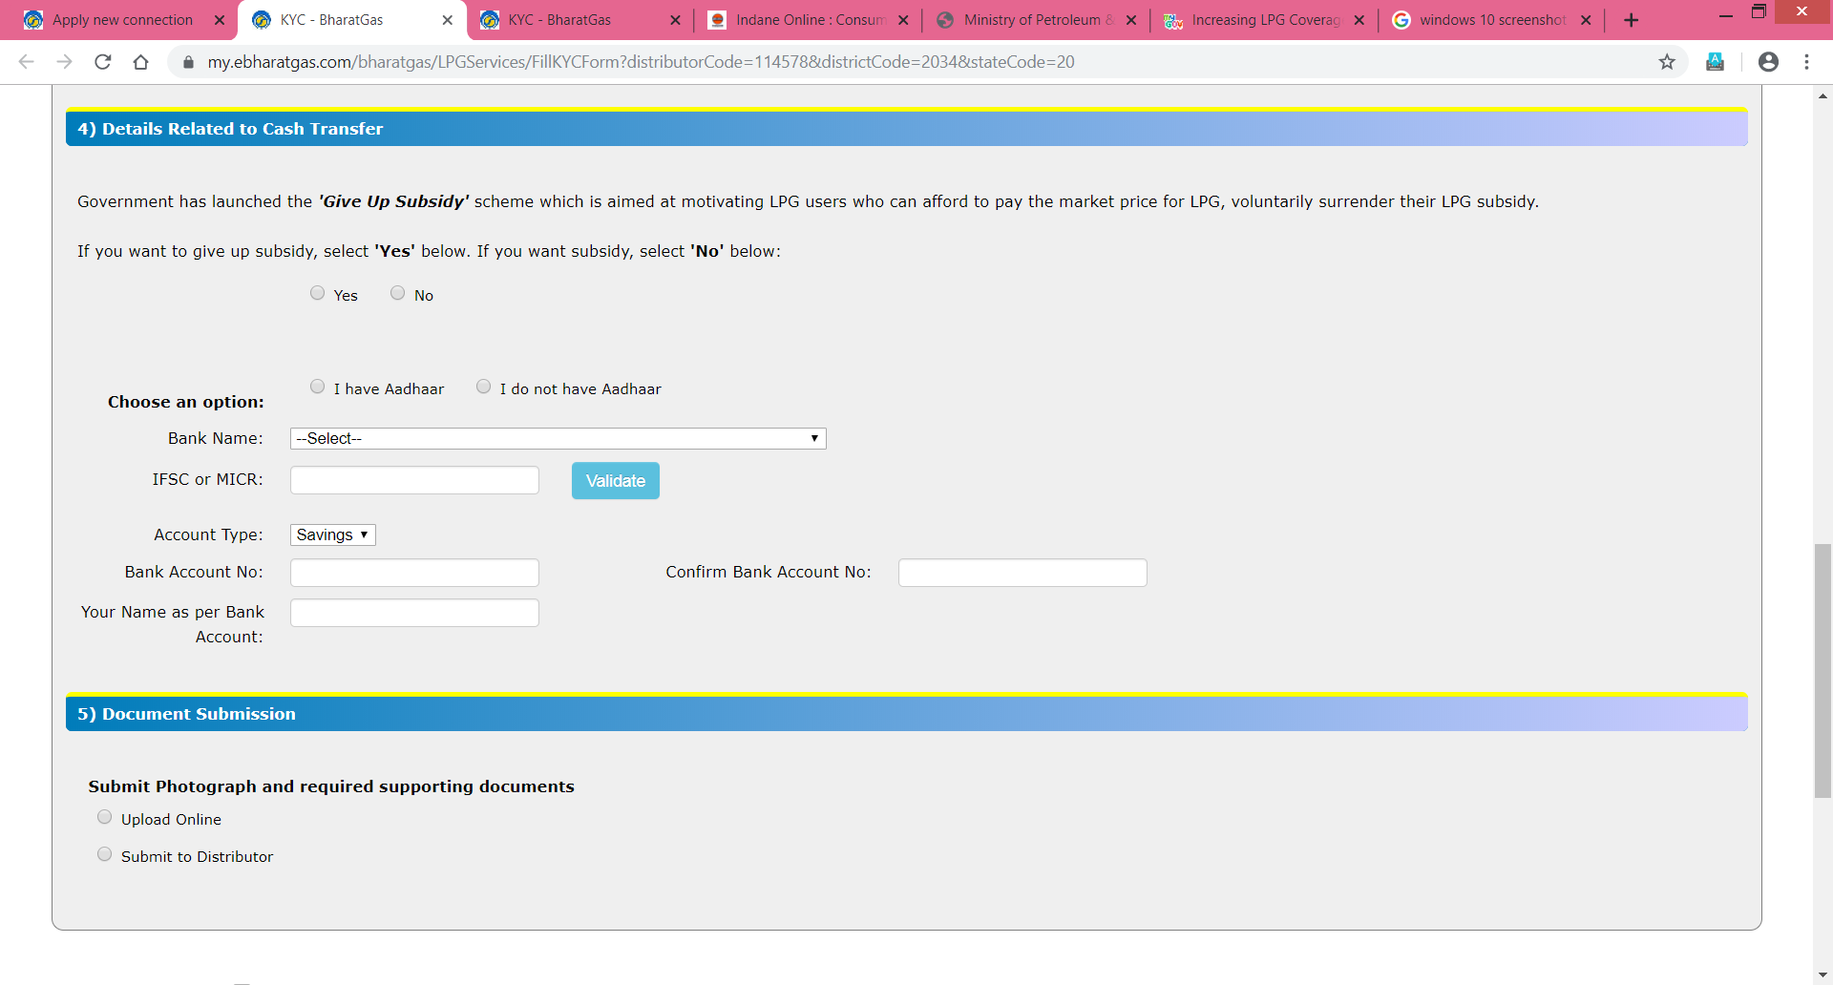

Slide 10
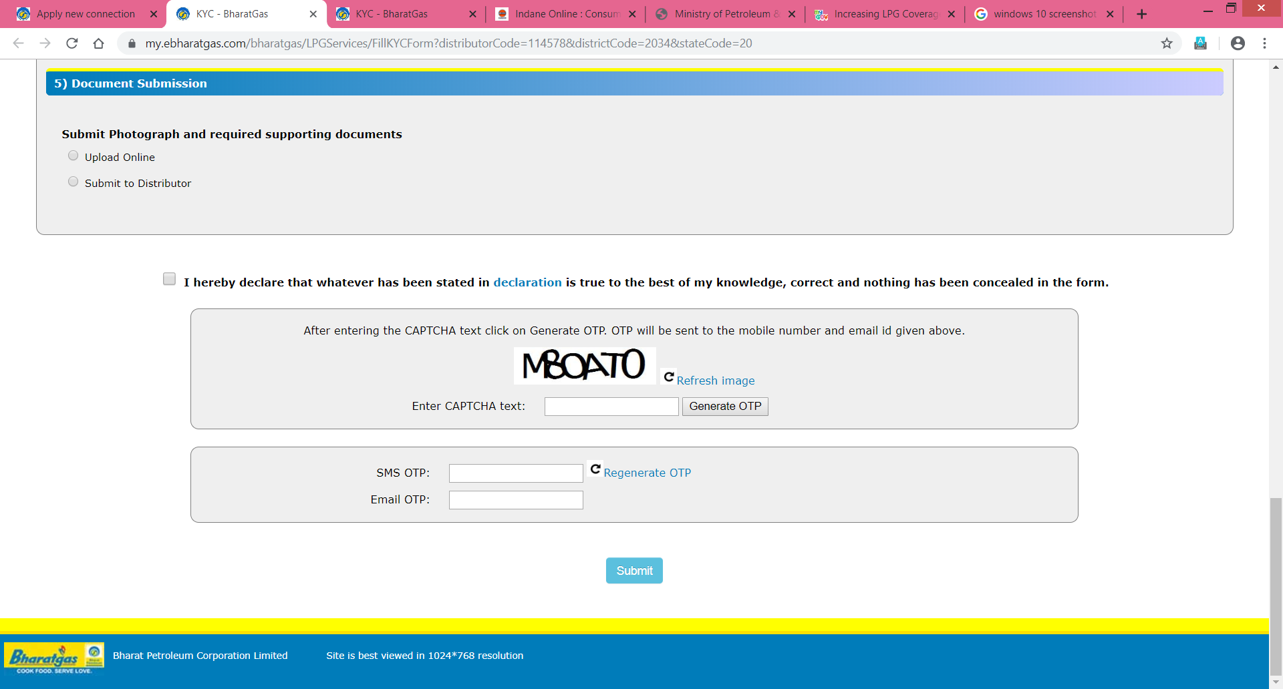

Slide 11
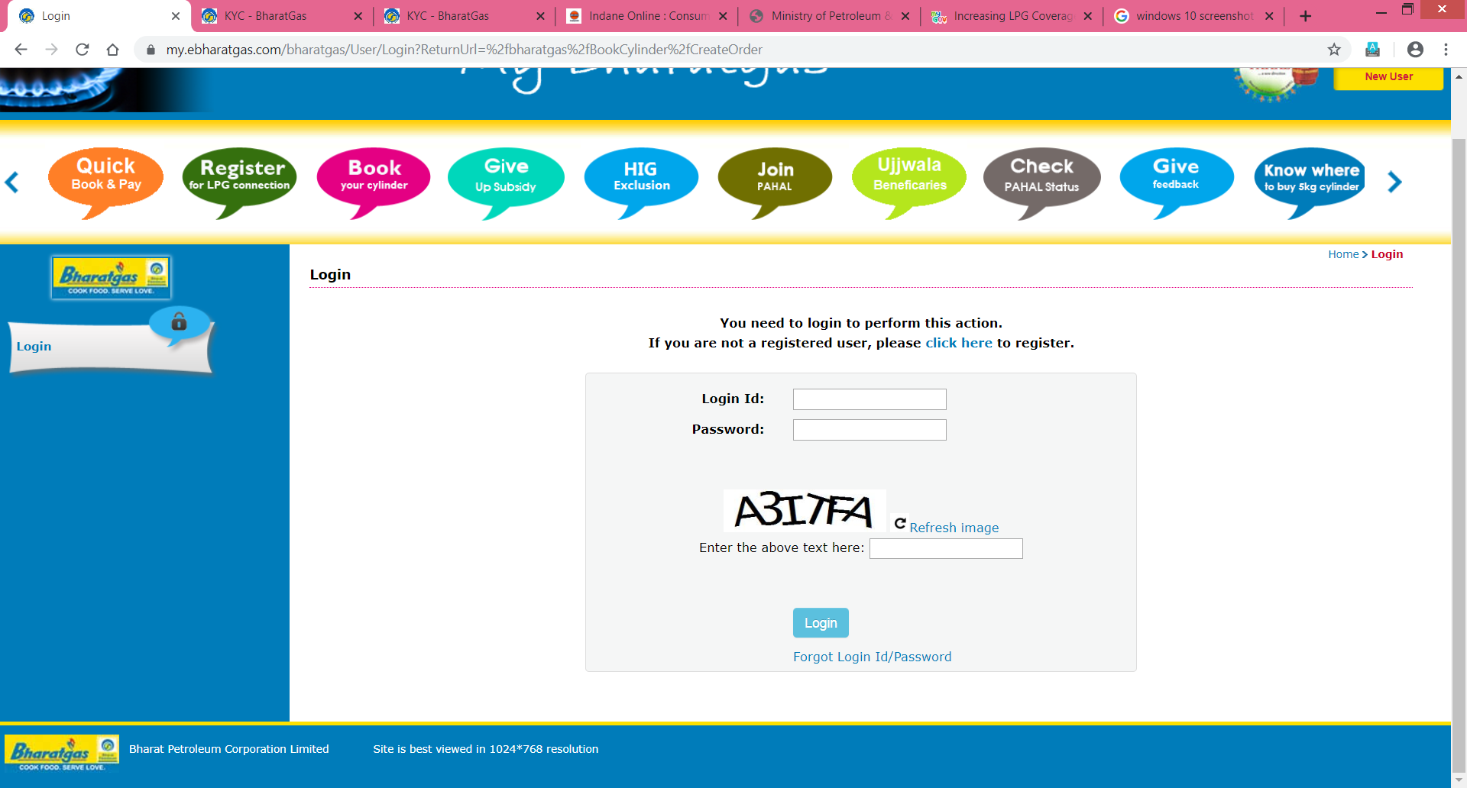
Step 2:Book Your cylinder

Slide 12
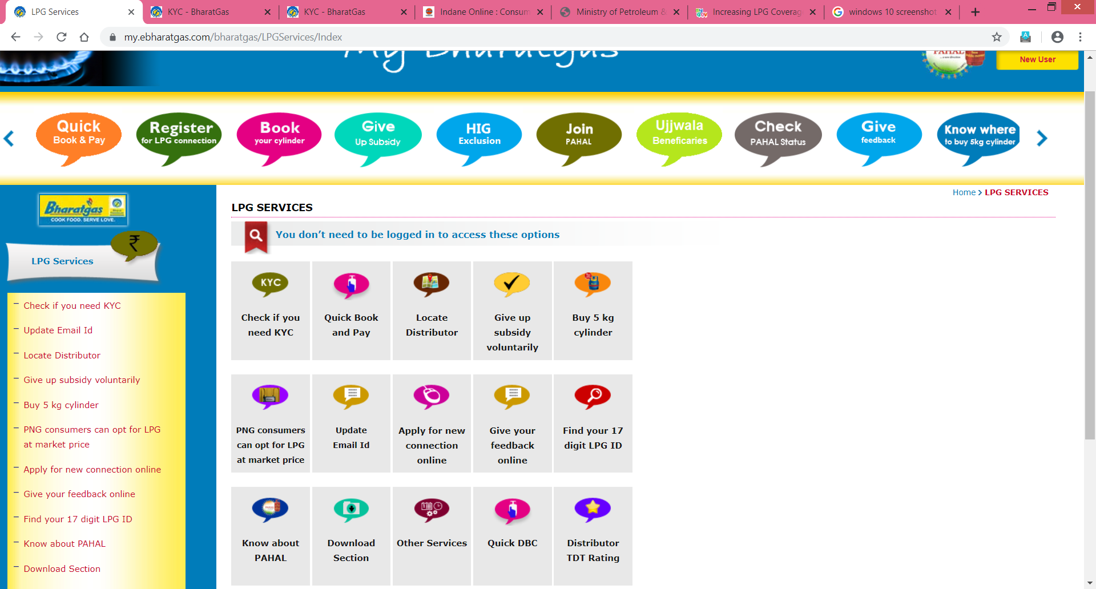

Slide 13
    Thank you…………..

