Slide 1
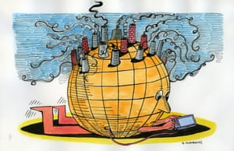
ENERGY SAVING TECHNOLOGY
DR ASHWINI JAGTAP PROB DYSP D7

Slide 3
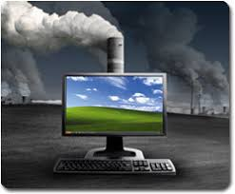
Power cosumption : Desktop require 85 watts as idle, 1500 pounds CO2 in 24 Hr, Needs 500 trees to absorb

Slide 4
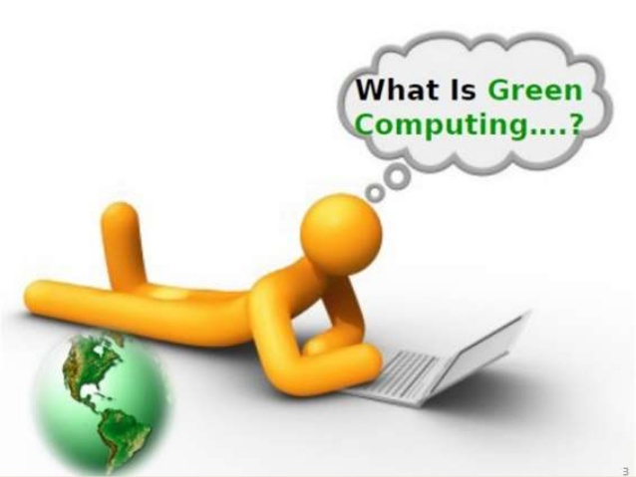
1992, with the Energy Star program Timely turn off , Hibernation
Manufacture Design Use Disposal

Slide 5
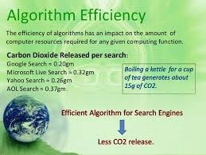
Algorithmic efficiency Directly affects the amount of resources required for running computer functions. Linear-based search to hashing or indexing can result in faster processes, thereby reducing the usage of resources.

Slide 6
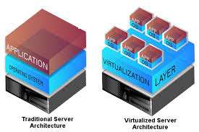
Virtualization Two or more logical computer systems can be run on the same piece of hardware. One can cut down the number of computer systems required by simply having one powerful system. As one system will certainly consume less power than many.

Slide 7
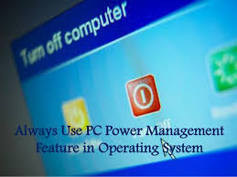
Power Management operating systems, such as Windows and macOS versions. Third-party software, such as 1E NightWatchman and Faronics Power Save

Slide 8
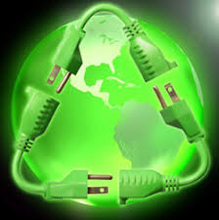
…..HARDWARE USAGE
Use of hard disk drives of the small form factor, i.e. 2.5 inch, as they consume less power.
Replace them with solid-state drives that contain no moving parts.
CRT monitors are also known to consume more power when compared to the newer LED or LCD monitors.
ZONBU Computer

Slide 9
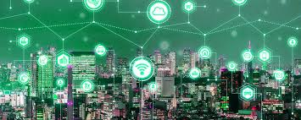
Cloud computing
Many companies can, and have been, moving their applications to the cloud, thereby cutting down on use of computing and energy resources and carbon emissions

Slide 10
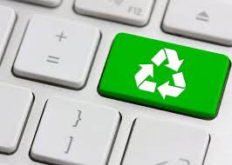
SAFE DISPOSAL RECYCING
Poisonous materials, such as lead, chromium, mercury and cadmium
DELL

Slide 11
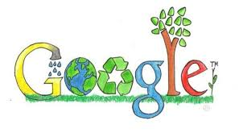
Blackle
Website powered by Google Custom Search and created by Tony Heap of Heap Media
Save energy by displaying a black background and using grayish-white font color for search results.

Slide 12
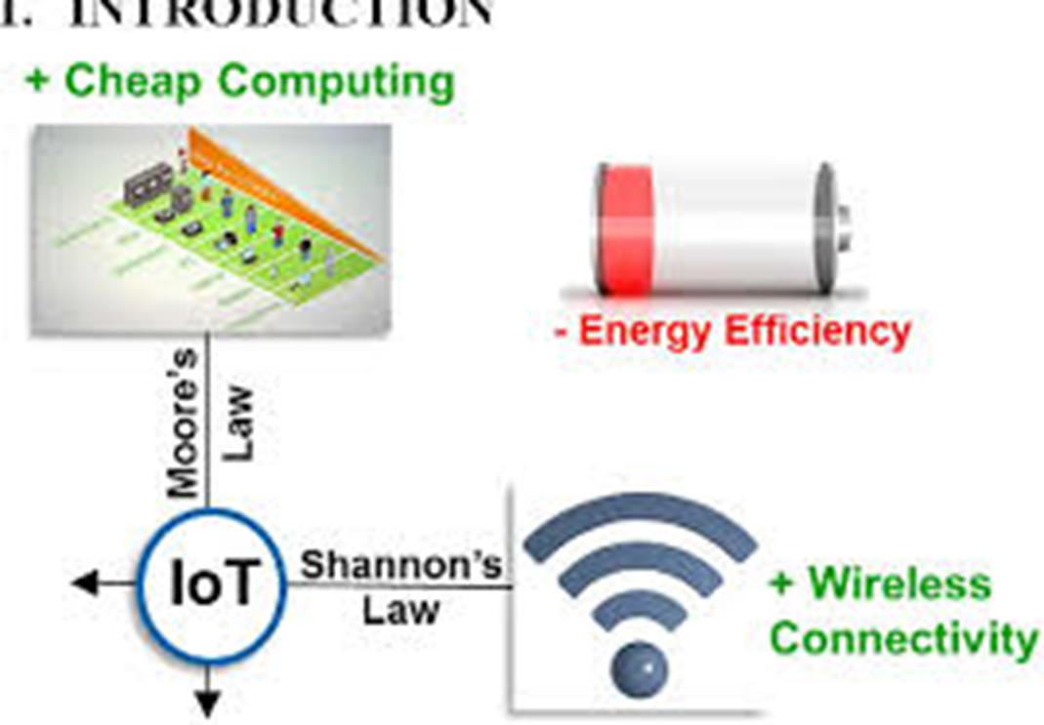
Internet of Things
Internet of Things

Slide 13
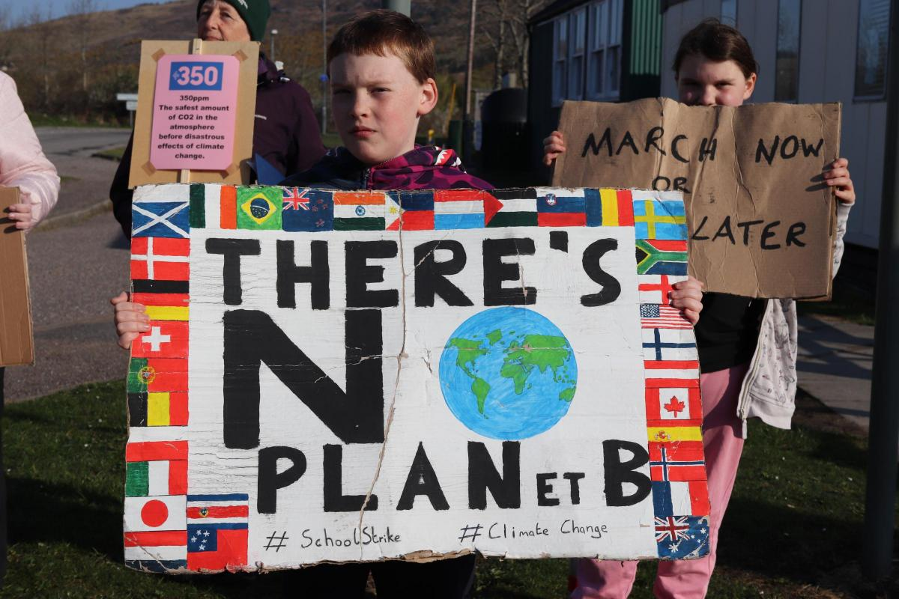
THANK YOU !!!!!!!!

