Slide 1
APPLY FOR BIRTH CERTIFICATE ONLINE.
Presented by: Ashwini Kondba Amale
Cadre : Assistant commissioner of sales tax
Class : ‘A’
Roll No : A2

Slide 2

Introduction
In India, every birth has to be registered with the concerned State Government. Birth certificate is an essential legal document issued by Government to record a person’s birth and identify them by name, place, date of birth and parentage. It is important for all citizens to obtain a birth certificate to avail various facilities provided by the Government.
Registration of Birth & Deaths Act, 1969 governs the procedure for registering birth and death in India. According to this registration act, every birth has to be registered with the concerned state Governments within 21 days of its occurrence.

Slide 3
Registration of Birth & Death Act, 1969
Registration of Birth & Deaths Act, 1969 governs the procedure for registering birth and death in India. According to this registration act, every birth has to be registered with the concerned state Governments within 21 days of its occurrence. Department issuing birth certificate in Maharashtra are given below:

Slide 4
Concerned Authority
Birth Certificate is issued by the Municipal Corporation/Municipal Council in urban areas whereas in rural areas the authority is the Tehsildar at the Taluka level.
The authority at the village level is the Gram Panchayat Office.
Eligibility
Any Indian citizen.
Fees
Rs.20/- per copy service charges plus SGST and CGST.
Validity
Your Birth Certificate is valid for Life Long.
Time Frame
Maharashtra birth certificate will be issued within 5 days from the date of application.

Slide 5
Documents Required
.
Identity proof of the parents for verification
Parent’s marriage certificate
Letter from hospital – Proof of birth of child issued by the hospital where child is born
Parents’ birth certificate or SSC marks sheet
Concerned website
https://aaplesarkar.mahaonline.gov.in/en
http://crsorgi.gov.in/web/index.php/auth/login
https://portal.mcgm.gov.in/irj/portal/anonymous

Slide 6
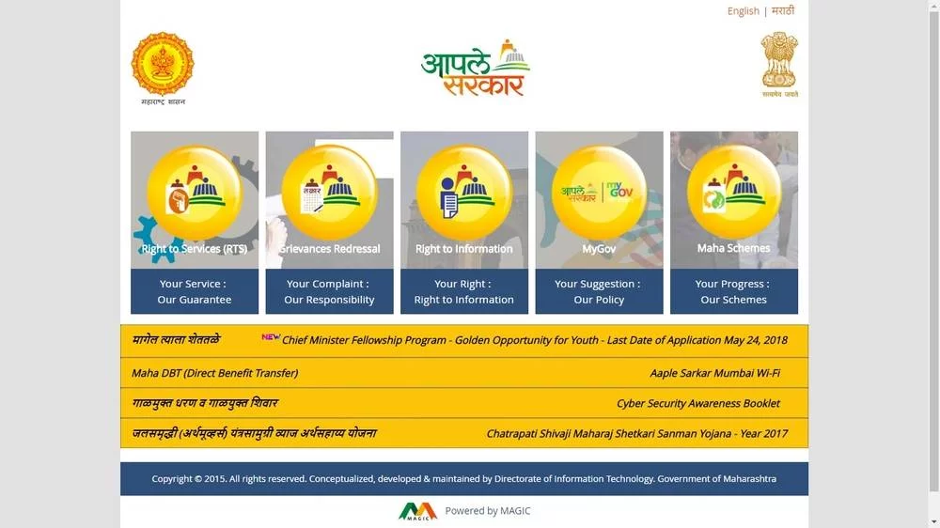
Apply Birth Certificate through Rural Development and Panchayat Raj Department
Step 1: You need to visit Aaple sarkar website home page.
Step 2: Select RTS option from the main page.

Slide 7
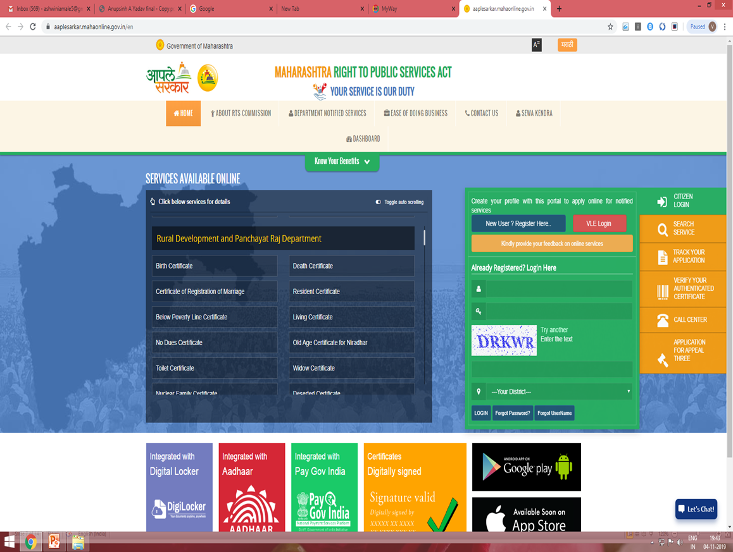
Step:3
If you are a new user, click on the register button
If you are already registered, then login here.

Slide 8
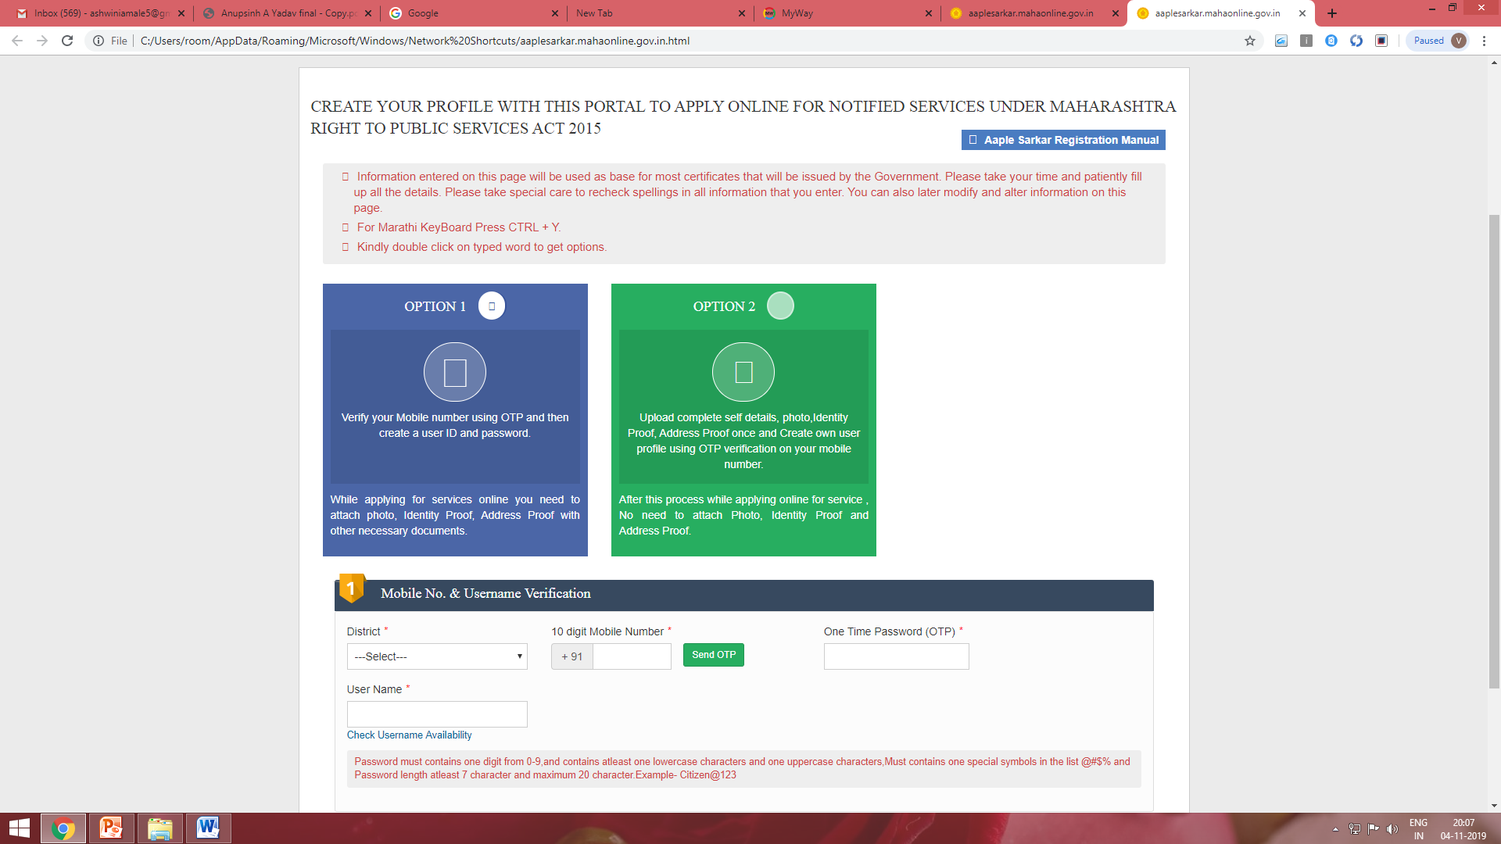
We are using first option.
Here two option are available for creating user profile.
Here fill the information correctly.
After filling details you will get the confirmation massage of profile created successfully.

Slide 9
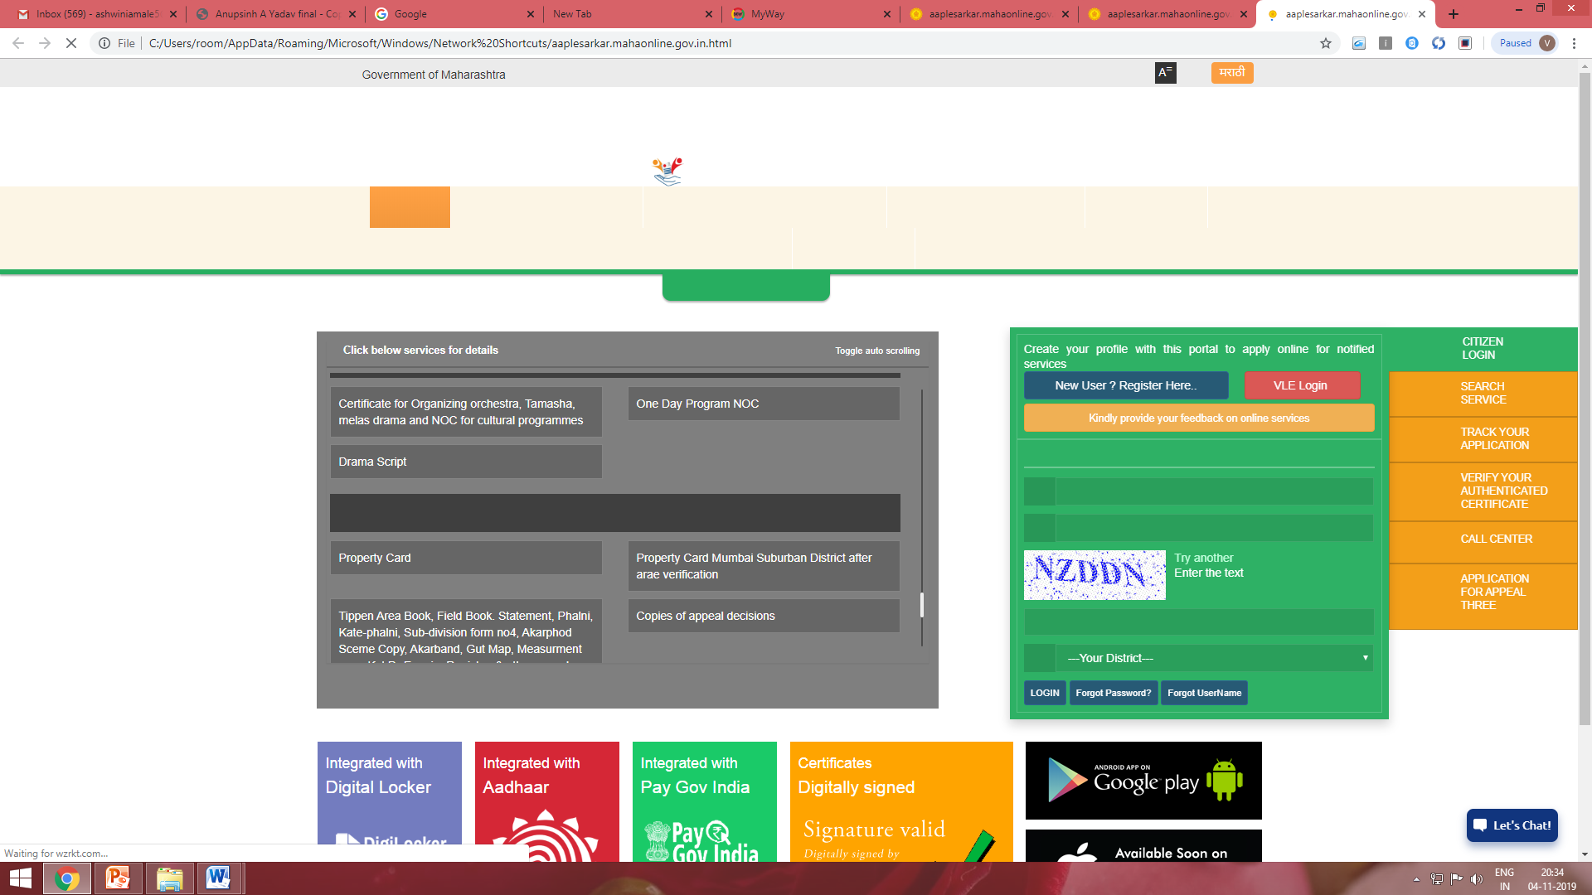
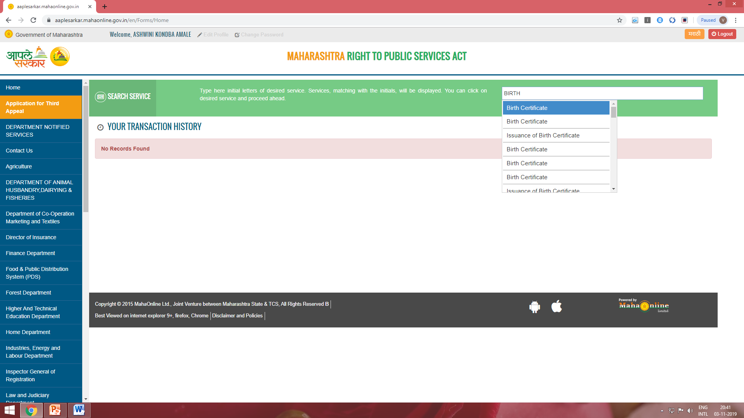
Step 4: Login to the portal using username and password to apply for a birth certificate.
After login this page open

Slide 10
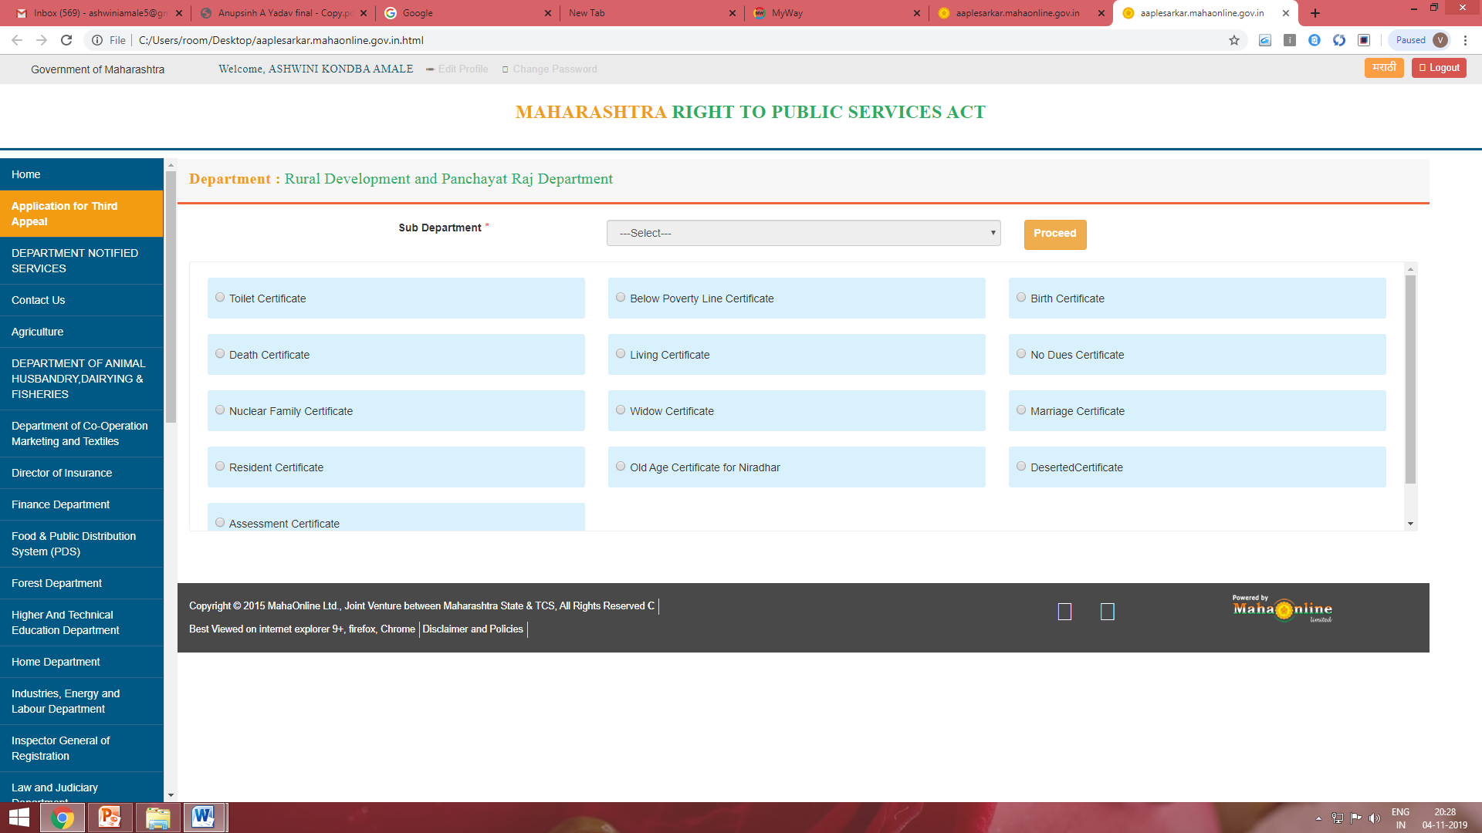
S
Search for Rural development or urban development and select birth certificate option from the menu.

Slide 11
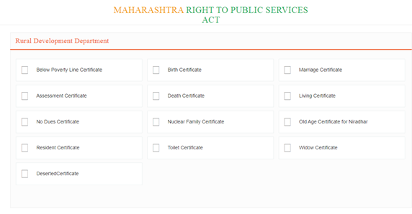
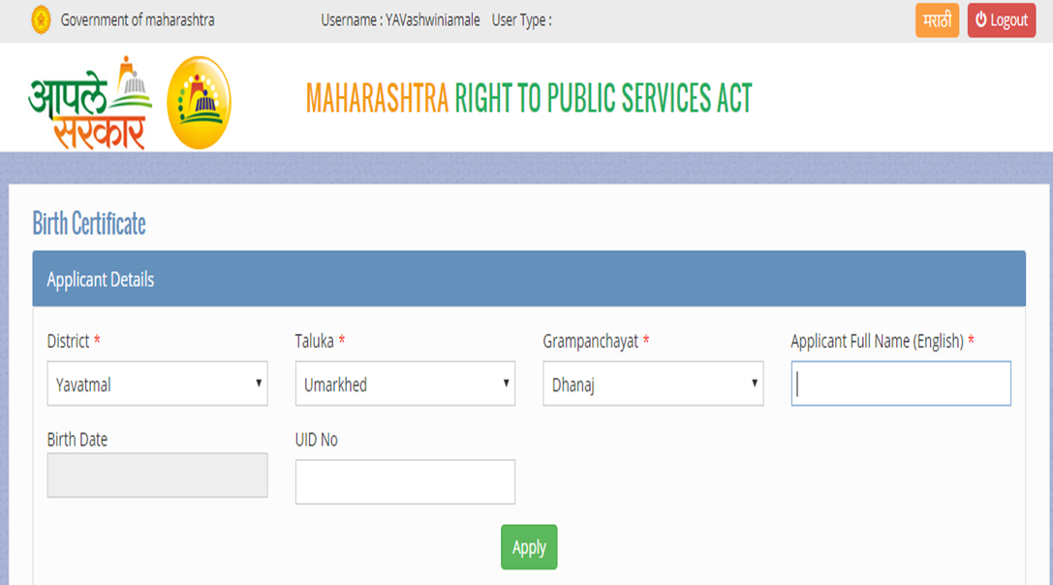
After proceed this tab open, select the service.
Step 6: In the new page, provide all required information for certificate.

Slide 12
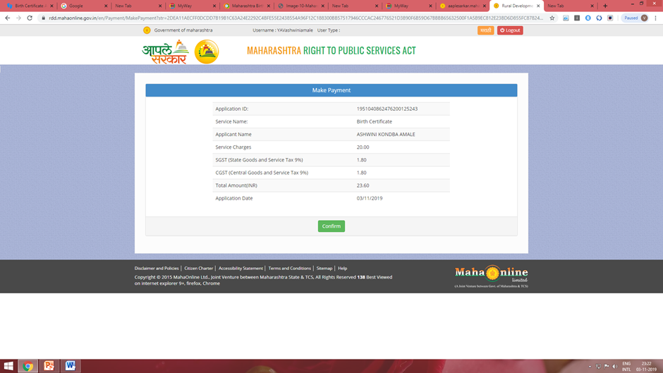
.
Status of Application
Make Payment
application will be forward to concerned department

Slide 13
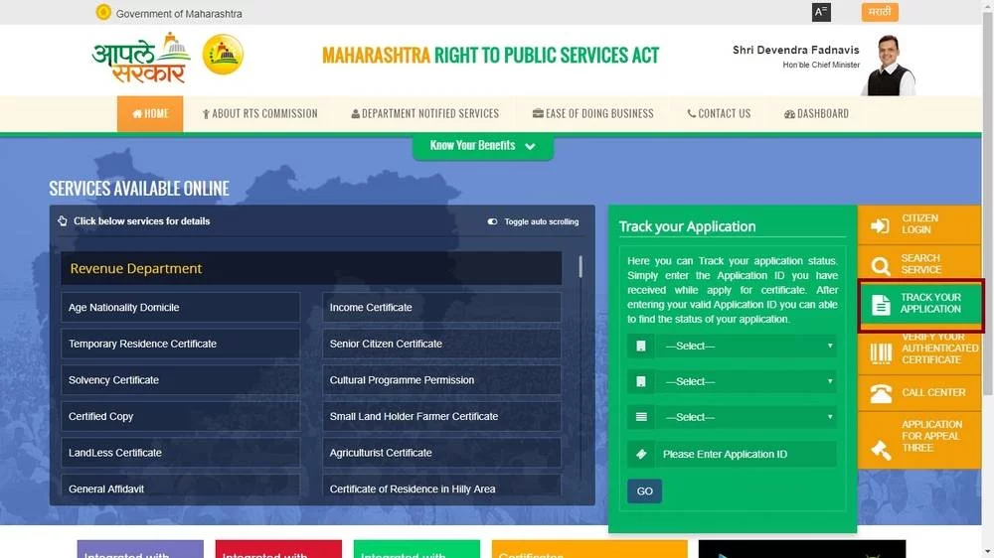
You can check status of the application by visiting the Apple sarkar page.

Slide 14
THANK YOU!

